Slide 1
Product Training
Commissions
Where “Lean” principles are considered common sense and are implemented with a passion!

Slide 2
Commissions
The WinMan commissions module is used to track commissions paid to agents. Commissions are paid to agents and can be paid on products or sundries.
WinMan Commissions handle split commissions and can have as many reps splitting a commission as required.
WinMan Commissions also handle payments to Agents, which are set up as suppliers and paid like most vendors. The WinMan commissions module generates the necessary purchase invoices for payment.

Slide 3
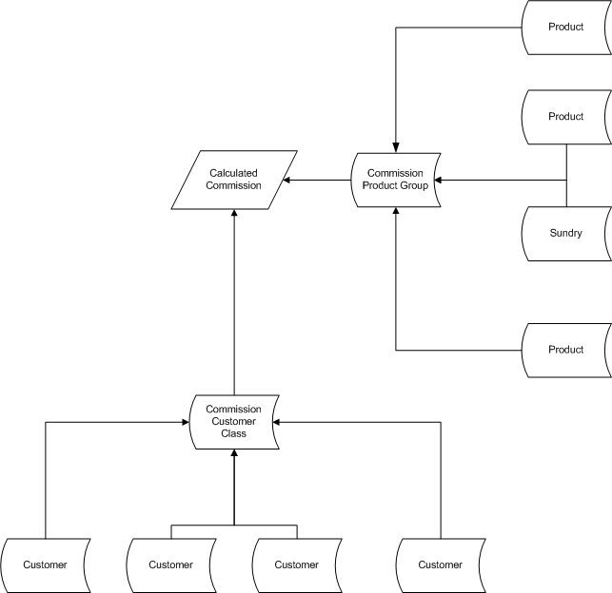
Commissions

Slide 4
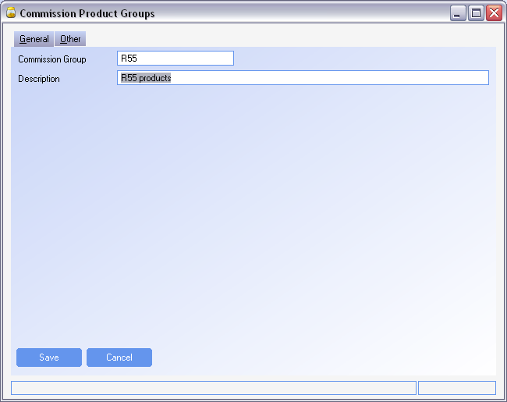
Commissions
Commission Product Groups
Commission Product groups are used to group parts and/or sundries that will receive the same commission.
The Product Group is cross references with the customer class to determine the commission percent.
Product groups provide advanced functionality where not all items will receive the same commission, and each product and customer relationship doesn’t have to be defined.

Slide 5
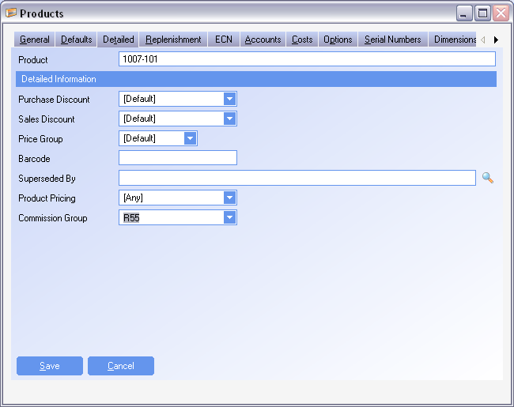
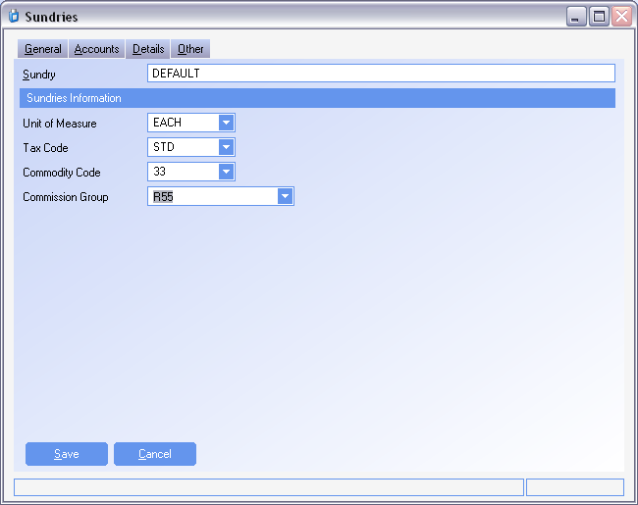
Commissions
Commission Product Groups
Product Groups are related to a product on the Detailed Tab of the Product module using the Commission Group field
Product Groups are related to a sundry on the Details Tab in the Sundry module using the Commission Group field

Slide 6
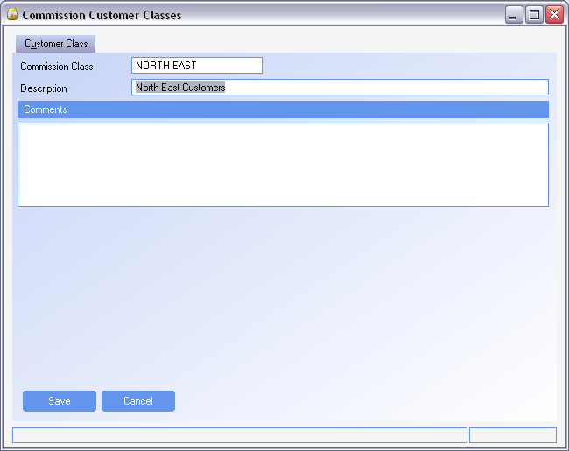
Commissions
Commission Customer Classes
Commission Customer classes are used to group customers that will receive the same commission.
The Customer Class is cross references with the product group to determine the commission percent.
Customer Classes provide advanced functionality where not all customers will receive the same commission, and each product and customer relationship doesn’t have to be defined.

Slide 7
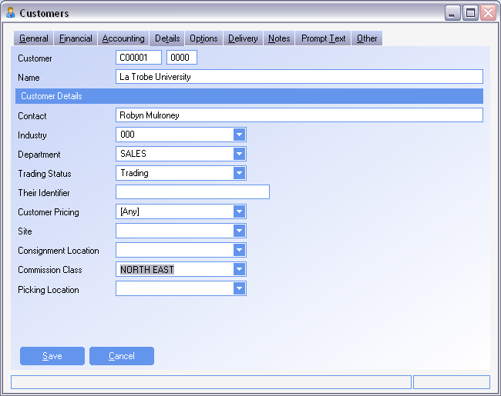
Commissions
Commission Customer Classes
Customer Classes are related to a customer on the Details Tab of the Customer module using the Commission Class field

Slide 8
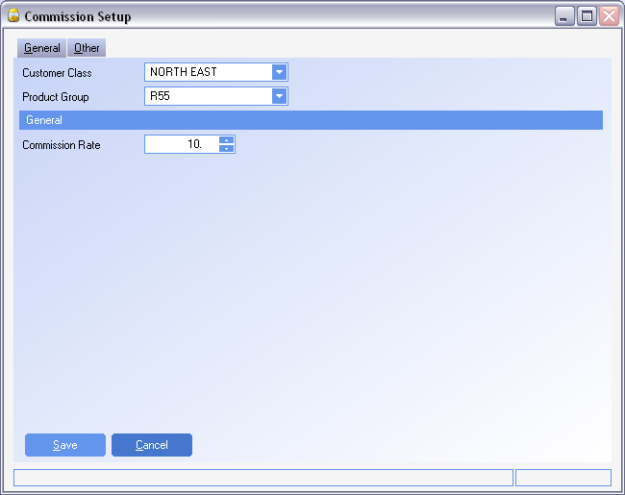
Commissions
Commission Setup
Commission Setup is where the Customer Classes and Product Groups are related to each other
The commission rate is the percentage of the sale value that the commission will generate.

Slide 9
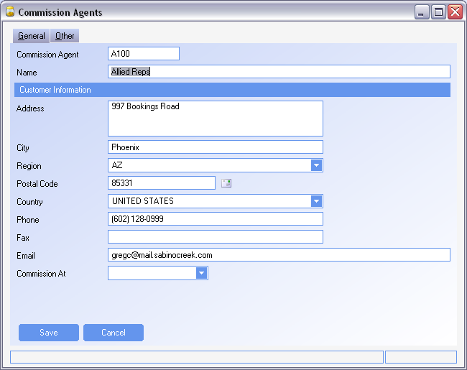
Commissions
Commission Agents
Commission Agents (sometimes called Reps) are used to report commissions to.
When creating an agent, fill out all fields as necessary.
Commission At will determine at what event the agent will be paid. An agent can be paid at;
Order (When the order is taken)
Invoice (When the invoice is generated)
Receipt (When the cash receipt has been received)
Once an agent has been created, a Supplier will automatically be created using the Agent information and supplier defaults. A drill down is provided to get to the supplier next to the Commission Agent field
SYSTEM SETTING: Use the Commission Agents option Default Commission at to (I)nvoiced, (R)eceived or (O)rdered when adding an agent to set default Commission At.

Slide 10
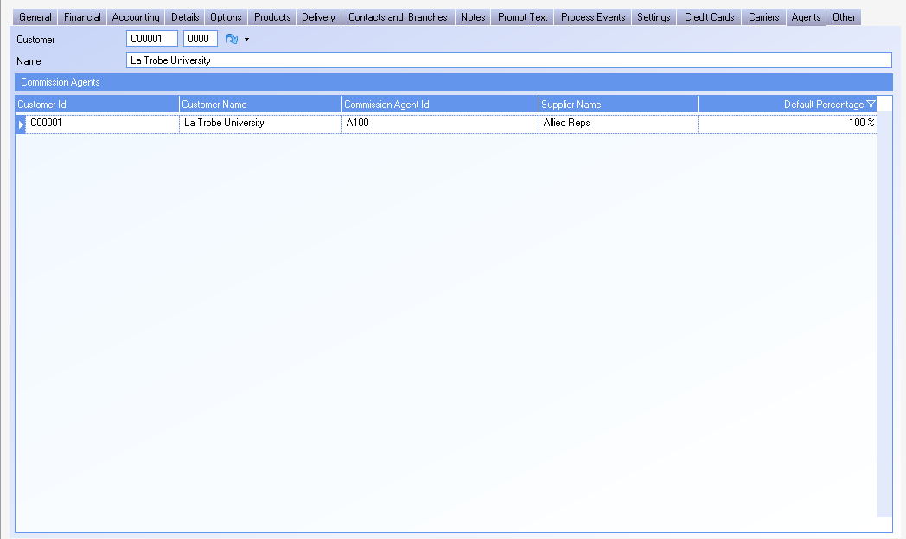
Commissions
Agents and Customers

Slide 11
Commissions
Agents and Customers
Agents that are to receive commission for a sale to a customer, should be added to the customer record
Commissions relate to specific branch. If multiple branches exist for a customer, all branches that are to receive commissions need to have agents added.
Agents are related to customers in the Customer module using the Add Agent action. Multiple agents may be added to the same customer in cases where a split commission is to take place. Agents can also be related to customer in the Commission Agents module using the Add Customer action.
The Default Percentage for each agent added refers to the percentage of the calculated commission that the agent is to receive.
eg If 2 reps are used and they are to split the commission 60/40, 1 rep would have a default Percentage of 60% and the other would be 40%.
SYSTEM SETTING: When multiple agents are added to a customer the system default is to set the default percentage to 100%. Use the Commission Setup option The first agent will receive 100% and then all subsequent agents for a customer will receive 0% by default with this profile enabled to have only the first agent default to 100% and have all others have a default percentage of 0%.

Slide 12
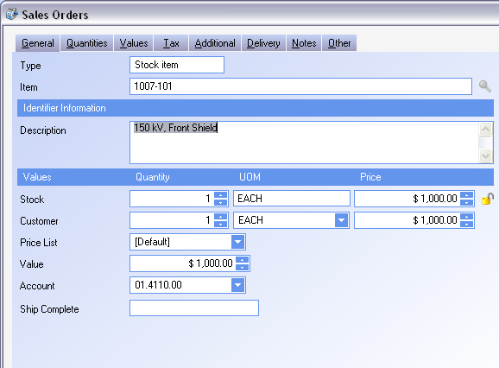
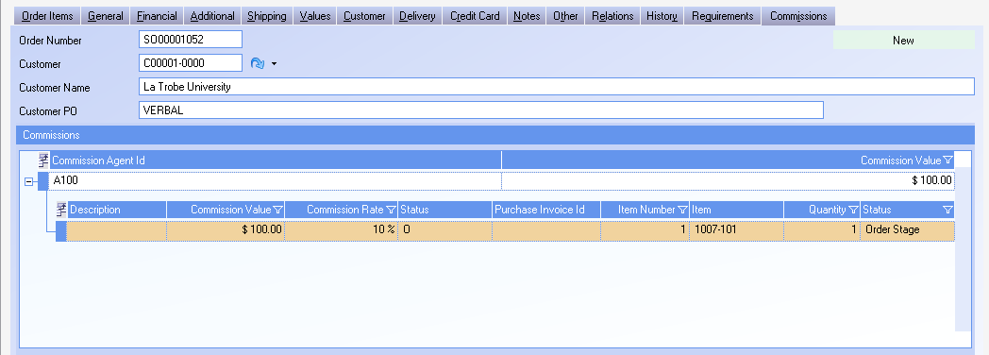
Commissions
Sales Order Commission

Slide 13
Commissions
Sales Order Commission
SYSTEM SETTING: To use commissions, the Sales Orders system option for Use Commissions on Sales Orders must be set to Y and activated
Sales Order line items are added using the Add item action in the Sales Order module
If the product/sundry commission group for the item added to the sales order and the customer commission class for the customer exist in the commission set-up then a commission line item will be added on the commission tab
When multiple agents exist for the same sales order, commissions will be grouped by agent. When each agent is expanded, all commission lines can be viewed
To change commission details, modify the commission line item. The agent, or rate may be changed. The commission value will be updated based on the rate change.
To add a commission line to an item that is not found in the set-up module right click on the sales order line and select the action Add Commission for line.

Slide 14
Commissions
Sales Order Commission
SYSTEM SETTING: Free Text items by default will not have commission line items generated. Use the Commission Setup option Set a commission rate to use for free text sales order items to specify the commission percentage that all free text items will receive when created.
SYSTEM SETTING: Freight items by default will not have commission line items generated. Use the Commission Setup option Set a commission rate to use for freight sales order items to specify the commission percentage that all freight items will receive when created.

Slide 15
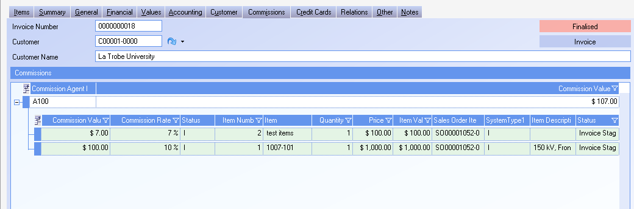
Commissions
Sales Invoice Commission

Slide 16
Commissions
Sales Invoice Commission
Commissions that have been created in Sales Orders will automatically populate the Commission Tab in Sales Invoices. Once the sales order has been invoiced, any modifications needed for the commission must be done to the invoice. The sales order commission line items can no longer be modified
To change commission details, modify the commission line item. The agent, or rate may be changed. The commission value will be updated based on the rate change.
To add a commission line to an item that requires commission right click on the sales invoice line and select the action Add Commission for line.
Manual invoices created in the Sales Invoice module will automatically add commissions for any sundries set-up in the commission set-up.
Credits that are created and related to an invoice item where a commission was generated, will generate a negative commission line item.

Slide 17
Commissions
Sales Invoice Commission
SYSTEM SETTING: Free Text items for manual invoices, by default, will not have commission line items generated. Use the Commission Setup option Set a commission rate to use for free text sales invoice items to specify the commission percentage that all free text items will receive when created. When credits are created, negative commissions will also be generated for all free text items on the invoice, regardless of if they are related to an invoice where commission is generated.
SYSTEM SETTING: Freight items for manual invoices, by default, will not have commission line items generated. Use the Commission Setup option Set a commission rate to use for freight sales invoice items to specify the commission percentage that all freight items will receive when created.

Slide 18
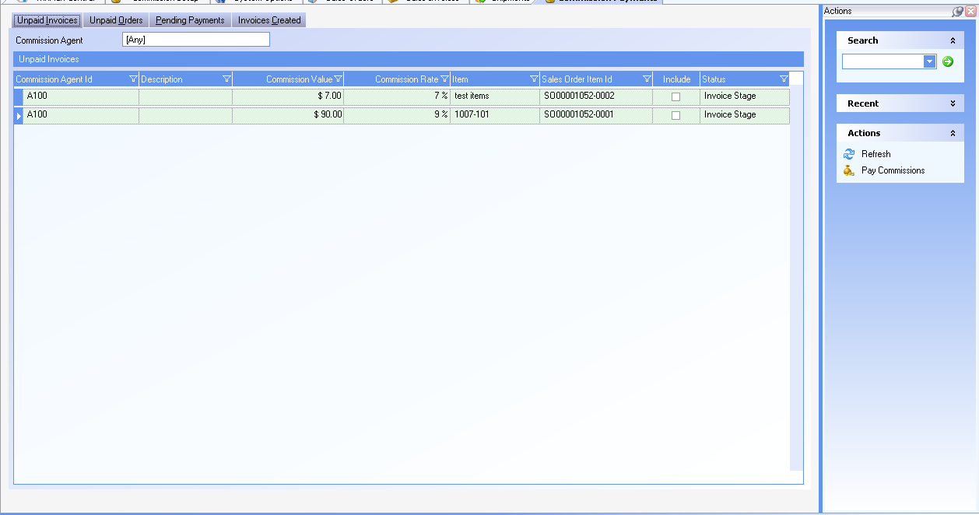
Commissions
Commission Payment

Slide 19
Commissions
Commission Payments
The Unpaid Invoices Tab of the Commission Payments module will display any open commissions that are at the invoice status. This will only have data if you are using the option to pay Agents when cash is received
The Unpaid Orders Tab will display any open commissions that are at the Sales Order status and have not been invoiced.
The Pending Payments Tab will display the commission line items that are ready to be paid.
The Invoices Created Tab will display the purchase invoices created to the Agent for payment. Right clicking on the invoice provides a drill down to the purchase invoice.
The Commission Payments module will automatically select items for payment based on the Commission At field for each agent. Additional items can be selected for payment and items already selected can be selected by checking/unchecking the Include column in the Unpaid Invoices. Selected items can be viewed on the Pending Payments Tab.
SYSTEM SETTING: By Default, Unpaid Order items can not be selected for payment. To be able to select order items for payment, select the Commission Payment setting Pay Commissions from Sales Order. Enable this option and set the value to “Y” to be able to select order items for payment

Slide 20
Commissions
Commission Payments
When first entering the Commission Payments module, all commission reps will be displayed together. To view an individual Agent, use the Search feature to find a specific Agent.
SYSTEM SETTING: By default, all Agents can be viewed with the initial opening of the commission payments module. If there are many reps, or many sales lines receiving commissions, this initial start-up can become slow. To remove the option of seeing all reps at the same time when first opening the Commission Payments module select the commission payments option Allow viewing of commissions by agent. Enable this option and set the value to N to view each agent individually.

Slide 21
Commissions
Commission Payments - Action
Use the action Pay Commissions to pay an agent the selected items for payment. If a specific agent is selected, only that agent will be paid.
SYSTEM SETTING: By default, the purchase invoice that is created will be created as New and need to be manually finalized. Use the Commission Payments setting Finalize invoices automatically to create purchase invoices automatically finalized and ready for payment
SYSTEM SETTING: By default, line items created on the purchase order will show each sales order line. When many lines are being paid this can create a large invoice. Use the Commission Payments setting Create invoice lines grouped on lines, order or agent to group commission lines on the purchase invoice. Selecting the Order option will create one line on the purchase invoice for all items on a sales order. Selecting the Agent option will create one line on the purchase invoice for all items being selected.

