Slide 1
Product Training
Credit Cards
Where “Lean” principles are considered common sense and are implemented with a passion!

Slide 2
Credit Cards
Credit card functionality is intended to work for sales related activities only and does not include purchasing. A credit card payment gateway merchant is required to be set up to work with WinMan functionality through a Plug-in. WinMan customers will need to set this up separate from WinMan. A standard Plug-in exists to work with Authorize.net, however other providers can be used (extra work to the Plug-in will be required.
Note: Other providers must have a .Net interface to work with WinMan.
SYSTEM SETTING: To use credit cards in WinMan the Master Credit card option must be turned on. Use the Credit Cards system option Process credit cards to turn on credit card functionality. Enable the option and set the value to Y.

Slide 3
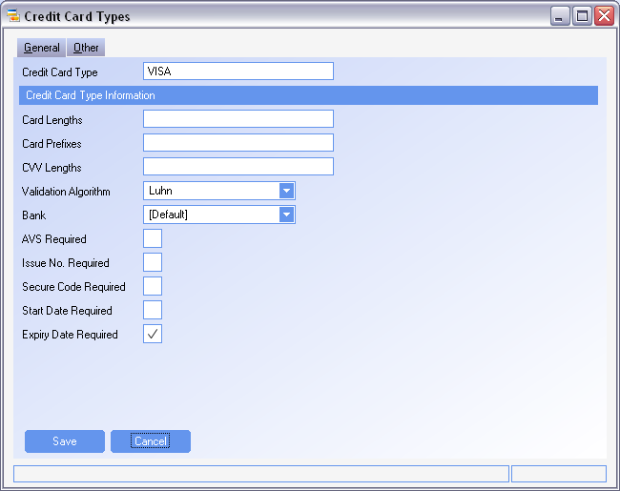
Credit Cards
Credit Card Types
A credit card type for every credit card that is to be used should be created.

Slide 4
Credit Cards
Credit Card Types
Card Lengths – If the valid card lengths are know, they can be entered using a comma to separate the values. Leave blank for no check on card length. If lengths are used then cards with invalid lengths are not allowed by WinMan.
Card Prefixes - If valid card prefixes are know, they can be entered using a comma to separate the values. Leave blank for no check on card prefix. If prefixes are used then cards with invalid prefixes are not allowed by WinMan
CVV Lengths - If the valid CVV (secure code on the back of the credit card) lengths are know, they can be entered using a comma to separate the values. Leave blank for no check on CVV length.
Validation Algorithm – The Luhn algorithm can be used to validate major credit cards. No algorithm can be used for credit cards that do not work with the Luhn algorithm.
Bank – The bank that will be used to receive cash to for credit card receipts.

Slide 5
Credit Cards
Credit Card Types
AVS Required – Address Verification Service is a field that can be used by the plug-in to determine if a credit card requires Address Verification before approval. The field has no system action.
Issue No. Required – If an Issue No is required this field should be checked. When required, the Issue No must be entered before the credit card can be entered into WinMan. This is typically not used in the North American market.
Secure Code Required – A field that is used for credit cards in Europe.
Start Date Required – If a start date is required this field should be checked. When entering a credit card, if the Start Date is checked, WinMan will check to see that the Start date is less than or equal to the current period. This is typically not used in the North American market
Expiry Date Required - If an expiry date is required this field should be checked. When entering a credit card, if the Expiry Date is checked, WinMan will check to see that the Expiry date has not passed.
SYSTEM SETTING: Address Verification Service is managed in the Credit Card Plug-in. The Plug-in can determine by Credit Card if it is required (using the AVS Required field) or the Credit Card system option Disable address verification on credit cards if all credit cards will use Address verification or all will not use Address verification.

Slide 6
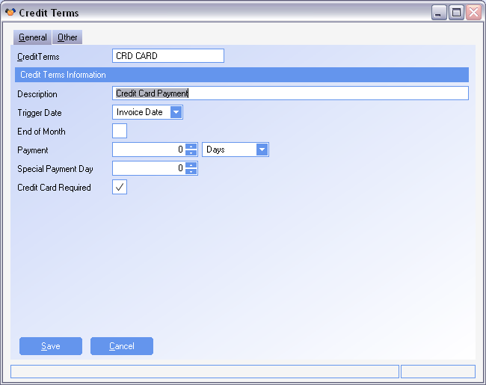
Credit Cards
Credit Terms
A credit term should be set up for customers that will be paying by credit card
The term can be called anything but the check box for Credit Card Required must be checked. WinMan uses this field to determine if credit card processing will take place.
The credit term can be applied to the customer or to an individual sales order if required

Slide 7
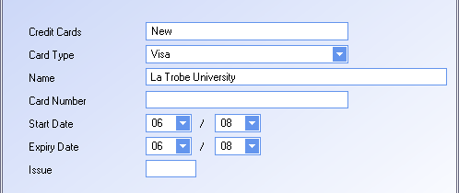
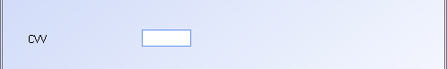
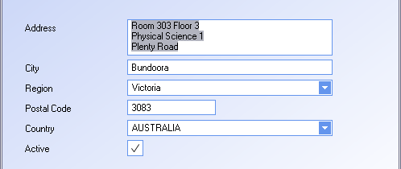
Credit Cards
Customers
Credit cards can be added to customers in the Customer module using the action Add Credit Card.
A credit card stored against a customer can be selected at sales order entry.
Credit card numbers are encrypted when stored and only the last 4 digits of the number can be viewed in WinMan or the database.
Start date and Issue fields are typically not used in the North American market.
The CVV will be prompted for each time it is required but never stored in the WinMan database.
The address for the credit card will default from the customer record but should be verified that it is the address for the card.
Once a credit card has been marked as not active the credit card can no longer be used.

Slide 8
Credit Cards
Configuration
SYSTEM OPTION: The CVV for a credit card will be prompted for in WinMan and depending on security, can force a user to obtain the CVV. By default users with Admin authority in the module where the credit card is added can by-pass the CVV. If the CVV is to be used this setting should remain the same. If the CVV is not going to be used, the Credit Cards system option Credit Card security level required for CVV override (0=none...5=admin) should be enabled. The value should be set to 0 so that all users can leave the CVV field blank when taking credit cards.
NOTE: The CVV is not stored in WinMan and if a re-authorization is required, it will need to be entered again.
SYSTEM OPTION: The credit card process in WinMan is done in 2 parts the authorization and the capture. There are 3 options to do this;
Authorize and Capture at Sales Order firm
Authorize at Sales Order Firm and Capture at Shipment Finalize
Authorize and Capture at Shipment Finalize
By default, option 2 is used in WinMan. To use option 1 or 3, use the Credit card system option
Required credit card action (A=Auth at Sale (default), C=Auth & Capture at Sale, S=Auth & Capture at Ship). Enable the option and set the value to C, or A.

Slide 9
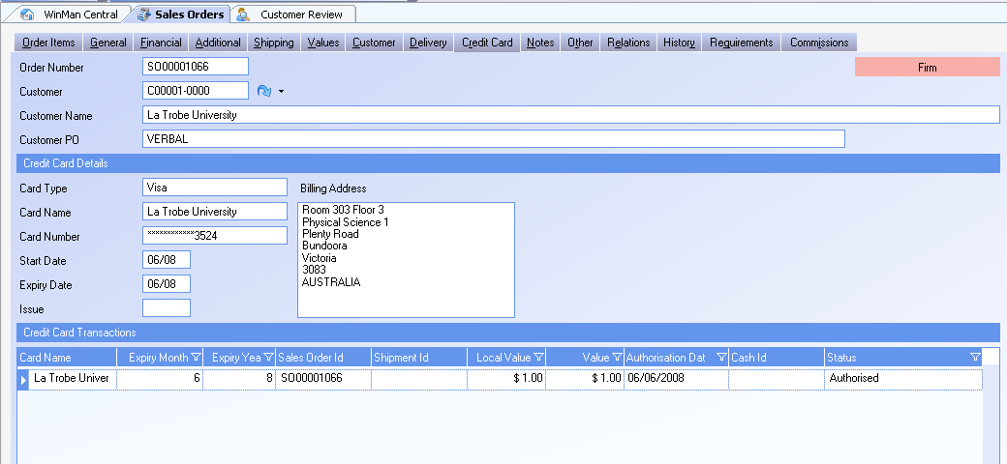
Credit Cards
Sales Orders

Slide 10
Credit Cards
Sales Orders
A credit card can be added to a sales order using the action Add Credit Card. Only 1 credit card can be added per order. If credit cards have been added to the customer account, they can be selected.
Adding a Credit Card should only be done after the order has been completely entered. Adding a credit card will begin the firming process. Selecting the action Firm will also prompt for credit card information in the same way the action Add Credit Card will.
If a credit card action such as authorization is to be completed in Sales Orders, the user will be prompted to complete the action after the credit card has been entered. If the user declines the process, the sales order will be put in a Held status. Using the action Firm will re-start the process of authorization.
If an authorization can not be gained, or the credit card is declined, the order will go to a Held status. A new credit card can be tried, or another attempt with the current card can be done using the Firm action.
SYSTEM SETTING: By default if an authorization does not come back, the order is not firmed and can not be shipped. If the failed authorization is to be ignored (not recommended), use the Credit Cards system option Allow sales order firm with failure. Enable the option and set the value to Y to firm orders regardless of the authorization result.

Slide 11
Credit Cards
Sales Orders
Credit card actions in sales orders are triggered by the credit terms having the Required Credit Card field selected. However, if a credit card is added to an order with terms that are not set up to be credit card, the Sales Order will be handled as a credit card order.
The credit card option that will authorize and capture at sales order firm, will generate an unallocated cash receipt the capture. This will be matched to the invoice when generated. Also, when using this option, if the capture has been completed, and a change is made to the sales order, the user will be prompted to refund the original transaction. Once the change is made, the order will need to be re-firmed and another authorization and capture will need to be done.
If the option to authorize at sales order and capture at shipment is used, and the authorization has been completed, any changes to the sales order will require a re-authorization. The user will be prompted to void the original authorization before any changes can be made.
Once the sales order has been shipped (partially or complete) the sales order will be locked and no changes can be made.

Slide 12
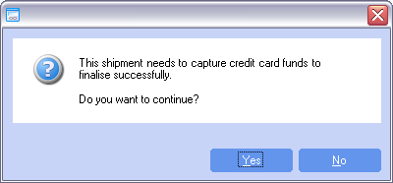
Credit Cards
Shipments
The credit card capture in the Shipments module will occur when the shipment is finalized.
The option to cancel outstanding items on the sales order at shipments finalize will not be available when shipping a credit card sales order. To cancel the items on the sales order, go into sales orders and delete the order.
The credit card capture must be successful for the shipment to become finalized in WinMan.
In cases of a partial shipment, the initial authorization will be voided and an authorization and capture will be done for the value of the goods being shipped and a separate authorization will be done for the value outstanding on the sales order
An invoice will automatically be created for the shipment as well as a cash receipt for the credit card transaction. The two transaction will automatically match, and not have any outstanding values. Credit card invoices are not marked as printed and will print out if printing is done in a batch process. A modification to the invoice print should be completed to reference that credit card payment has been received and no amount is outstanding.

Slide 13
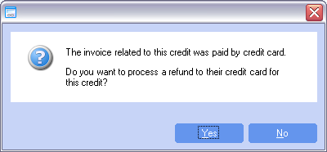
Credit Cards
Sales Credits
When credits are created that relate to invoices that were billed by credit card, a refund can occur. Users will be prompted if a refund is to be given when the credit is finalized.
The action Refund to Credit Card can also be used to refund a credit card at any time. Only credit cards that have been used on the account can be selected when refunding to a credit card.
SYSTEM SETTING: By default the action to refund credit cards is in the action menu of the Sales Invoices module. This action can be removed using the Credit Cards system option Disable credit card refunds from sales credit notes. Enable the option and set the value to Y to remove the action. This option will not disable the functionality of applying refunds when a credit is finalized that related to credit card invoice.

