Slide 1
Product Training
Fixed Assets
Where “Lean” principles are considered common sense and are implemented with a passion!

Slide 2
Fixed Assets
The Fixed Asset Modules provide a way to depreciate assets over a given time period. Straight line depreciation is the only automated method used for depreciation calculation. Other methods may be used but must be calculated and added manually.
Once depreciation entries are set-up, journal entries will be created automatically at the desired posting time.

Slide 3
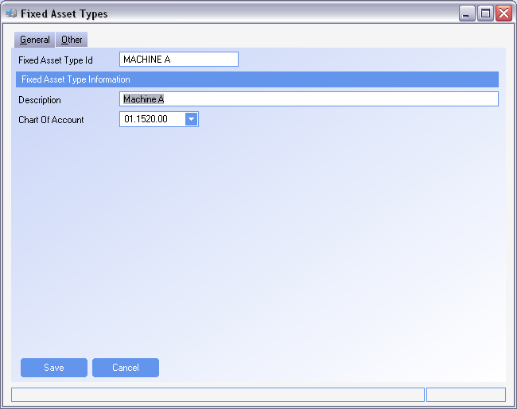
Fixed Asset Types
Fixed Asset Types
Assets that are to be depreciated must first be entered in the Fixed Asset Types module
Fixed asset type will be the asset name or the item being depreciated
The chart of account is the asset account where the value of the item is found

Slide 4
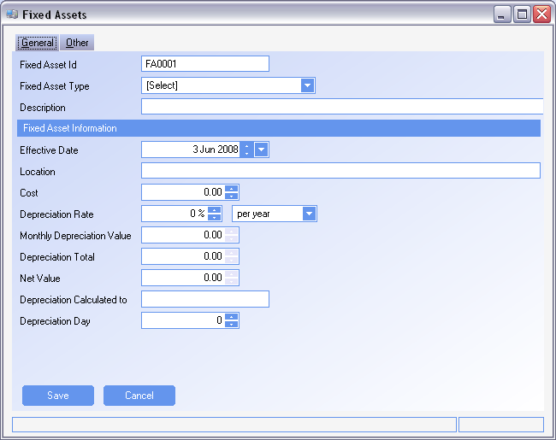
Fixed Assets
Fixed Assets Header

Slide 5
Fixed Assets
Fixed Assets Header
The fixed Asset ID is a unique number for the depreciation of the asset.
Fixed Asset Type is the Asset as it was created in the Fixed Asset Types module
Effective Date – The date that depreciation will be calculated from. The day of the month used in the effective date, will be the default date for depreciation to post to the GL.
  If depreciation is to post on the 1st of the month, make sure the effective date is the 1st of the month.
Location – The location of the Asset
Cost – The total cost of the item used to calculate the deprecation value. This should be the total value to be depreciated.
Depreciation Rate – The rate at which the item will be depreciated at and the time period, which can be by year or by month.

Slide 6
Fixed Assets
Fixed Assets Header
Depreciation Rate – The rate at which the item will be depreciated at and the time period, which can be by year or by month.
Monthly Depreciation Value – The value of depreciation as calculated by;
    Cost * Depreciation rate /12 (when using per year)
    Cost * Depreciation rate (when using per month)
Depreciation Day – the day of the month that the journal entry will take place for the calculated depreciation
SYSTEM SETTING: The prefix for the Fixed Asset identifier is defaulted to FA. This can be altered using the Fixed Assets system option Fixed Asset identifier prefix. Enable the option and set the value to the prefix required
SYSTEM SETTING: The length for the Fixed Asset identifier is defaulted to 6 characters. This can be altered using the Fixed Assets system option Fixed Asset identifier length. Enable the option and set the value to the length required. Maximum length is 15 characters.

Slide 7
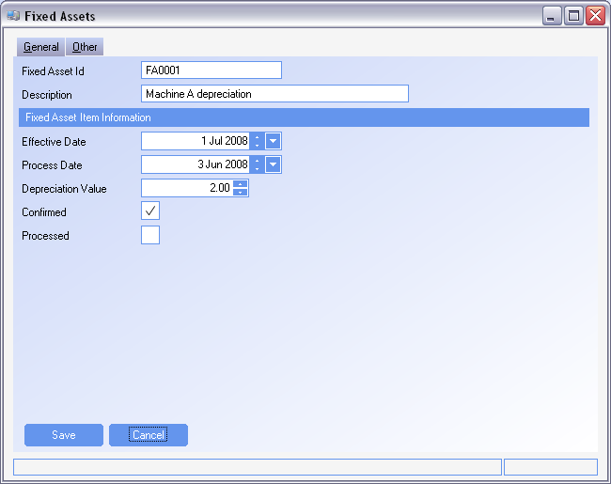
Fixed Assets
Fixed Assets – Line items

Slide 8
Fixed Assets
Fixed Assets Line Items
Effective Date – the date that determines what period the depreciation will post to
Process Date – When the GL record will actually be written
Depreciation Value – The value of the depreciation that will be written to the GL
Confirmed – An item must be confirmed before it will post to the GL
Processed – Once the item has posted to the GL the processed field will be checked. This is a system field that can not be changed by the user.
The GL account for depreciation can be found in the System Set-up module. Use the Sites tab, and the sub-tab Accounts for the Depreciation account.
TIP: An item must be confirmed and have a process date less than or equal to the current date before it will post
SYSTEM SETTING: Line items are created with the confirmed field already selected. If items are to have a review or sign off process before they are to post, line items can be created without the confirmed field selected. Use the Fixed Assets system option Determines whether to insert confirmed flag as true or false when calculating depreciation. Enable the option and set the value to False to have items not created as confirmed.

Slide 9
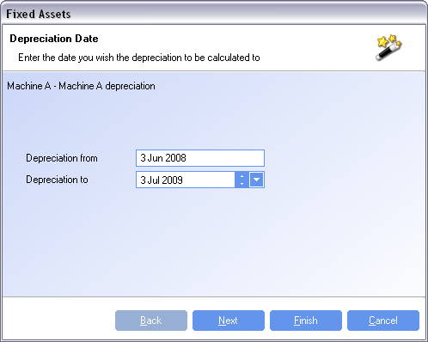
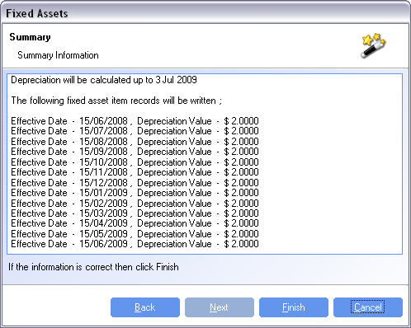
Fixed Assets Actions
Calculate Depreciation
Use the Calculate Depreciation Action to calculate Depreciation values for a period of time.
Monthly entries for depreciation are calculated based on the monthly depreciation value calculated in the header
The effective date will be the Depreciation day as found in the header for each month.
The process date will use the effective day from the header to determine what day of the month will be the process day.
  Ie using an effective date of June 5 in the header will have a process date for line items on the 5th of each month

Slide 10
Fixed Assets Actions
Calculate All Depreciations
Calculate All Depreciations is a way to calculate depreciations for multiple assets at the same time.
Select which Fixed Assets are to be depreciated and the depreciation will be calculated in the same way as the action Calculate Depreciations
Dispose Depreciation
Dispose Depreciation will create an entry for any unprocessed depreciation
Posted line items will remain however any un-posted line items will be removed and replaced with an entry that is the cost from the header – any processed depreciation.
Add item
In cases where straight line depreciation is not used, manual entries can be added using the Add item action. Values for each depreciation line item can vary but may not exceed the total cost from the header.

