Slide 1
Product Training
Basics and System Flow
Where “Lean” principles are considered common sense and are implemented with a passion!

Slide 2
Basics of an Enterprise System
An “Enterprise” System, often referred to as an ERP system, is an integrated closed loop system.
ERP (or Enterprise Resource Planning) is an enterprise wide formal system that balances resources against demand. In simple terms ERP tries to net all resources to the zero level. It touches all aspects of an enterprise and the supply chain.
A closed loop system reacts to feedback and adjusts accordingly. The cruise control in your car and the water supply in a toilet tank are examples of closed loop systems. The cruise control alters its input to the throttle as the speed of the car changes due to wind or terrain in order to keep the car at a constant speed. The float on the toilet tank provides feedback to the water system indicating when it is time to cut off the water supply. WinMan, an Enterprise system is a closed loop system because it adjusts the supply or resources and material to keep pace with demand.

Slide 3
The ERP Balancing Act
Sales Orders
Time Phased
Purchase Orders
Time Phased
Manufacturing Orders
Inventory
Bill of Material
Lead Times

Slide 4
Steady State
To balance supply and demand, a company will respond to demand for its
products by purchasing materials and processing those materials. In the simple picture above, demand comes from sales orders while supply comes from manufacturing orders and purchase orders. The timing of the supply has to match the timing of the orders (demand). In order to do that, inventory, lead times, manufacturing times, etc. have to be considered.
Clearly then, an ERP system has to have access to everything that is known about the products in order to function properly. Traditionally, MRP has been used for planning and launching the execution, or at least providing the information to do so, based upon the information it has. MRP looks at the demand from the top down, determining the need for the end items and then working its way through the components determining those requirements. MRP suggests when orders should be placed and when they should be completed. Later, we learn how the WinMan MRP module determines when and how many to order and produce.

Slide 5
Lean and Integrated
WinMan has all of the tools necessary for running a lean operation. It also has full functionality for “push” operations and can work in a mixed mode (both lean and traditional) environment.
WinMan is a completely integrated system. This means that there is generally a financial impact when a transaction occurs, such as receiving inventory, shipping goods, etc.
Users of the system need to be aware that there is a cause and effect for any action that takes place.

Slide 6
Financial Integration
Manufacturing
Labor
Material Movement
Consumption
Scrap
Sales
Shipping
Accounts Receivable
Returns & Repairs
Purchasing
Receiving
Accounts Payables
Returns
Financials
Accounting
Journal Entries
Standard Cost Changes
Cash transactions
Consolidation
Inventory
Cycle Counts
Physical Inventory
Transfers
Disposition

Slide 7
Financial Integration
WinMan Accounting uses either standard costing, actual costs, or actual material costs and standard labor costs. You choose what works best for your company.
All financial transactions are automatically generated as inventory, sales, purchasing, manufacturing and accounting activities take place.

Slide 8
Order Flow
Calculate Requirements (MRP)
Manufacture Goods
Receive Finished Good
Ship to Customer
Firm Manufacturing Orders
Receive Purchased Material
Release Manufacturing Orders
Issue Material
Customer Sales Order
Customer
Approve/Execute POs
Financials

Slide 9
Order Flow
The flow begins with the Customer Order and goes clockwise.
MRP determines the requirements based upon quantities on hand, quantities required, lead times, manufacturing times, order due date, etc.
Manufacturing orders are firmed indicating to MRP that the supply for the demand has been set.
Purchase orders are approved and material is orders.
Purchased material is received.
Manufacturing orders are released (this can be done earlier in the cycle, in fact, it could happen at step 2).
Material is issued to the manufacturing order.
The product is manufactured.
The manufactured item is received into finished goods from work in process.
The product is shipped to the customer.

Slide 10
Order Flow
During the manufacturing process labor times, product movement, return to stock etc. transactions can be done. There is also the option to backflush, use Kanbans to drive stock replenishments, go to a complete pull system (lean), etc. All of these will be explored.
At the center of the activity are the financials. Nearly every single transaction has a financial impact.
In a “Lean” environment backflushing is used, the flow would be more like:

Slide 11
Order Flow – Lean
Pull Signal to Manufacturing
Ship to Customer
Manufacture Goods
Customer Sales Order
Customer
Receive Finishied Good/Backflush components
Financials

Slide 12
Product Training
WinMan Navigation
Where “Lean” principles are considered common sense and are implemented with a passion!

Slide 13
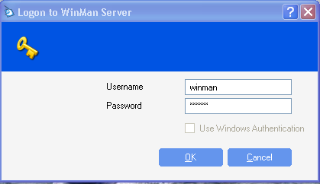
Basics for using the system
For training, login to the system using <user> winman, <password> winman. For in-house systems, the system administrator will provide you with the logon credentials.

Slide 14
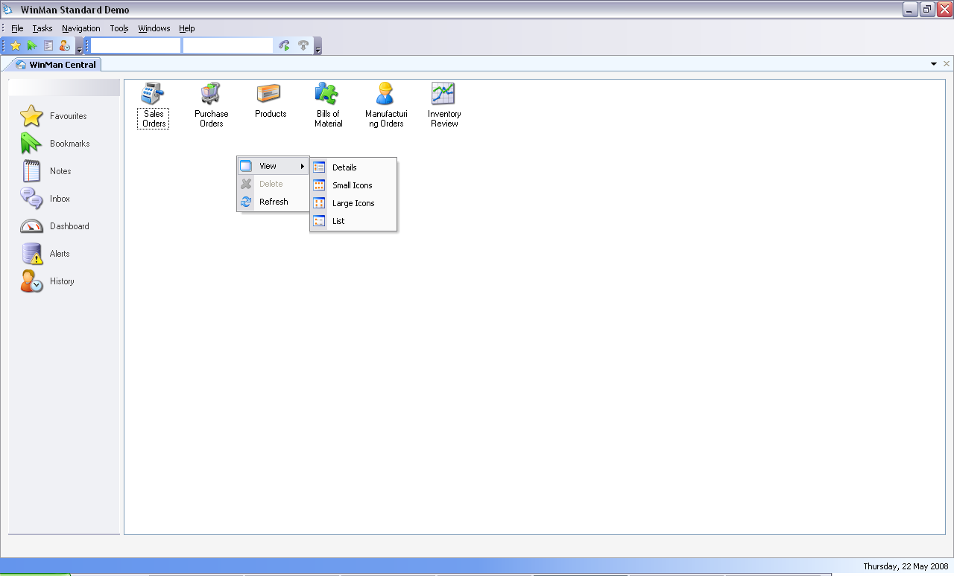
WinMan Central
Once logged on you will be in the WinMan Central area which is always open while running WinMan. The initial folder view will be your Favorites. An example user logon with Favorites established is shown below.
The Favorites Icons are user specific shortcuts to WinMan modules or reports and can be arranged in the following methods;
  Details
  Small Icons
  Large Icons
  List
Favorites are set up by going to the required module and selecting Tools/Add to favorites. After adding favorites the WinMan desktop will show the shortcut icons.

Slide 15
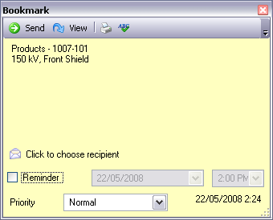
WinMan Central
Bookmarks
Bookmarks are similar to Favorites, but can link to specific pieces of data or a report. A bookmark could be a BOM or sales order that is used frequently.
A bookmark automates the step of finding the WinMan module and searching for the specific record
Bookmarks are added using Tools/Add Bookmark.
Bookmarks can also be sent via email to anyone. The email will contain the same information as found in WinMan. As the bookmark is in email format, there is no drill down functionality and it will not appear in the Bookmarks section of WinMan Central.
A bookmark can also be sent to another WinMan user using Tools/Send Bookmark. Multiple users can be sent a bookmark at the same time

Slide 16
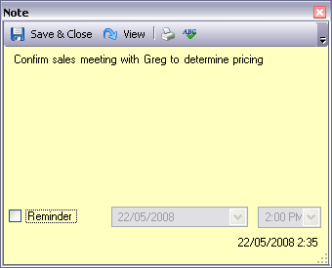
WinMan Central
Notes
Notes can be used to store any kind of reminders or notes about anything
Use the mouse to click in the open space of the note to begin note entry
Notes are added using Tools/Add Note.
Notes can be send to other WinMan users using Tools/ Send Note.

Slide 17
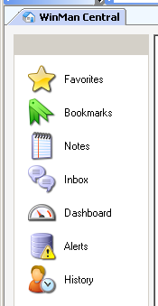
WinMan Central
 | Inbox is used in tandem with process controls. If a particular process control triggers an email then it can be seen in the inbox. Dashboard is user specific. This is used to display a ‘default’ report that can be accessed at any time. There are many dashboard reports that can be used. These can be viewed in the reports area of WinMan. Dashboards will update every 30 seconds. History will display the most recent records reviewed as well as the module they were reviewed in. History items work like bookmarks, in that you can double click the history item and it will open the module on the specific record.
SYSTEM SETTING: The default number of history items is 30. This number can be increased but the larger the number, the more requirements that will be put on the server and performance can be affected. To change the number of items in history, use the General setting User history records and set the number of history records required.
SYSTEM SETTING: Items in WinMan Central will refresh once every 60 seconds (with the exception of the dashboard that updates every 30 seconds). The rate of refresh can be adjusted using the General system option Set the polling interval for WinMan Central in milliseconds (Default is 60000). Enable the option and set the value in milliseconds for the frequency of WinMan central being refreshed.

Slide 18

WinMan Toolbar
File actions allow closing a module (ie sales order entry) or exiting WinMan entirely.
Tasks are functions available for the active program. This will include the actions and prints as well as a menu item for system tasks.
Navigation launches the drop down menus to all accessible areas.
Tools remain consistent among the WinMan areas once the user leaves the WinMan central area.
Windows allows control of Window layers and is a handy way to close all windows while keeping WinMan open.

Slide 19
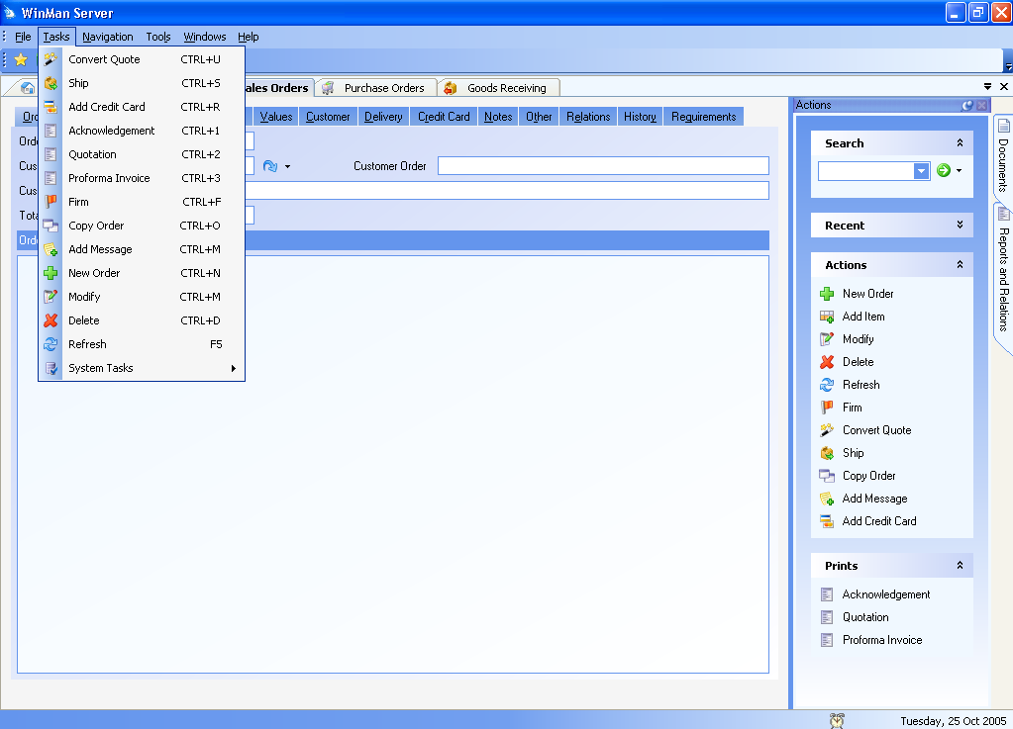
WinMan Toolbar - Tasks
Manipulation of the data can be done using the application specific actions at the side of the screen or the drop down tasks menu.

Slide 20
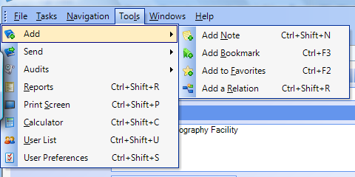
Tools Menu
Through the Tools Menu many actions can be accomplished and time savings recognized.
Reports – Brings up a listing of all available reports.
User Preferences – Manage your user information including your address and phone number, your password details, as well as your dashboard settings.

Slide 21
WinMan Toolbar - Tools
Send Tools
Send → Send Email - Send an email. Email templates can be used and with the outlook integration the Outlook address book can be accessed.
Send → Send Fax – If a Fax integration is setup a fax can be sent from WinMan.
Send → Send Letter – A form letter can be sent to a WinMan contact or company with contact/company information being inserted into the form letter automatically. See the WinMan CRM documentation for setup of form letters.

Slide 22
WinMan Toolbar - Tools
Audits Tools
Manage Detail Auditing – Detail auditing is managed per module per table. For example in the Sales Order Module detailed auditing can be turned on for Sales Orders and/or Sales Order Items.
Detail auditing gives full detail of the record as it was before a change and after the change. Not using Detailed auditing will provide less detail for any changes made.
To view a detailed audit, the tables that are available in each module will appear below the Manage Detail Auditing menu option. The audit details displayed will be for the record current in the module

Slide 23
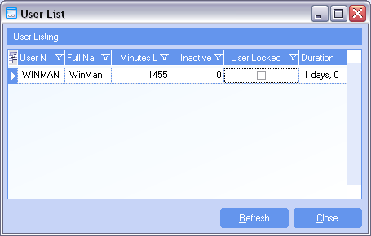
WinMan Toolbar - Tools
User List
The user list will provide a list of all active users logged into WinMan and well as for how long.
If licenses are all being used, this is tool that can help monitor if additional licenses need to be purchased.

Slide 24
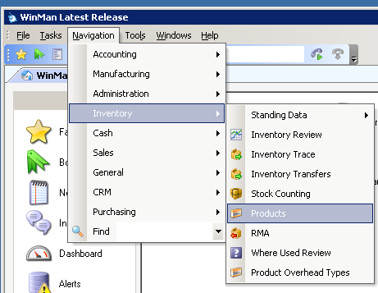
Navigation
To open the different areas of the system select the menu option from the Navigation menu.
Use the Find option to type the program name without searching the menu structure

Slide 25
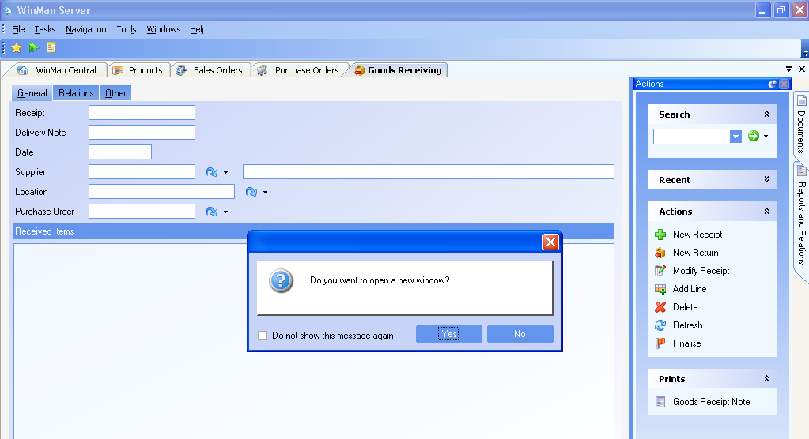
Navigation
Multiple windows can be opened simultaneously, however if the window selected is already open, a message will be displayed asking if you would like to open a new window. Multiple windows of the same logic can be open at the same time with same or different data

Slide 26
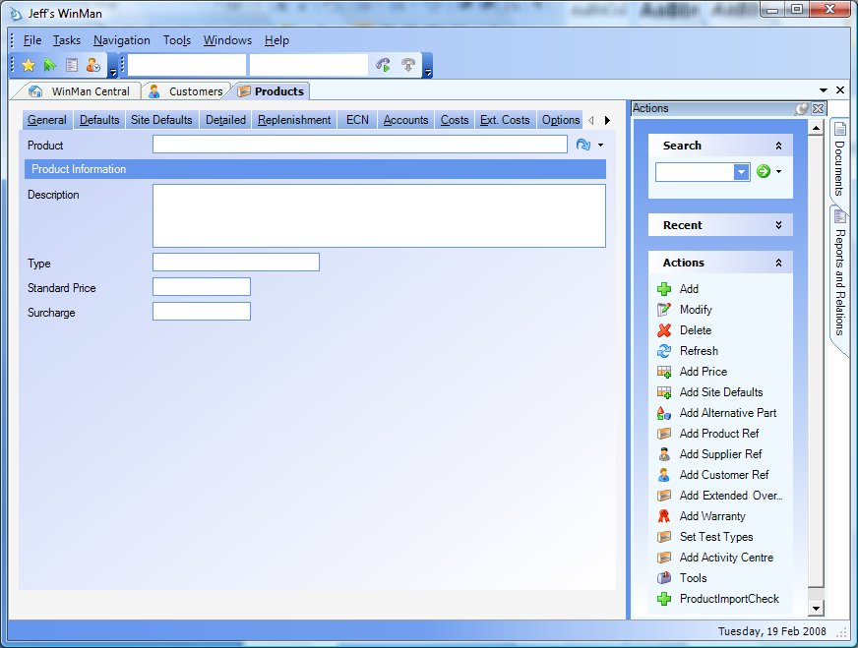
Adding/Amending/Deleting
When first accessing a screen we start with a “fresh page” that has no data on it. Here is a “fresh” product screen.

Slide 27
Searching for Data
To display existing records use the search option from the top right of the screen. Use * as the wildcard search or ? for an individual character.
The wildcard search is effective in standing data modules. However when in modules with large data sets, users should avoid the wildcard and refine the search.
The results from the search are displayed in a window. Open the required record by either double clicking the line or selecting it and clicking OK. If an exact match was found from the selection the system will go straight into that record.
SYSTEM SETTING: The number of results returned for a search by default is 100. This number can be changed, but the larger the number, the more performance will be affected. To change the maximum number of results returned from a search use the General setting Maximum Search Results. The setting should be enabled and the value should be the maximum number of records to be returned

Slide 28
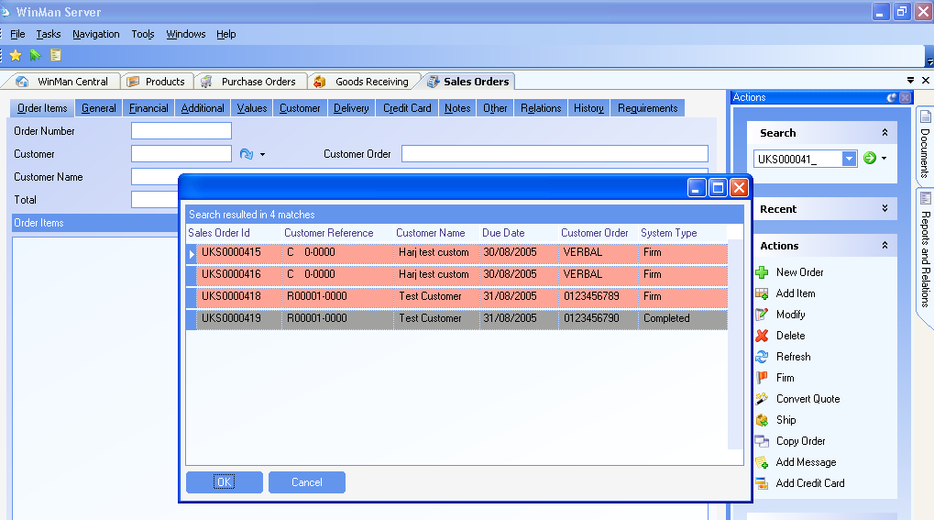
Searching for Data
Enter the search criteria in the Search dialog. The records matching the search will be displayed. Double click the record to be viewed

Slide 29
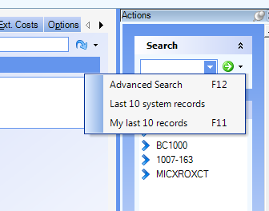
Searching for Data
WinMan allows other ways for quickly finding your data. If you select the down arrow (right beside the green arrow for searching) you will have the option for the last 10 system records or your last 10 records. The last 10 system records are the last 10 records that anybody using WinMan would have worked with. Your last 10 records are the last 10 that you have actually worked with. In some screens, you will also have an advanced search option which gives the option to search for a record based on something other than the default index
Down arrow for extra searches

Slide 30
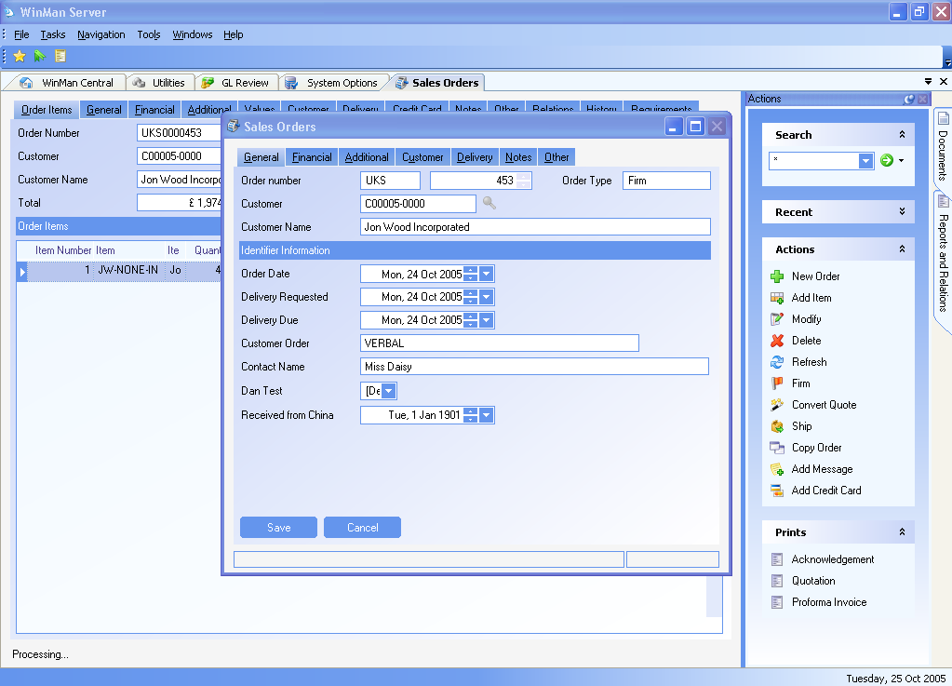
Modifying Data
When opening a record, the screen will show the data in “read only” mode; to amend the data the user must click on “modify”. Clicking on “modify” will cause a new window will to open. The data may now be changed.
Double clicking on the field to be modified will also open the modify screen.
Only those users with the proper permissions will be able to modify the screen.
When in a module with a header and line items, the modify action will always open the header in modify mode. Line items should be double clicked, or right clicked on the line and select Modify

Slide 31
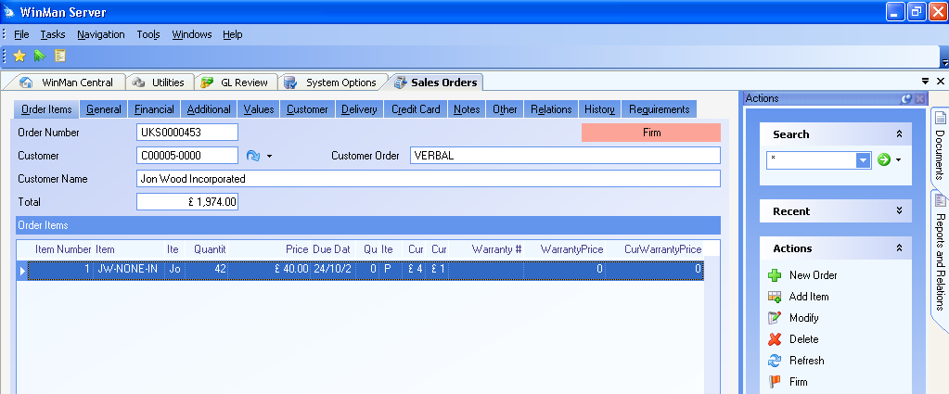
Deleting Data
Using the action Delete, WinMan will check to make sure the record can be deleted before actually deleting the current record. If the record can not be deleted, the user will be alerted.
When in a module with a header and line items, using the Delete action will delete both the header and all the line items. If only a specific line item is to be deleted, right click on the line and select Delete.

Slide 32
Actions
Actions are specific to an area and will include how you might complete a task. The actions in the sales order entry area will be different that those in the shipping area.

Slide 33
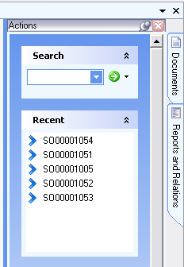
Recent
The Recent area will display the most recent records a user has accessed in a specific module.
By clicking on an item in the Recent area, the item selected will become the active record in the module.
The Recent area will track the last 5 records accessed in the module
SYSTEM SETTING: The number of records found in the recent area can be adjusted. The area for Recent records is fixed so if the number of records specified does not fit in the area, the records must be scrolled. To change the number of Recent records use the General setting Maximum MRU Items. Enable the setting and use the number of records required as the value

Slide 34
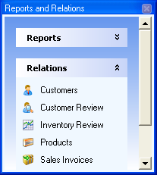
Reports and Relations
This Panel allows your system administrator to relate other programs or reports that are used closely with the current program but may not be part of a standard drill down or look up. The advantage here is that a user will not have to go through the standard navigation to get to something that they do on a repetitive basis.
To add a relation, simply access the program that a relation is to be added to. Select Tools, and then Add a relation. A dialog with all WinMan programs will display and ones that are to be relations, need to be checked.
To relate a report, access Reports from the Tools Menu. Find the report that is to be related and right click on it. Select the option Relate to program and select the program that the report is to be related to.

Slide 35
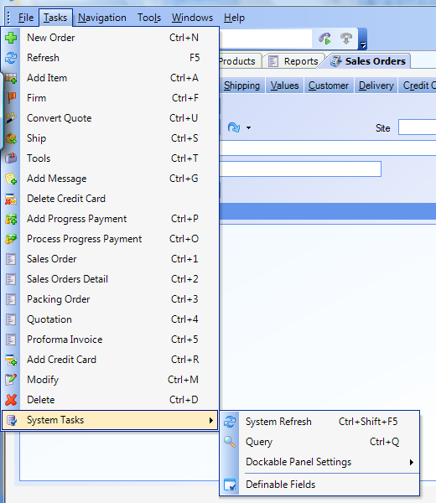
Definable Fields
Additional user defined fields can be added using this task. User defined fields are related to the primary tables of the application that you are in. If you are in Sales orders, you can add user defined fields to sales order headers, and sales order items but not to customers.
This action is generally reserved for the system administrators.

Slide 36
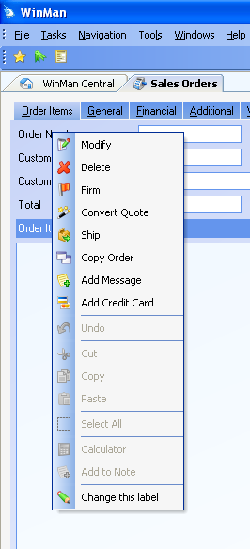
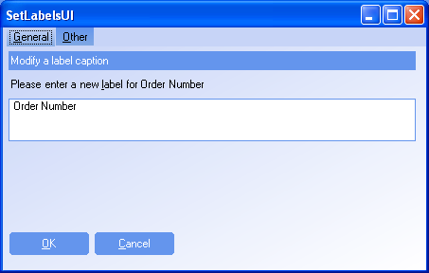
Changing Labels
To change a label simply right click on the label and select the option to Change This Label.

Slide 37
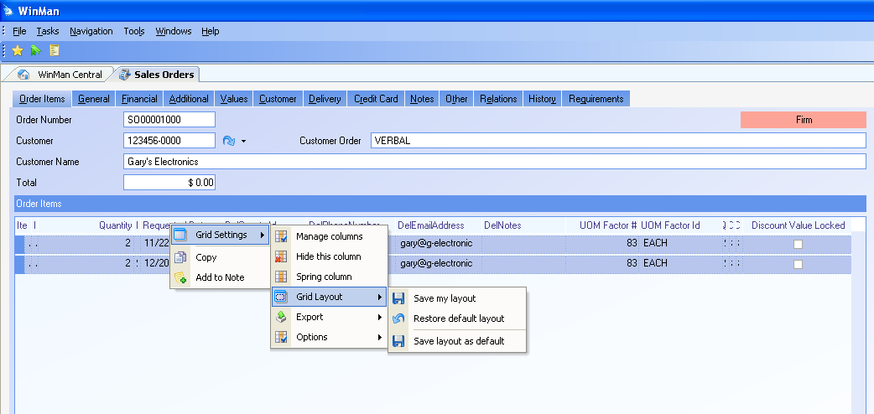
Grid Management
Grids, or detail blocks can be managed from within WinMan. Fields can be either selected or de-selected, columns can be dragged and arranged in any order and column widths can be adjusted.
Administrators can create default settings; users can create individual settings to meet their individual needs.

Slide 38
Grid Management
To change columns, right click on a column heading of the grid, select Grid Settings and Manage columns. A list of all the available fields will display. To select a field to be displayed, click the Show column. Auto size will adjust the width of the columns based on your screen display. Lock column will lock the column in place that the size can not be adjusted by the user.
A specific column that is displayed can also be managed without going into Manage Columns. A user can right click on the column to be managed and after selecting Grid settings can select Spring Column or Hide Column. Hide Column removes the column from the grid display (but can be re-selected through Manage Columns). Spring column has the same affect as the Auto size functionality in Manage Columns.
Once a grid has been set up it can be saved as the default. To save settings, right click on a column, select Grid Settings, then select Grid Layout, and Save Layout as Default. All users will have this default setting when they first login. At any point users can adjust their grid settings to reflect their own needs. Users can then save their custom layout by right clicking on a column, select Grid Settings, then select Grid Layout and Save as my default. If they would like to go back to the default settings, instead of Save as my Default, the user can select Restore default layout.
Data can also be sorted in a grid by clicking on the column heading that is to be sorted. To reverse the order that the data appears in, simply click the column heading a second time and the order will reverse itself.

Slide 39
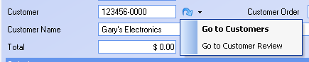
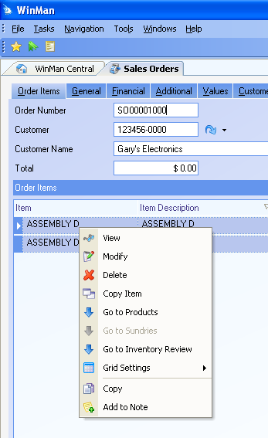
Drill Downs
Data within a grid or data that is on a tab can be drilled down from. Data on a tab can be drilled down using the blue arrow seen below. If the black down arrow is present, click on it and any additional drill downs will display, as seen below, then simply select which drill down is required.
Data can also be drilled down from data on a grid. Simply right click on the line of data to see drill down options. In the example to the right, the options to drill down include a drill down to products and a drill down to inventory review. Drill downs on each grid will be unique to the data within the grid.

Slide 40
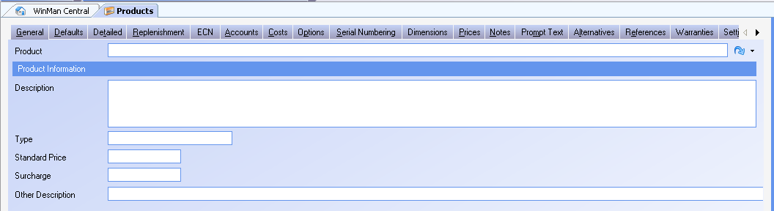
Tab Management
Tabs within a specific module can be set up a couple of ways. In modules that have too many tabs to fit on a screen, the extra tabs are accessed by using the scroll arrows.

Slide 41
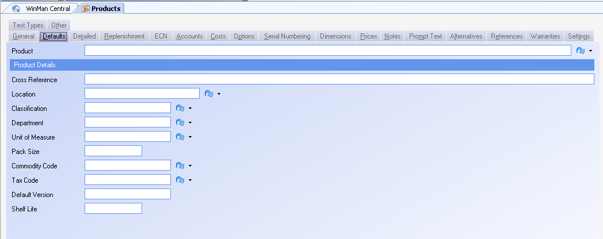
Tab Management
SYSTEM OPTION: Using the Style system option Wrap Tabs the tabs can be wrapped to fit on the screen. Enable the option and set the value to Y to enable tab wrapping. When using the Wrap Tabs option, another advantage is that the tab currently being accessed is much more visable

Slide 42
Tab Management
Tabs within a specific module by default are scrolled across the top of the module right below all the open modules

Slide 43
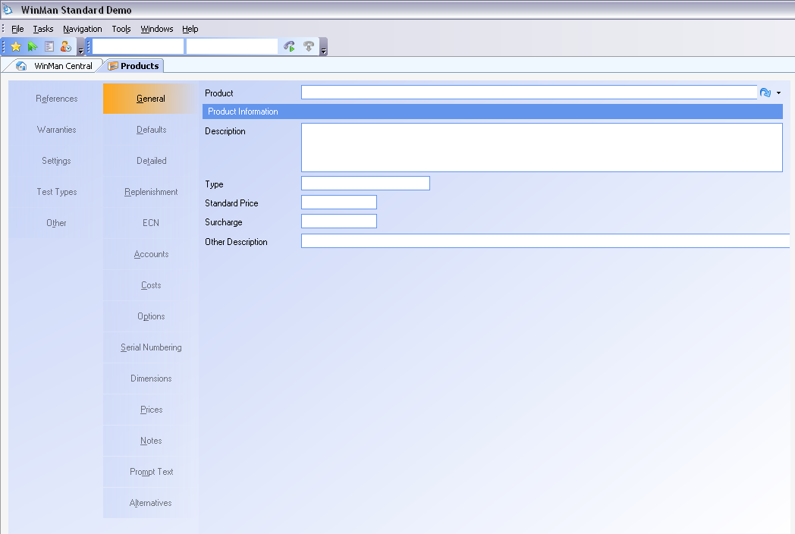
Tab Management
SYSTEM OPTION: Using the Style system option Section tab orientation to move the tabs from the top of the module to the left of the module. Enable the option and set the value to L to move data tabs to the left of the module.

Slide 44
Product Training
Printing Reports and Documents
Where “Lean” principles are considered common sense and are implemented with a passion!

Slide 45
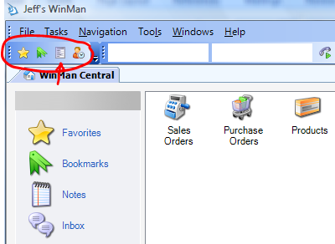
Reports
Reports can be run directly from the report list. To access the report list click on the report icon located at the top of the screen as shown or select the Reports from the Tools menu..

Slide 46
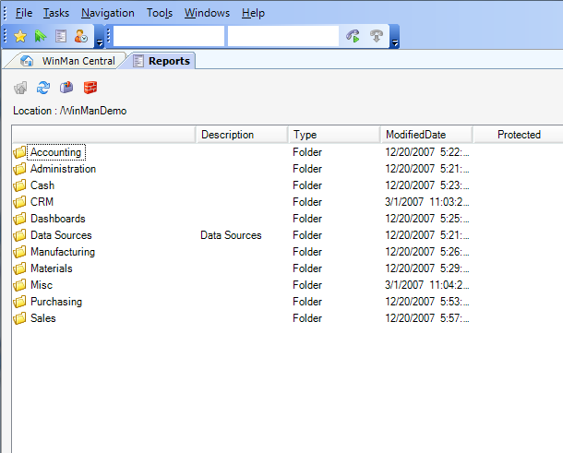
Reports
Reports are organized in folders. By default, they are grouped by function. Your implementation may change this structure to better suit your company if needed.

Slide 47
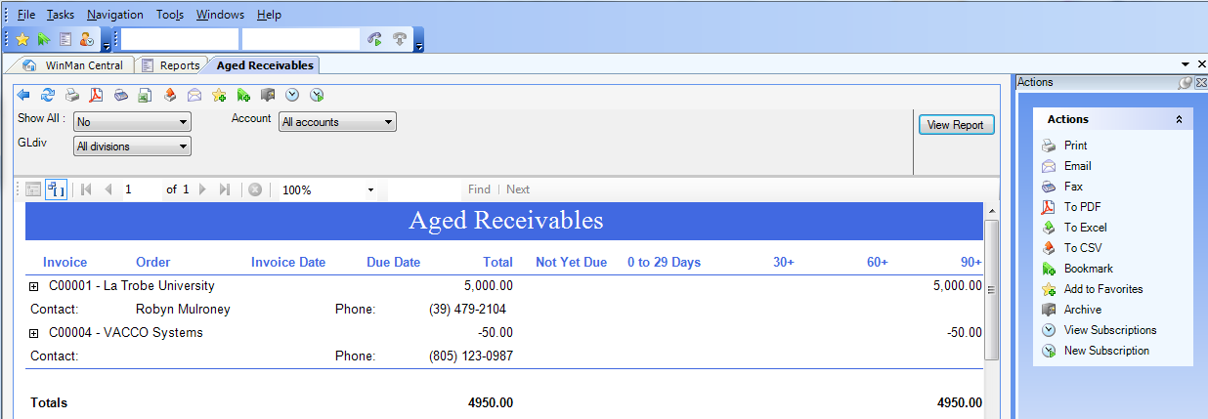
Reports
A report may work a little differently than others. For instance, it may require a customer number, a part number, date range, etc. There are however, similarities to how the functions surrounding the report work. Here is an Aged Receivables report. Notice the plus sign next to the invoice number. Clicking on the plus sign will expand the report and give more detail for the line.

Slide 48
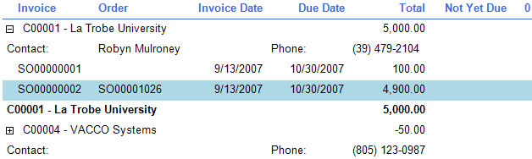
Reports
This screen shot show the result of clicking on the first plus sign.
Note the additional detail. This report will also allow us to drill down to the invoice by clicking on the invoice. You can tell it is a drill down because the cursor changes to a hand when it passes over the invoice number, just like a hyper-link in Internet Explorer. Multiple drill downs can exist on the same report, and can be configured by the system administrator.

Slide 49
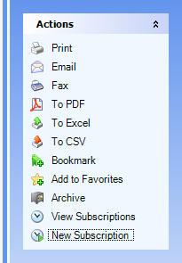
Reports
Once you have run the report you can export it, mail it, fax it, convert it, etc. Most of the options are shown below and are self explanatory.
SYSTEM SETTING: Reports have a default time-out 1 minute 40 seconds which is the time the report has to generate. If reports are require more time to run, and time-out errors occur when running a report, the time-out limit can be increased. Use the Reports system option Report Timeout (defaults to 100000 milliseconds) to increase the timeout period. Enable the option and set the value to the number of milliseconds that should be used.
NOTE: If there is an error while running the report, WinMan will be “frozen” until the timeout period has passed. Care should be taken with increases to this option

Slide 50
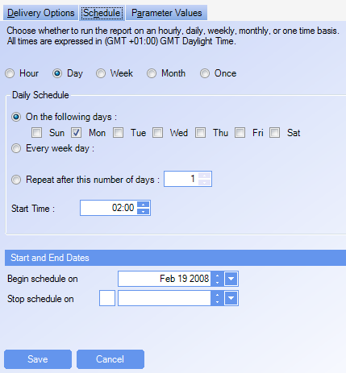
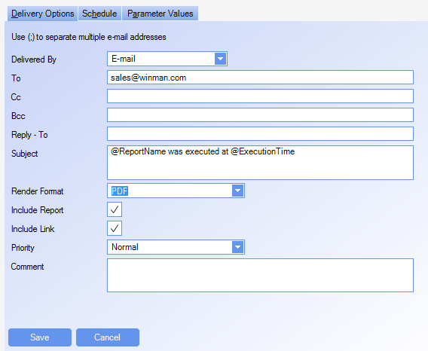
Reports
Subscriptions allow a report to be run on a schedule and emailed to specified recipients.

Slide 51
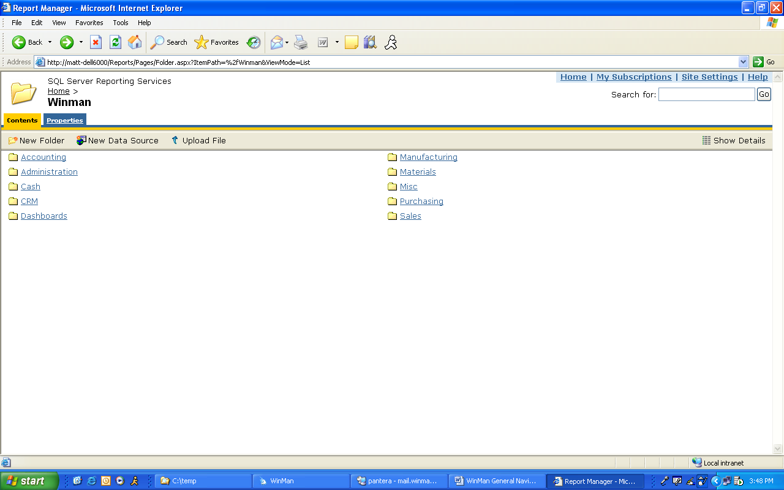
Reports
Reports can also be accessed outside of WinMan using an internet browser.
In the browser, type the SQL server name and “\Reports”. If the SQL server name is WinMan you would enter Winman\Reports.

Slide 52
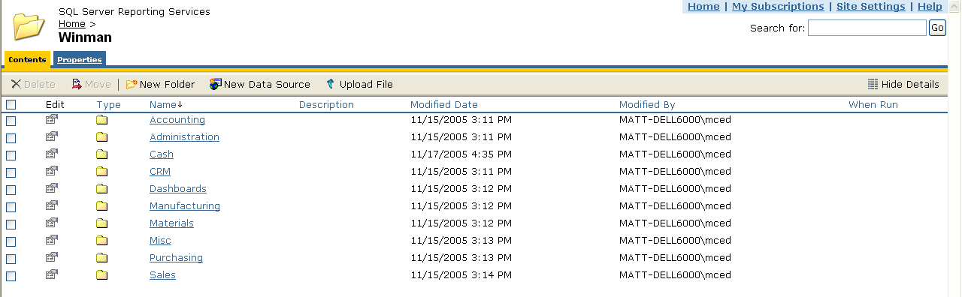
Report Security
To set-up report security enter the Report Portal and select the Show Details icon on the header bar. Security can be set for a specific folder or a specific report. In the example below, security is set for a folder. However, to set security for a specific report, simply drill down to the report and follow the same steps.

Slide 53
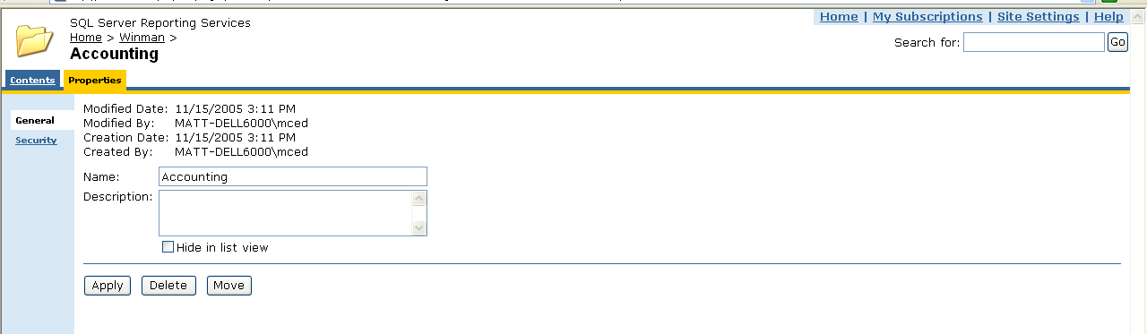
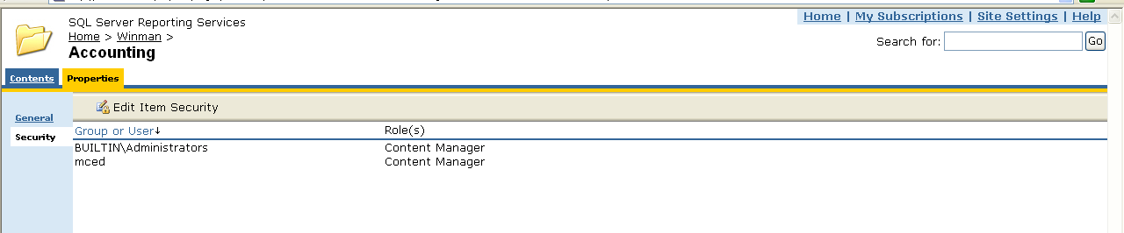
Report Security
Select the Edit icon for the folder that security is being set for and then select the Security Tab

Slide 54
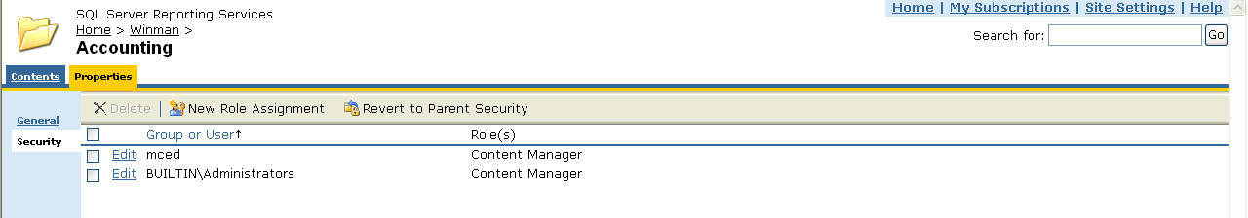
Report Security
Click on the column heading Group or User. Grant access for users or user groups that have been setup in the Windows Domain Controller.

Slide 55
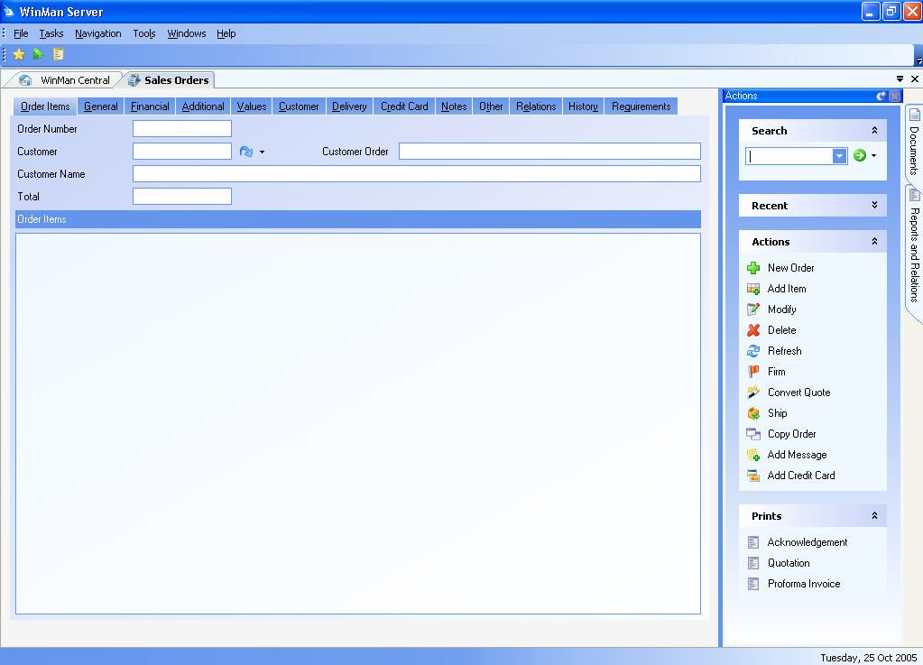
Prints
Prints are reports such as invoices, sales orders, picking slips, etc. Prints are typically used for an individual item where a report is for a larger data set. The available prints for the different areas of the system are shown in the print window on the bottom right hand side of the screen. The display window for the prints is the same one used for reports.
Right clicking on a “Print” or document will allow you to specify where and/or how you want the system to output the report.

Slide 56
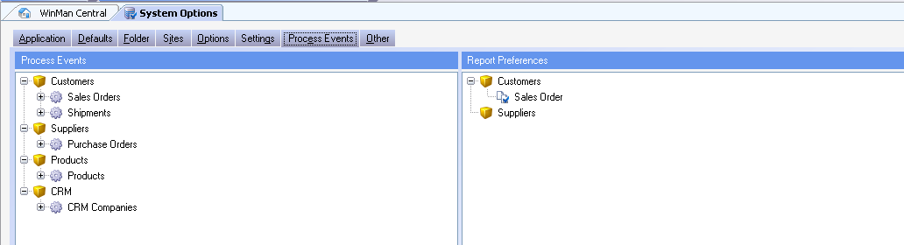
Print Preferences
Prints that are sent out to customers or suppliers can have print preferences set up.
Print preferences can be set up for any standard print or custom print provided the print is a Print menu item in at least 1 module. (ie Quotation print in the Sales Orders module)
Print Preferences have a default that is set up in the System Options module on the Process Events Tab, in the Report Preferences section

Slide 57
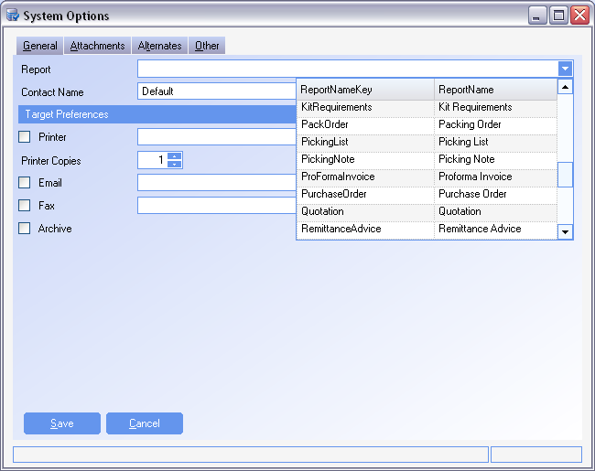
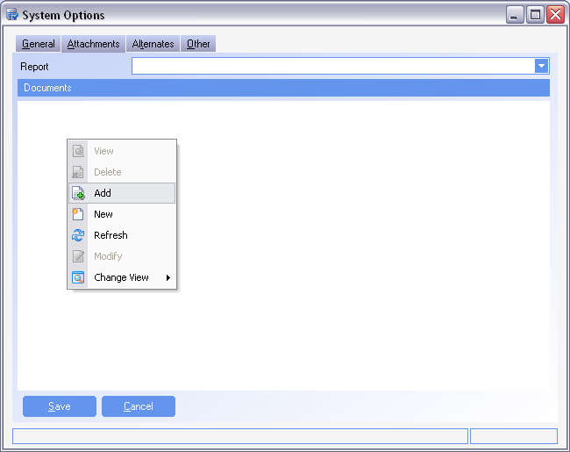
Print Preferences

Slide 58
Print Preferences
Print Preferences set up for customers will have a setting in the customer module to change (See Customers documentation) and print preferences for suppliers will have a setting in the supplier module to change (See Suppliers documentation)
To add a Print Preference right click on either Customers or Suppliers and select Add.
Select the report and the default sending method. Any or all print methods can be selected.
Note: Archive will add a PDF copy of the print to the item (ie Sales Order) in the module the print was sent from (Sales Orders).
To add attachments use the attachment tab and right click in the area. Select the option Add and add any documents to be attached. This could be a terms and conditions document.

Slide 59
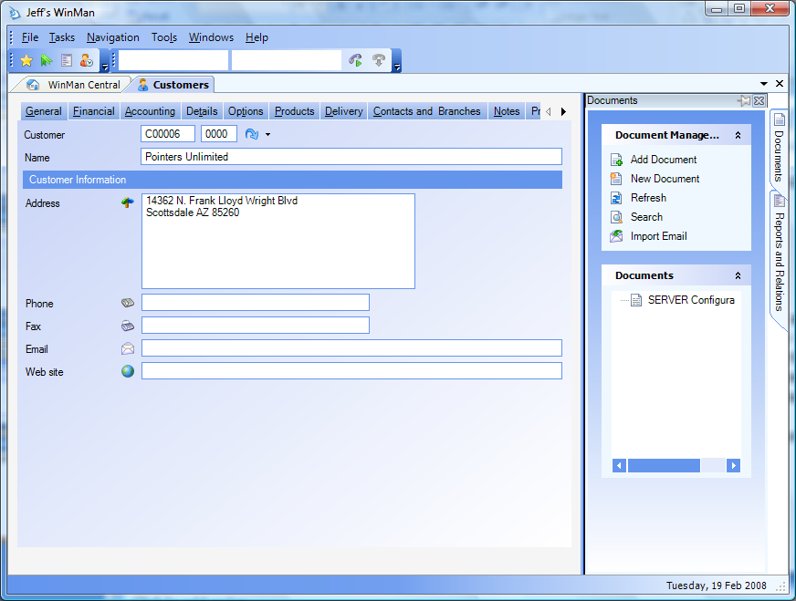
Attached Documents
WinMan allows documents to be attached to a current record. A document added to the example below will relate to the current customer. Any sort of document, drawing, or image/audio file may be attached. Note the list of existing documents. Key words may be added to search documents across multiple areas and screens. Often users use their names or a department as a key word.
Documents tab
Add Document – Adds a document
New Document – Allow a note to be attached as a document
Search – Brings up a search window. Searches can be by title, date, keywords, etc.
Import Email – Import an email from outlook

Slide 60
Product Training
System Data Setup and Defaults
Where “Lean” principles are considered common sense and are implemented with a passion!

Slide 61
Setting Standing Data
WinMan utilizes many pieces of data to make the system easier to use for the end user and eliminate errors, a software version of “Poka-yoke”, or mistake proofing. Standing Data is often found in drop down boxes, such as units of measure, GL Accounts, etc.
The following data needs to be set up in order for WinMan to function properly.
Chart of Accounts
Accounting Departments
Accounting Divisions
GL Classifications
GL Categories
GL Accounting Types
Security Profiles
Users (Can be done later)
Accounting Calendar
Work Schedule
Areas and Locations
GL Classifications

Slide 62
Setting Standing Data
Units of Measure
Write Off Codes
Inventory Reason Codes
Banks
Industry Codes
Labor Rates
Currencies
Commodity Codes
Countries
Tax Codes
Credit Terms
Freight Methods
Discounts
Settlement Terms
Departments
States
Messages
Purchase Order Prefixes
Sales Order Prefixes

Slide 63
Setting Standing Data
Credit Reason Codes
Prices
Most of the Standing Data is discussed in the functional area they relate to. A few are required when setting system defaults. We will cover those next.

Slide 64
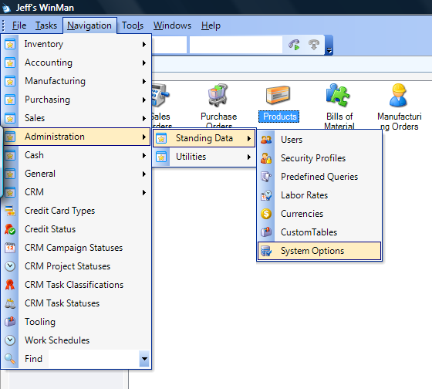
Setting System Defaults
The system setup and options are accessed through the Administration Menu.

Slide 65
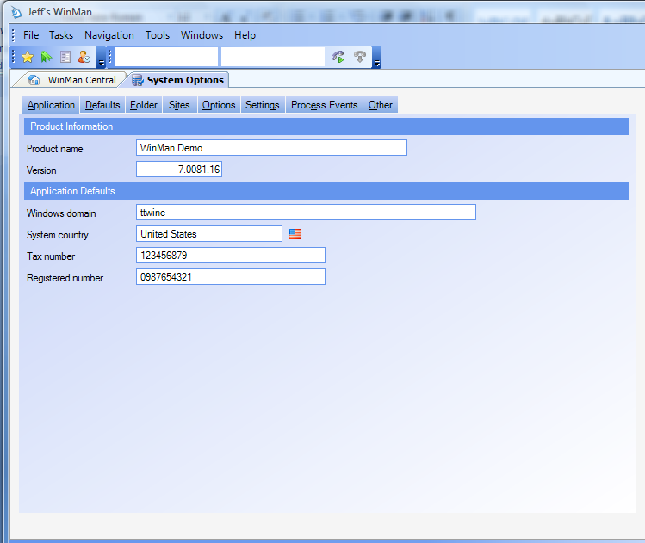
Setting System Defaults
The Version is a read only field. The system administrator will know the domain. The country determines certain formats for displaying and printing.

Slide 66
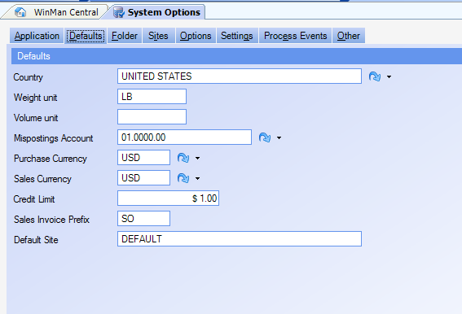
Setting System Defaults
Set various default settings for creation of static data. The unit weight indicates whether metric or English units are used.

Slide 67
Sites
WinMan can handle multiple sites. A typical structure might be as follows.
Corporate
Manufacturing
Distribution East
Distribution Central
Distribution West

Slide 68
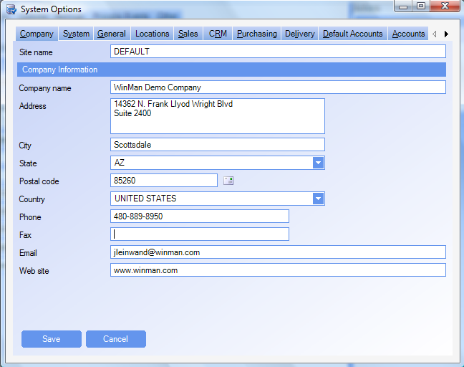
Sites
Each site has its own set of information describing it and its defaults.

Slide 69
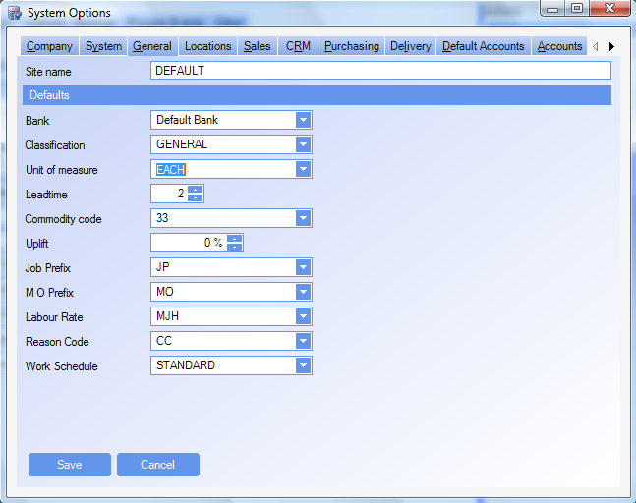
Sites
Each site has its own set of information describing it and its defaults.

Slide 70
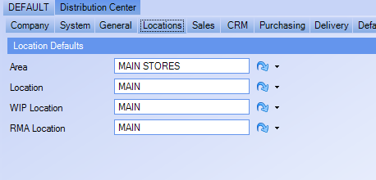
Sites
The locations tab allows the default locations for the site. These defaults can be overridden at entry time.

Slide 71
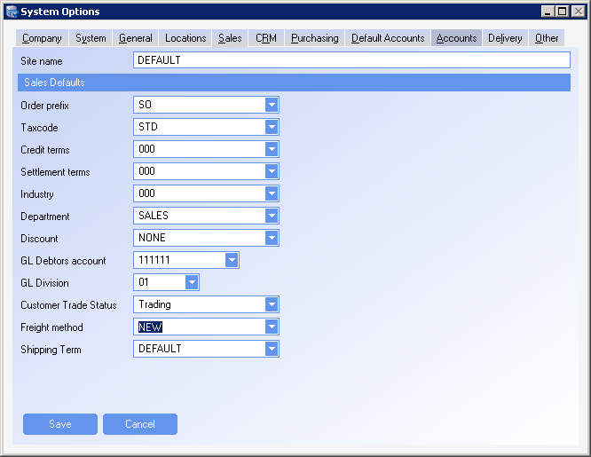
Sites
The Sales Defaults define the default values that will appear on sales orders associated with this site.

Slide 72

Sites
The Purchase Defaults define the default values that will appear on purchase orders associated with this site.

Slide 73

Sites
You can have a different delivery location for each site.

Slide 74
Sites
The account setup will be discussed in full in the accounting section.

Slide 75


System Options
System Options can change the appearance of the system, change behavior, or define formats within WinMan. Double clicking on an option will activate the option for editing. A green color means the options has been activated.
Options are categorized.

Slide 76
Product Training
Standing Data
Where “Lean” principles are considered common sense and are implemented with a passion!

Slide 77

Standing Data
Areas and Locations
In WinMan, the hierarchy for locations from largest to smallest is Sites, Areas and then Locations. Sites are used when inventory, sales and purchasing needs to be kept separately. Generally, there is a geographic gap between sites.
A site can then have multiple areas. Areas are used as a way to group locations.
Locations represent the smallest and most used designation. Locations are where inventory is stored.
When adding an area select the site it relates to.

Slide 78
Standing Data
General Tab
Account Division – Select the accounting division that all inventory transactions will use
Capacity – Reference field
Availability
  Sales – Inventory can be used for picking of shipments only
  Manufacturing – Inventory can be used for issuing to manufacturing orders only
  Sales and Manufacturing – Inventory can be used for picking shipments and issuing to manufacturing orders
  Jobs – Can be used only for jobs
  Unavailable – Can not be used for any operations
  Consignment – Used for purchased parts that are received but still owned by vendor. No accounting transactions occur until inventory is moved to a non-consignment location
  Sub-Contractor – Used for parts on sub-contract
  Bonded – Inventory can not be used. Inventory must be moved to a non-bonded location to be used. Items that are received into a Bonded locations will not have duty until the items are moved to a non-bonded location. Inventory values will go the GL upon receipt.
Exclude from MRP – Inventory in locations marked as exclude from MRP will not enter MRP calculations

Slide 79
Standing Data
Consumable Sequence – Used when a specific location(s) is required to be picked from before another location. Locations with a sequence number of 1 will be picked from (using a FIFO basis), then locations with a sequence number of 2 will be picked from, etc. Multiple locations can share the same sequence number.
Pick Sequence – A reference field that can be used for pick list print sequence.
Dimensions Tab
All dimension are used for reference/reporting only.

Slide 80


Standing Data
Classifications

Slide 81
Standing Data
Classifications allow parts to be classified for reporting purposes as well as used for consumable materials.
General Tab
Description – A description for the classification.
Consumables Tab
Active – Select if consumables is active
Reason Code – The reason code that will be used to expense the consumables
No of Days – The number of days after the receipt that the inventory will be consumed

Slide 82

Standing Data
Departments

Slide 83
Standing Data
Departments are used in a number of places throughout the system. Departments are used to group WinMan users. Departments are also found in Customers, where they could represent a non-commissionable Sales Rep, Suppliers, where they could represent a buyer and Products where a buyer could also be represented.
If the department is to be used to relate WinMan users together, the action Add Users can be selected to add users to a department. A listing of all users in WinMan will be displayed to select from. A user can belong to many departments. The relationship of users to departments can also be completed in the Users program where a user is selected and all available departments are displayed and then selected.
General Tab
Department – Enter a Department ID
Description – A description for the department
Email Address – An email address for the department
Telephone – A telephone number for the department

Slide 84


Standing Data
Units of Measure
Unit of Measure
Unit of Measure Factor

Slide 85
Standing Data
Units of measure are used to identify the unit of measure for products. An item can have only one unit of measure. However, a unit of measure can have many unit of measure factors which include a conversion factor used for sales orders and purchase orders. Unit of measure factors allow users to enter quantities on both sales orders and purchase orders in either the base unit of measure or any of the unit of measure factors they select.
General Tab – Unit of Measure
Unit of Measure – enter a unit of measure
Description – enter a description of the unit of measure
Print Text – enter how you would like the unit of measure to appear on paperwork

Slide 86
Standing Data
General Tab - Unit of Measure factor
Factor – What the conversion unit of measure is called
Description – A description of the conversion unit of measure
Print Text – What the conversion unit of measure will appear as on paperwork
Conversion – What you would multiple the base unit of measure by to get the correct conversion.
Example: A product is going to be stocked in Feet but sold in inches.
Set-up: Create a unit of measure called Feet. This will be the unit of measure in products. Create a unit of measure factor called Inches for the unit of measure Feet. The conversion factor will be 12 (12 inches = 1 Foot)

Slide 87

Standing Data
Commodity Codes

Slide 88
Standing Data
Commodity codes are used as an additional way to classify products. It is also used to group products to determine a Duty value.
General Tab
Commodity Code – Enter the commodity code ID
Description – Enter a description for the commodity code

Slide 89


Standing Data
Discounts
Discounts
Discount Break

Slide 90
Standing Data
The discounts program allows you to set up discounts that are used on both the purchase orders and sales orders.
Discounts can be set up with a straight percentage that will calculate on all transactions.
A discount could also be more focused and used only when a certain value or quantity is reached and then either a percentage discount or fixed value discount can be given.
Finally if more complicated rules are required, a combination of fixed discount can be used with a rule based discount.
If a straight percentage is required, a good rule to follow would be to name the discount with the percentage to be used. Ie 10%. When using this method, make sure the Discount Percentage field on the Discount Tab of the Discount program accurately reflects the discount percentage. Make sure there are no line items found in the Discount Breaks Tab.
If a rule is required such as, if a quantity of 100 is required to obtain a 5% discount then the discount percentage should be set to 0. A line item should be added where the Trigger type is Quantity and the trigger value is 100. The discount break type should be set to Percentage and the discount break value would be set to 5.

Slide 91


Standing Data
Customer/Product Pricing Classifications
Product Pricing
Product Pricing cross reference

Slide 92
Standing Data
The product pricing classifications programs allow you to define the grouping that are then selected for each part by way of the Product Pricing field on the Detailed tab of the products program.
The customer pricing classifications programs allow you to define the groupings that are selected for each customer by way of the Customer Pricing field on the Details tab of the Customers program.
Once both set of groupings have been defined, either program can be used to create the relationship between products and customers.
When adding a relationship, add the discount structure that is applicable (must have a discount) and the starting and ending date (only if applicable – if no dates are required leave blank).
Within the Product Pricing Classification is a Markup tab. A markup can be added which if the standard price is used (i.e. no price list), and the standard price is greater than the cost threshold, the markup percentage will be added to the standard price.

Slide 93

Work Schedule
As you will later see, in the Accounting Calendar, you set your default work schedule. You may also have additional work schedules. To modify, select a day with your cursor, right click and then click “Modify”. You can also double click the line to achieve the same result.

Slide 94

Standing Data
Product Overhead Types

Slide 95
Standing Data
Product Overhead Types are used to set-up multiple types of overhead that could relate to a product. Overhead Types might include freight, agent costs or import duties. Multiple overhead types may be added to the same part.
General Tab
Product Overhead – Select the Overhead ID
Description – Enter a description for the Overhead ID
Percentage Type – Check if the overhead is to be a percentage, leave un-checked if the overhead is an absolute value.

Slide 96


Standing Data
Prices

Slide 97
Standing Data
Price lists can be created and then related to a customer to provide a price list that one or many customer will receive for product pricing. Pricing records can then be created for a price list that specify the price of the item.
A part can appear more than once on the same price list. In a case where multiple prices exist for the same part, the minimum quantity is reached and they both have valid date ranges, the price with the smallest validation period will be used.
Genereal Tab – Price List
Price List – Enter the Price list ID
Description – Enter the description of the Price List
Currency – Enter the currency of the Price List

Slide 98
Standing Data
General Tab - Prices
Select the product for pricing
Price – Enter the price of the item
Sales Leadtime – Enter the leadtime of the item (Time it will take to make the item and have it ready to ship).
General Ledger sales Account – The revenue account for the item
Minimum effective quantity – If volume pricing is required select the minimum quantity that is required for the price.
Effective Dates Tab
Start Date – Date the pricing record will take affect
End Date – Date the pricing record will no longer be in affect

Slide 99

Standing Data
Warranties

Slide 100
Standing Data
A warranty can be created for a period of time (years, months, weeks, days). Warranties are then linked to parts which then can be sold on the sales order. The warranty then works with the RMA module to determine if a return item is covered under warranty, and when the warranty expires.
Warranty Tab
Warranty – use a description ID to name the warranty (ie 2 Year)
Description – Describe the warranty (ie 2 Year Full Warranty)
Warranty Period – Define how long the warranty is for

Slide 101

Standing Data
Test Types

Slide 102
Standing Data
Test types are used at time of receiving to alert receiving users that an incoming inspection or test is required
General Tab
Test Type – Enter a test type
Description – Enter a description for the test type

Slide 103

Standing Data
States

Slide 104
Standing Data
All states and provinces should be entered into the state’s program. States are used for customers, suppliers and delivery addresses
General Tab
State – Enter the state abbreviation
Description – Enter the full name of the state.

Slide 105

Standing Data
Countries

Slide 106
Standing Data
All countries that will be used for both customers and suppliers should be entered in countries. Duty rates are also determined by country. Use the action Add Duty Rate to select a commodity code and a duty percentage that will be calculated at time of receipt. If duty rates are not entered, duty will be calculated from the product.
General Tab
Country – Enter the name of the country
ISO 2 character – The ISO 2 character country abbreviation. Used with the UPS/Fed-EX shipping integration.
ISO 3 character – The ISO 3 character country abbreviation. Used for reference in WinMan
ISO Numeric – The ISO numeric country abbreviation. Used for reference in WinMan
Taxable – A reference field that can be used for reporting
EC Member – Used to designate if a country is in the European Union. A reference field in WinMan.

Slide 107

Standing Data
Currencies

Slide 108
Standing Data
Currencies are used to designate which currency a customer and supplier will trade will. The exchange rate that each currency is set up with will determine what conversion rate is used for each transaction. Both system currency dollars and the foreign currency values are stored in the transaction files. Fields that represent the foreign value are designated as starting with “Cur” eg Curvalue.
General Tab
Currency – The currency ID should be descriptive eg US Dollars
Description – Give a description of the currency
Actual rate – The actual rate of the currency. Used as a reference field for reporting.
Standard rate – The rate used in WinMan for all transactions
Euro Rate – A field that can be reported against for any Euro conversions.
Note: The system does not use this rate. If a currency of Euros is required, it should be set up a new currency.
Display – An abbreviation used in system for the currency eg $US

Slide 109

Standing Data
Banks

Slide 110
Standing Data
Banks store cash values that include payments to customers and suppliers, receipts from customers and suppliers as well as any GL transactions that might affect the bank balance. Each bank account that either pays or received cash should be set up as an individual bank.
General Tab
Sort Code – A reference field for the routing number
Account Number – The bank account number used for reference.
Currency – The currency of the bank account
GL account – The cash (Asset) account that is used for accounting. Typically, each bank will have a separate GL account.
Address Tab
The address and contact information of the bank

Slide 111
Standing Data
Details Tab
Overdraft limit – The overdraft limit, used for reference only.
Active – If the bank is active and can be selected for transactions
Next check number – The next check number that will be used when generating payments. When making payments this field is automatically updated and does not have to manually be updated after every payment.
International Tab
BIC – A reference field that can be used for Electronic Payment outputs
IBAN - A reference field that can be used for Electronic Payment outputs

Slide 112

Standing Data
Credit Terms

Slide 113
Standing Data
Credit terms are used to calculate due dates for customers and suppliers. Early Pay discounts are separate and covered under Settlement terms. Terms of 2% 10 Net 30 would have a Credit Term of Net 30 and a Settlement term of 2% 10
General Tab
Credit Term – The Credit Term ID eg Net 30
Description – A description of the Credit Term
Trigger date – Invoice date or delivery date can be selected. This is the starting date if specifying number of days for payment.
End of Month – The due date will be calculated as the last day of the month for the trigger date.
Payment – The number of days/months after the trigger date for the due date. If end of Month is selected the number of days will be added to the last day of the month
Special Payment Day – A fixed day of the month for the due date. If day 30 is selected, and the 30th day of the month does no exist (February), the last day of the month will be used in its place.
Credit Card Required – If a credit card is required on the sales order. This is used with the Credit Card authorization module.

Slide 114

Standing Data
Settlement Terms

Slide 115
Standing Data
Settlememt terms are used to calculate early pay discounts for customers and suppliers.
General Tab
Settlement Term – The settlement term ID. Eg 5% 10
Description – The description of the settlement term EG 5% if paid within 10 days
Allow Settlement – If a discount is to be taken
Settlement – The number of days from the invoice date that if the invoice is paid, a discount will be calculated
Settlement Rate – The rate of the discount that will be calculated

Slide 116

Standing Data
Tax Codes

Slide 117
Standing Data
Tax codes are used to calculate the tax for customers and suppliers as well as how it should report in the GL. A tax code should be set up for each taxing authority that tax is collected for or paid to.
General Tab
Tax code – The taxing authority Eg VA
Description – A description of the taxing authority eg Virginia
Tax Rate – The rate at which tax is calculated
GL account type – The account that tax is reported to the GL
Compound Tax – If more than one tax is being used and the tax needs to calculate tax on the invoice AND any other tax values.

Slide 118

Standing Data
Industries

Slide 119
Standing Data
Industries are used to track what industries a customer or supplier belong to. Industries can be used for reporting.
General Tab
Industry – The name of the industry
Description – The description of the industry

Slide 120


Standing Data
Carriers

Slide 121
Standing Data
A Carrier is used to group freight methods while freight methods are the specific shipping method. A Carrier could be UPS or FED-EX while the freight methods might be UPS-RED or UPS-BLUE.
General Tab - Carrier
Carrier – Enter the Carrier ID eg UPS
Description – Enter a description for the Carrier
Tracking URL – The tracking URL used to track shipments on the internet.
General Tab – Freight Method
Freight Method– Enter the freight Method eg UPS-BLUE
Description – UPS next day
Price – The standard price when the freight item is added to a sales order

Slide 122
Standing Data
GL Type Revenue – The revenue account used for freight. Used when a freight item is added on a sales order, shipment or sales invoice.
Cost – The standard price when the freight item is added to a purchase order
GL Type Cost – The expense account used for freight. Used when a freight items is added on a purchase order or purchase invoice
Commodity Code – Used for reference to group freight methods.
Tax Code – If the tax code on the sales order or sales invoice header has 0% tax, the tax code of the freight item will override the default tax code for the freight sales line.
Tracking URL – The tracking URL used to track shipments on the internet
Carrier ID – Used for the shipping integration, this is the freight ID the shipping system is expecting to see. Eg a freight method can be set up as UPS-BLUE but the UPS system is expects UPS-BLUE to be BLUE-01. This field must be populated for the shipping integration to work.
Taxable – A reference field used if the item is taxable

Slide 123

Standing Data
Shipping Terms

Slide 124
Standing Data
The shipping terms are the terms for payment of the freight. This generally includes options such as Prepaid, Collect, or 3rd Party.
General Tab
Shipping Term – Enter the shipping term
Description – Enter the description of the shipping term.

Slide 125

Standing Data
Inventory Reason Codes

Slide 126
Standing Data
Inventory reason codes are used to adjust stock quantities and values. Inventory reason codes are used in supplier returns, RMAs, inventory counts and in the inventory review module for manual adjustments.
General Tab
Reason Code – Enter a 2 character reason code ID
Description – Enter the description of the reason code
Account Type – Enter the expense account that the adjustment will affect.

Slide 127

Standing Data
Manufacturing Order Prefixes

Slide 128
Standing Data
Manufacturing Order prefixes are used as a prefix for manufacturing orders. Multiple prefixes are added for reporting purposes.
General Tab
Prefix – A prefix that can be as many as 6 characters. Usually 3 characters keeps the MO numbers managable
Description – Enter the description of the prefix
Next Number – The next number for the prefix. This is automatically controlled within the system and needs no manual updating.

Slide 129

Standing Data
Purchase Order Prefixes

Slide 130
Standing Data
Purchase Order Prefixes are used to separate PO’s for reporting purposes. At least 1 PO prefix must exist to enter a PO. PO prefixes can be used to represent a buyer, a type of PO(regular, sub-contract, replacement, etc) or some other way that PO’s might need to be separated.
General Tab
Purchase Order Prefix – The 3 digit prefix code used to identify a Purchase Order
Description – A description of what the prefix is
Next Number – The next sequential PO number used to create a PO. This number is automatically increased with every PO by WinMan.
Discount - A discount that will override all other discounts for line items on a purchase order. If discounts are used by supplier, product, or supplier cross reference this field should remain as [Default]

Slide 131

Standing Data
Sales Order Sources

Slide 132
Standing Data
Sales order sources are a quick way to determine where your sales orders are coming from. They can be used to track marketing efforts and effectiveness.
General Tab
Sales Order source – The sales order source
Description – A description of the sales order source

Slide 133

Standing Data
Sales Order Prefixes

Slide 134
Standing Data
Sales Order Prefixes are used to separate SO’s for reporting purposes. At least 1 SO prefix must exist to enter a SO. SO prefixes can be used for type of SO(regular, quote, RMA, consignment) or some other way that SO’s might need to be separated.
General Tab
Sales Order Prefix – The 3 digit prefix code used to identify a Sales Order
Description – A description of what the prefix is
Next Number – The next sequential SO number used to create a SO. This number is automatically increased with every SO by WinMan.
Account Division – If the profile to use revenue divisions by prefix is turned on this will be the default division for all line items added. If profile is not turned on this field will do nothing
Order Type – The default order type for the prefix (Order or Quote)
Consignment Sale – If orders are defaulted to be consignment sales.

Slide 135

Standing Data
Write Off codes

Slide 136
Standing Data
Write off codes are used with the cash program to write off invoice values. Write off codes can also be used to expense any bank fees on a cash transaction.
General Tab
Write Off code – The 3 digit code used to identify the write off
Description – A description of what the write off is
Account type – The expense account used for the write off transaction

Slide 137



Standing Data
Sundries

Slide 138
Standing Data
Sundries are non-inventoried items are either sold or purchased. Sundries are items where you do not keep track of quantities on hand, rather they are either expensed or reported as revenue when they happen. Sundries can be things such as shop supplies, catalogs or office supplies.
General Tab
Sundry – A sundry ID
Description – A description of the sundry. This will default into the sales order and purchase order line descriptions and appear on sales and purchase prints.
Price – The default selling price on a sales order/invoice
Cost – The default price on a purchase order/invoice
Taxable – A reference field to indicate if the item is taxable

Slide 139
Standing Data
Accounts Tab
GL Revenue Type – The default revenue account when added to a sales order/invoice
GL Cost Type – The default expense account when added to a purchase order/invoice
Details Tab
Unit of Measure – The unit of measure that the item is sold and purchased in
Tax Code – The tax code that applies to the sundry used as reference only
Commodity Code – The commodity code for the sundry used as reference only
Commission Group – The commission group for the sundry that is used to calculate a commission value if the sundry is a commissionable item

Slide 140

Standing Data
Standard Messages

Slide 141
Standing Data
Standard Messages are used on Sales Orders, Sales Invoices and Purchase Orders. Standard messages are used for messages that are going to be used in multiple instances so that the message doesn’t need to be re-types many times
General Tab
Message – A message ID that will identify the message
Description – A description of the message. Might include when it is used.
Text – What the message is that should be added to the order or invoice.

Slide 142

Standing Data
Exchange Difference Codes

Slide 143
Standing Data
Exchange difference codes are used to track exchange gain and loss values. At least 1 account needs to be entered into the system.
General Tab
Identifier – A 3 digit code for the identifier
Description – A description of the exchange difference code which may include when it is used.
Account Type – The account that the gain/loss value will be reported to.

Slide 144

Standing Data
Fault Codes

Slide 145
Standing Data
Fault codes are used with the RMA module. They identify why an RMA is created and are used for reporting.
General Tab
Identifier – A fault code ID
Description – A description of the fault code which may include when it is used.

Slide 146

Standing Data
Credit Memo Reason Codes

Slide 147
Standing Data
Credit Memo reason codes are used with sales credits. They are used to identify why a credit was created for reporting purposes.
General Tab
Identifier – A reason code ID
Description – A description of the reason code which may include when it is used.

Slide 148
Work Schedule
Exception can made to the schedule to account for holidays. Breaks, both paid and unpaid may also be setup. This is done by selecting one of the actions circled below.

Slide 149

Work Schedule
This is an example of an exception to the summer schedule. Here, the factory is not working on the Fourth of July. Note that February 14 is bold. That indicates an exception on that day.

Slide 150

Work Schedule
Breaks can be scheduled so that the system is aware of work hours.

Slide 151
Work Schedule
The standing data will be explored in full when we reach the module that uses the standing data.

Slide 152
Product Training
Where “Lean” principles are considered common sense and are implemented with a passion!

Slide 153
Products
Products are items that are inventoried. All movements, receipts and issues are recorded in order to maintain the perpetual inventory.

Slide 154

Products
General Tab

Slide 155
Products
Product – The product number
  Product naming scheme to be used
    Intelligent
    Semi-intelligent
    Next Number
SYSTEM SETTING: If a sequential number is required for new part numbers use the Products setting Automatically default product ID. This will automatically create a 10 character sequential part number
SYSTEM SETTING: If a part number is automatically being created using the above setting, the default length of 10 characters can be amended. Use the Products setting Automatic default product ID length to change the length. Enable the setting and set the value to the number of characters the part number should be
SYSTEM SETTING: If a part number is automatically being created for new part numbers and a prefix is required use the Products setting Automatically default product ID prefix. Enable the setting and set the value to the prefix for the new part numbers

Slide 156
Products
Description – The description of the part (300 characters)
Type – Must be one of the following;
  Standard Assembly – Items that are manufactured
  Purchased – Items that are purchased and can not have a bill of material
  Purchased Assembly – Items that the system will treat as a purchased part for MRP, but the item can have a bill of material and be made using a Manufacturing Order or Backflush
  Transient Assembly (also known as Phantoms)– Items that are a manufactured assembly and when placed on a bill of material, will be exploded down to components
Standard Price – Default price for item when added to a sales order if no price lists exist
Surcharge – Additional charge that will be added to the sales order in addition to the price. Revenue from this will go to the same GL account as the item.
NOTE: If a different GL account is needed, a sundry should be used and added to the sales order as a second item.

Slide 157

Products
Defaults Tab

Slide 158
Products
Cross Reference – Used in Keyword search for parts
Location - Provides a default location when receiving for a purchased part or a default location when a manufactured item is being finished (but can be changed at time of finish)
Classification – A way that allows you to classify items for reporting. Inventory and sales reports currently use classifications for groupings. Can be used for product lines.
Department – A way to group parts for responsibility and reporting. This could be a buyer code.

Slide 159
Products
Unit of Measure – The unit of measure should be the lowest factor of the unit of measure used for the part. It is how units will appear on bills of material. If a conversion factor is needed for customers or suppliers, unit of measure factors found in the Unit of Measure program, can be used to convert quantities.
i.e. Widget A is stocked in Inches and sold in Feet. The unit of measure in Products would be Inches and a unit of measure factor would be Feet with a conversion factor of 12
Pack size – The minimum quantity size that an item can be moved in. Used for reference only
Commodity Code – A way to identify items by commodity code. Can also be used as an additional way to group parts for reporting

Slide 160
Products
Tax Code – A tax code for the item that is used for reference only
Shelf Life – The shelf life number of days will be added to the date an item is finished on a manufacturing order to default an expiration date. This can be changed by the user when the Manufacturing finish is being completed.
i.e. If an item is finished on Jan 3 and its shelf life is 10 days, the suggested expiration date will be Jan 13.

Slide 161

Products
Detailed Tab

Slide 162
Products
Purchase Discount – A discount that will occur on purchase orders that will over-ride the discount from the vendor. If discounts are determined by vendor, this field should be left as Default
Sales Discount - A discount that will occur on sales orders that will over-ride the discount from the customer. If discounts are determined by customer, this field should be left as Default.
Price Group – Used to group items for the purpose of updating prices based on price list. This can be used if multiple items appear on multiple price lists at the same price. Most instances this will be Default.

Slide 163
Products
Barcode – A free text field that can be populated if a barcode is required. A reference field that has no affect on the system
Superseded by – An alternate product that is suggested at time of sales order entry. Either the main product or the superseded by product can be selected on the sales order.
Product Pricing – Used when a discount is dependant on both customer and product. The product pricing is used to group parts that will have the same discount structure. This will override the sales discount field above.
Commission Group – Used to group like parts that will have the same commissions. Commission percentages are calculated by determining the commission group and the commission class from customers.

Slide 164

Products
Replenishment Tab

Slide 165
Products
Method – Can be MRP or ROP. MRP will take into account supply and demand, factor in due dates and order quantities and make suggestions for proposed purchase orders and proposed manufacturing orders. ROP will wait for stock levels to fall below the re-order point and then generate proposed purchase orders and proposed manufacturing orders.
Re-Order Point – A safety stock level that both MRP and ROP will look at and generate proposals once stock is below.
Minimum order quantity – The minimum quantity that will be generated on a proposed order.
Optimum Order quantity – If a proposed order requires more than the minimum quantity, the quantity will increase by a factor of the optimum quantity.
Eg The minimum quantity is 8 and optimum quantity is 4. If the demand for the item is 17 the proposed order will be for 20.

Slide 166
Products
Procurement leadtime – The number of days that is required to make a product or to buy a product.
Supplier Restricted – Purchase Orders can only be created for suppliers that have a supplier cross reference entry.
Kanban Procurred – No proposed orders will be created through MRP or ROP.
Receipt Batch Qty – The quantity that will be the maximum batch quantity for a purchase order receipt.
i.e. If the receipt batch quantity is 10 and 70 are received, 7 lots of 10 will be received into inventory.
Planning Buffer – The number of days added to the procurement lead time to calculate due dates. Extra days that are used with due date to buffer against delays.

Slide 167

Products
ECN Tab

Slide 168
Products
Use change control – Check if ECN control is required
Product Version – The version of the product, can be a letter of number. When a product is added to inventory the Product version is assigned to the batch, and will follow that batch for tracking purposes.
ECN Type – The current ECN
Last ECN Applied – The last ECN applied to the part. If a change is made to a field in products that is under ECN control, the user must pick an ECN that relates to the change.

Slide 169

Products
Accounts Tab

Slide 170
Products
Inventory – An Asset account that is used for inventory and is from the system defaults. Can have separate accounts for Raw Material, Sub-assemblies and Finished Goods.
Work in Progress – The system default WIP account will act as the default for this field. In most situations the WIP account will not be changed from the default.
Labor – The labor recovery account that is used as the offset when labor is added during a Manufacturing Finish, or a Goods receipt.
Overhead – The overhead recovery account that is used as the offset when overhead is added during a Manufacturing Finish, or a Goods receipt.

Slide 171
Products
Material Variance – Variance account for any material variances for Manufacturing Finishes
Labor Variances – Variance account for any labor variances for Manufacturing Finishes
Overhead Variances – Variance account for any overhead variances for Manufacturing Finishes
Sales Type – The default sales account used when no price list is found.

Slide 172
Products
Sales Division – If revenue is separated by division and products align with specific divisions, the division field should be used. This will override the sales order prefix or division from the customer master. If not applicable, should be left as “Default”
Duty – The duty account used for the duty value. When an item is received with a duty value, the value of the inventory will be increased by the duty value. The duty account is the credit account used to offset the inventory value.
Duty Value Rate – The rate at which duty will be calculated for a product

Slide 173

Products
Costs Tab

Slide 174
Products
Standard Material – For purchased parts, this can be manually entered as the standard material cost for the item. Manufactured items, must have a cost roll up completed for standard material cost, no manual entry is allowed.
Standard Labor – For manufactured items, the standard labor value.
Overhead – For manufactured items, the standard overhead value.
Activity Based – For manufactured items, the standard cost of all the routing steps.
Note: This is not traditional Activity Based Costing
NOTE: To the right of the Standard costs, are Costs at this Level. These are the costs for the specific part, and do not include sub-assembly costs.
i.e. If the labor cost of a sub-assembly is $10 and the labor cost of the actual item is $40, the Labor cost at this level would be $40 and the total standard labor value would be $50.

Slide 175
Products
Overhead Recovery Method – Overheads can be recovered by;
  Absolute value
  Percentage
  Combination Absolute value and percentage
  Extended Overheads – Purchased Parts only
Options A,B and C can be set on the Costs tab in the Overhead Recovery Method section. Extended Overheads are added on the Ext. Costs tab by way of the Add Extended Overhead action. Extended overheads can be added through the Product Overhead Types program.
Automatically recover from standards – Labor, overhead and activity based costs can be charged to an item either by using the standard value, or using the actual values. If standards are required, all items in this section should be checked.

Slide 176
Products
Latest Costs – Calculated daily. Will look at the latest purchase or manufacturing finish.
Average On-hand costs – Calculated daily. This will average the cost of all on-hand inventory.

Slide 177

Products
Options Tab

Slide 178
Products
Use Configurator – A configurator is required
Sub-Contract – A sub-contract operation is required for the item
Cascade MO’s – This option will create all sub-assemblies for a parent using the highest level MO number and appending a “/#” where # is a sequential number.
Eg If MO123 has a sub-assembly, MO123/1 would be the MO created. The cascade MO’s option must be used with back-to-back manufacturing orders and is typically used with large items that have long lead times.
Apply Provision – Determines if an additional quantity should be added to proposed work orders generated from MRP. The additional quantity can either be a percentage or an absolute value.
Provision Amount – The amount that will be added to MRP proposed orders

Slide 179
Products
Order Options
  Generate a Manufacturing Order for each sales order – A proposed MO for the quantity of the sales order line item will automatically be generated. Quantities on the MO will be updated to reflect the sales order provided the MO has NOT been released. Once the MO has been released any changes must be dealt with manually. For use with manufactured items only.
  Generate a Manufacturing Order for the optimum order quantity – A manufacturing order using the optimum order quantity will be automatically generated.
  Generate a Purchase Order for each sales order – A suggestedPO for the quantity of the sales order line item can be automatically generated. The default vendor will be suggested, but can be changed when the sales order line has been created. For use with purchased items only. Quantities on the purchase order will be updated to reflect any changes from the sales order.

Slide 180
Products
Available for Orders – Determines if the part can be added to a purchase order
Engineering Only – A field that designates if the item is for engineering only. Used for reference only, no system action.
RoHS – Designate products that are RoHS compliant, non-compliant, exempt or unknown. Used for reporting only, no system action.
Build to Ship – An item will be backflushed when a shipment is created. This includes consuming components from BOM of shipped item, finishing item to inventory and picking item for shipment. Can be done when;
  Always
  Only if no stock
  Prompt build to ship – user determines if backflush is completed
  Prompt build to ship if no stock – will prompt user only if no stock is on hand

Slide 181
Products
MRP Consolidation – Number of days a proposed order will look back and consolidate quantities of a proposed order.
Taxable – Reference field if the item is taxable. No system action taken

Slide 182

Products
Serial Numbering Tab

Slide 183
Products
Serial Numbering can be done at the following times;
When Received (Purchased Parts)
On MO Completion (Manufactured Parts)
On MO Issue (Purchased and Manufactured Parts)
When Shipped (Purchased and Manufactured Parts)
Identify serial number when issuing – User must pick serial numbered items when being issued to a manufacturing order. If not checked, will issue serial numbers based on location consumption sequence then FIFO.
Identify serial number when picking – User must pick serial numbered items when being picked for a shipment. If not checked, will issue serial numbers based on location consumption sequence then FIFO.

Slide 184

Products
Prices Tab

Slide 185
Products
A product can be linked to multiple price lists and have different prices on each price list. The Prices table links a price list and a product together and can be added using the action Add price
  (Note Prices can also be added in the Prices Program)
Price lists can be created and then related to a customer to provide a price list that one or many customer will receive for product pricing. Pricing records can then be created for a price list that specify the price of the item. A part can appear more than once on the same price list.
A pricing entry can have effective dates, where a price is only good for a specified date range
A pricing entry also has a GL account which is used for Revenue

Slide 186

Products
Notes Tab
Notes about the part are added for reference

Slide 187

Products
Prompt Text Tab
Prompt text is a pop-up reminder in sales orders and purchase orders when the item is added
SYSTEM SETTING: By default prompt text is seen in both sales and purchase orders. Use the Products setting Locations to show product prompt text to control where prompt text is seen. Sales orders, Purchase orders, Both or None can be selected.

Slide 188

Products
Alternatives Tab

Slide 189
Products
Alternatives – Alternative Part numbers can be added for reference. They are added by selecting the action Add Alternative Part. Multiple Alternative parts may be added.
Product Cross References – Product Cross references are used to cross reference any manufacturer’s part numbers. They are added by selecting the action Add Product Ref.
Alternate Activity Centers – Alternate Activity Centers are used to track any alternate Activity Centers that could be used during manufacturing. They are added by selecting the action Add Activity Center.

Slide 190

Products
References Tab – Customer Cross Reference

Slide 191
Products
Customer – Customer cross references are used to track customer part numbers and customer part descriptions that might differ from the product number and description found in the products table. Customer cross references can also be added in the Customers program.
To add a Customer cross reference in Products select the action Add Customer Ref
Price – The price that this customer is to receive for the part. This will override any price list.
Discount – The discount that the customer will receive for the part. This will override any discount calculated from products or customers.
GL Sales Account – The revenue account that will be used. This will override any GL account found on a price list.

Slide 192
Products
Customer’s Part – The customer’s part number that will appear on sales prints. It also is used in part number look-ups throughout the system.
Customer’s Description – The customer’s description of the part that will appear of sales prints.
Picking location – A default location that inventory will be picked from before any other location. If there is not enough inventory in the Picking location, the remainder will be picked based on standard picking logic.

Slide 193

Products
References Tab – Supplier Cross Reference

Slide 194
Products
Supplier cross references are used as a place to store supplier part numbers as well as other much more information than is found in the customer cross reference. Additionally, supplier cross references are needed for MRP to suggest a vendor, sub-contracting, as well as Kanban. Supplier cross references can be added in Products or in Suppliers.
To add a supplier cross reference in Products select the action Add Supplier Ref.
Supplier – Select the supplier that the supplier cross reference will relate to
Normal Cost – The price that you buy the product from this specific vendor. This is the default price on the Purchase Order.
Date Last Quoted – The last day the item was quoted from the vendor.

Slide 195
Products
Supplier Sequence – The order that suppliers will be used with 1 being the highest and 999 the lowest. The supplier with the highest sequence number and within the leadtime of the requirement will be suggested.
Discount Applicable – The discount that will be used on the purchase order. This will override any discounts in Products or Suppliers.
Leadtime – The leadtime for this part from this vendor.
Unit of Measure Factor – The unit of measure factor that this item is purchased in from this vendor.
Receipt Batch Quantity – The receipt batch quantity in supplier cross reference will over-ride the receipt batch quantity in Products.
Location – The location that the item is to be received into. This will override the location from Suppliers and Products.

Slide 196
Products
Supplier Cross reference Kanban fields
  Original Quantity – Original quantity of the contract for the part
  Quantity Outstanding – The quantity still outstanding (not received) from the contract. Automatically decreases with each kanban receipt.
  Minimum Stock – The minimum stock that should be on hand. Can be used for reporting, no system action with this field
  Maximum Stock – The maximum stock that should be on hand. Can be used for reporting, no system action with this field
  Date – Date of last contract.
  Kanban Delivery Days – The days of the week that Kanban deliveries can occur. Used to calculate due dates for Kanban POs.

Slide 197
Products
Supplier’s description – The supplier’s description of the part that will appear on the Purchase Order print.
Supplier’s part number – The supplier’s part number that will appear on the Purchase Order print.
NOTE: Price breaks can also be added to supplier cross reference records. When viewing supplier cross reference records, right click on the entry that is to receive a price break, and select the action Add Price Break. Specify the minimum quantity required to obtain the special price as well as what the special price is.

Slide 198

Products
Warranty Tab

Slide 199
Products
Warranties can be linked to a part by using the action Add Warranty. Select the warranty to be added to the part, the price and if the warranty is the default (as many warranties as required can be added to the part). The warranties that are listed for a part are options on the sales order where a user can then add a warranty. The value of the warranty will then be added to the sales order line and be reported to the revenue account for that line. Most items under warranty control will have serial numbering turned on as a way to identify the item. If serial numbering is not turned on, at time of shipping, items will be treated as serial controlled. A shipping line will be created for each unit with a quantity of 1 and in cases where no lot number exists (ie the item was stock adjusted on hand), the user will be prompted for a serial number.
A warranty can be created for a period of time (years, months, weeks, days). Warranties are then linked to parts which then can be sold on the sales order. The warranty then works with the RMA module to determine if a return item is covered under warranty, and when the warranty expires.

Slide 200

Products
Setting Tab

Slide 201
Products
Pick Shipment Batch – When set to Y, when creating a shipment, a user will pick which batches are to be shipped. When set to N, standard picking logic will automatically be done.
Use Kanban Lot Number Inventory Control – For use with the manufacturing Kanban program, this setting is applicable at the component level. If set to Y, when using the long form Kanban entry, only components with a matching lot number to the lot number specified for the parent will be used.

Slide 202

Products
Test Types Tab

Slide 203
Products
Test types are displayed at time of receiving. They alert receiving users as to tests that need to be performed when the item is received. Multiple test requirements can be linked to a part, by using the action Set Test Type. Select the check box in the Include column of the dialog to set a test type.

Slide 204
Product Training
Product Structures and Engineering Change Control
Where “Lean” principles are considered common sense and are implemented with a passion!

Slide 205
Product Structure Overview
A Product Structure is a top down view of the components and assemblies that are used to make an item. A recipe, formula and bill of materials are all product structures.

Slide 206









Product Structure Overview
Finished Laser Pointer
Battery Compartment
LC Board
Switch
Laser
Lens
Barrel
ROM
Pot
Logic
Raw PCB

Slide 207
Product Structure Overview
Laser Pointer
LC Board
Rom
Pot
Switch
Laser
Lens
Barrel
Logic
Battery Compartment
Raw PCB
Demand
Costs
Note that a child item can also be a parent.

Slide 208
Product Structure Overview
Our Items
Laser Pointer – 44-1000
Battery Compartment – 44-2010
Barrel – 44-2001
Lens – 44-2015
Laser – 44-2300
Switch – 44-2303
LC Board – 44-1500
ROM – 44-2320
Resistor POT – 44-2380
Logic Chip – 44-2344
Raw Board - 44-2350

Slide 209

Product Structure Navigation

Slide 210

Product Structure Entry
When you do a search the system will only bring up assemblies. If you don’t see the item you expected, check its type.
For existing assemblies, the above screen will show the components and routing steps.

Slide 211


Product Structure Entry
Click on “Add Component” to open the window shown above. All components for an assembly are entered on a single level basis. That is, children of children are entered on the child’s product structure.
Note that if you know the description you can enter that into the component field. When you tab out of the field it will update as shown on the right. This is true in many other places within WinMan such as customer names. If multiple items match a window will pop up for you to choose the correct item.
Because there are generally many components in a structure, this screen has a “Save and Continue” button. Clicking on this button saves the current entry and opens up a new input screen.

Slide 212

Product Structure Entry
This is the result of entering the all of the components for the Laser Pointer.

Slide 213

Product Structure Entry
The “Structure Tree” tab shows an exploded view of the assembly. Note the wrench next to the Logic Board (44-1500). This indicates that the component is an assembly. There are no components for it because we have not entered them yet.

Slide 214


Product Structure Entry
You can specify the picking location and lead time offset (we’ll talk about that later). The item number is for sequencing.
Starting and Finishing date are very important . WinMan will not call for components that are not effective. If a component’s starting date is greater than release date or finishing date is less than the release date the component is ignored. Map Reference is also know as a Reference Designator.

Slide 215

Product Structure Entry
Now that components have been added to the Logic Board we can see the full structure tree for the Laser Pointer.

Slide 216

Product Structure Entry
The “Parent Tab” shows all of the assemblies that contain the Logic Board.

Slide 217

Product Structure Entry
As is the WinMan norm, right clicking on the detail rows provides shortcuts.

Slide 218

Where Used
Often, you will want to know what assemblies uses a specific component. The “Where Used” screen does that for you. In this case, the ROM, item # 44-2320 is used in subassembly 44-1500. It ends up in the final assembly 44-1000. This is the tree view.

Slide 219

Where Used
In the default view, each row shows an assembly that contains the selected component. The “Relation” column indicates if the assembly consumes the component or one of its ancestors. In this case, the first row shows contains a “D”, indicating that it has a direct relationship with the component. This means that 44-1500 is a parent. The second row has a relation of “I”, or indirect. From this we know the Laser Pointer contains an assembly that contains our component.
A component (or assembly) may have many parents.

Slide 220
Engineering Change Control
Many companies use product lifecycle management products (PLM, also known as PDM for Product Data Management) to control their product releases. Those that do have those kinds of systems but want to tightly control the engineering change process rely on WinMan for control.
WinMan gives the user the option of controlling individual items through ECN control. You choice the items you wish to control and WinMan will enforce compliance.
Once an item is under Engineering Change Control, any change within products to the Product description, Type, Classification, ECN Version or Test type will require a ECN. An ECN is also required if any changes are made to the bill of Material for the item.
To begin, you must create an ECN.

Slide 221

Engineering Change Control
You can have different types of Engineering Change Notices. For instance, one might be for new products, another for cost reductions, another for safety related issues, etc.
A line item added to the ECN that is generally related specifically to the item affected by the ECN.

Slide 222

Engineering Change Control
If the product field is left blank, the ECN can be applied to any item number.
This is useful when adding new products under ECN control as typically there isn’t a specific ECN for a brand new assembly.
SYSTEM SETTING: When adding ECNs the default status is Pending. Only Approved ECNs can be selected in WinMan. The status can be used as a sign-off in cases where someone creating an ECN is different than the person signing off on the ECN. When no such approval is required, ECNs can be created with a default status of Approved. Use the Engineering Change Notes option Default Engineering Change Notes System Type. Enable this option and set to A for Approved.

Slide 223

Engineering Change Control
To make the ECO more meaningful and useful, you should add notes that detail the change. Remember, the ECO in WinMan provides some control, but it is mainly documentation.

Slide 224

Engineering Change Control
To review, placing an item under ECN control requires the check box “Use Change Control” to be checked. You must also identify the ECN Type and the ECN to use. In the Last ECN Applied drop down, only approved ECN’s will appear.
Items that are under ECN Control also will require an ECN if any of the following fields in the product master are modified;
Product Description
Type
Classification
Test Types

Slide 225


Engineering Change Control
When you add a component to an item under change control you must enter an ECN.
Notice the ECN number corresponds to the ECN that was put in for the parent.

Slide 226


Product Structures
Now that we have two parents using the same logic board, here is what the “Where Used” report looks like for a child component.

Slide 227

Product Structures
A finished structure also allows us to see what the kitting requirements are.

Slide 228

Product Structures
Notice that as with all reports, the output can be sent to a PDF file, email, etc.

Slide 229


Other Utilities
Mass changes to a structure can be done through the actions.

Slide 230
Product Training
Routings
Where “Lean” principles are considered common sense and are implemented with a passion!

Slide 231
Routings
A routing for a product is like a roadmap or build sequence. While the Product Structure is a list of ingredients the routing tells us the operations and their sequence to build the assembly.
Let’s review our assembly from the Product Structures section.

Slide 232
Routings
Finished Laser Pointer
Battery Compartment
LC Board
Switch
Laser
Lens
Barrel
ROM
Pot
Logic
Raw PCB
Our assembly’s part requirements. For our routing, we are going to concentrate on the upper part with the light arrow going through it.

Slide 233
Routings
Finished Laser Pointer
Battery Compartment
LC Board
Switch
Laser
Lens
Barrel
Connect the Battery Compartment with the LC Board and the Switch
Connect the Laser Diode and test
Insert assembly into Barrel and attach lens

Slide 234

Routings Prerequisites
Labor Rates
In addition to showing the steps required to make an assembly, the routing also allow us to put in the operation time for each operation. This in turn allows to calculate the expected labor value.
To start, labor rates must be created.

Slide 235

Routings Prerequisites
Labor Rates
The “Amount of Pay” is based on the unit in the next column, in this case 20.00 per hour. If the work day is 8 hours, 41,600 in “Amount of Pay” and “per year” would yield the same results.
Vacation days (standard) and holidays (i.e. New Year’s Day) help to calculate the actual labor rate.

Slide 236

Routings Prerequisites
Labor Rates
The “Labor Rates” tab is the basis for labor value usage throughout the system.
Efficiency can be any number between 1 and 100. Most companies do not want to build waste into the system, so they set it at 100%.
Overhead can be loaded directly into the labor rate.
Percentage uplift comes into play if you are charging your customer directly for labor.

Slide 237

Routings Prerequisites
Labor Rates
The “Calculated chargeable rate” is calculated differently by WinMan depending up the unit of time for the rate calculation from the previous screen.

Slide 238
Routings Prerequisites
Chargeable Rates
Assume 20.00 per hour or 41,600 per year. (20*260*8)
Assume 15 vacation days and 10 paid holidays
Assume 8 work hours per day
This means that there are 235 work days per year (260 – 25).
For Daily Rate against an annual salary, the calculation is 41,600/235
For Daily Rate against an hourly rate, the calculation is 20*8
For Hourly Rate, the calculation is hourly 20 * 8 * 260/235

Slide 239

Routings Prerequisites
Activity Centers
Activity centers are where work is done. It could be a cell, a group of cells, a machine or group of machines, an area, etc.
Using the data from the previous screens, we create a Activity Center that can make 5 units per hour per resource. There are 5 resources available.

Slide 240

Routings Prerequisites
Activity Centers
Overhead recovery rates can be for the Activity Center. There are three ways to allocate overhead:
Absolute Value – Overhead Rate / standard quantity (i.e. if the overhead rate was 20, the recovery charge would be 4, 20 / 4.
% - This is a percentage of the labor charge
Each – Means a rate per unit. The rate will be the recovery charge.
The “Billing Rate Uplift” allows building a profit into the labor cost.

Slide 241

Routings Prerequisites
Processes
A process simply describes the activity. In our sample, we could have used the same process for each step.
The quantity field represents the number of resources required to do the work on a single unit.

Slide 242

Routings Entry
Routing entry is identical to entering a product structure. In fact, you do it in the same screen. Clicking on “Add Routing” brings up the routing entry screen.

Slide 243

Routings Entry
Once again, we can save and continue.

Slide 244

Routings Entry
Once the routing entries have been completed we can view the finished structure. You can see that the view is color coded. The blue highlighted lines are components and the other rows are routing steps. The type column also distinguishes the types, “C” type is component and “R” type is routing.

Slide 245

Product Cost
Now that we know what goes into the product and the work to make it we can let the system calculate the cost for us.
In the Product Structure window, select tools, opening up the box as shown below. Expand the view and click on Cost Roll Up. There is a nightly run that will also do cost roll ups.

Slide 246

Product Costs
Here is the result of the cost roll up. The labor costs from the routing step is placed in the Activity Based cost field. The labor cost field is used when the costs are known and entered manually rather than using routings.
Notice that the :Costs at this level for the activity based costs are different than the standard. That is because the lower level assembly had labor associated with it.

Slide 247
Other Utilities
Mass changes to a structure can be done through the actions.

Slide 248
Customers Training
Where “Lean” principles are considered common sense and are implemented with a passion!

Slide 249
Customers
Customers are used for sales orders, invoices, credits and RMA’s. The customer master stores bill to and ship to information.

Slide 250

Customers
General Tab

Slide 251
Customers
Customer – First field is a 6 digit customer number that will increment by 1 for each new customer. The second field is the branch. A customer can have multiple branches which can be used as ship to addresses.
Note: It is good practice to use the automatically generated sequential number as the customer number. Using an intelligent number that reflect the customer name are problematic with today’s mergers and acquisitions that lead to company name changes.
SYSTEM SETTING: The default length of a Customer number is 6 characters. This can be amended to be as many 10 characters. Use the Customer system setting Customer Identifier Length. Enable the profile and use the number of characters for the customer number as the value.
SYSTEM SETTING: The default prefix of a Customer number is C. The prefix can be amended to be any character. Use the Customer system setting Customer Identifier Prefix. Enable the profile and use the character(s) required for the prefix as the value.
SYSTEM SETTING: The default length of a Customer branch is 4 characters. This can be amended to be changed but the max is 4 characters. Use the Customer system setting Customer Branch Length. Enable the profile and use the number of characters for the customer branch as the value.

Slide 252
Customers
Name – The name of the customer
Address – Address of the customer
City – The city of the customer
State – The state that the customer is found in. State’s are in the table and must be maintained in the States program.
Zip code – Enter the zip code of the customer. For quick entry of City and State, enter the zip code and select the icon next to the zip code field.
Country – Enter the country of the customer
Phone number – The main customer phone number (Individual phone numbers can be assigned to a contact)
Fax – The main customer fax number (Individual fax numbers can be assigned to a contact)
Email – The main customer email address. (Individual email numbers can be assigned to a contact)
Web Site – The customer’s web site

Slide 253

Customers
Financial Tab

Slide 254
Customers
Billing Address – The branch that will be the Bill to for the customer. Each customer must have a billing address as all invoices generated will be assigned to the Bill to customer record.
Note: It is good practice to have all branches of 0000 represent the Billing address.
Currency – The currency that the customer is trading in.
Bank – A default bank for the customer used as reference only.
Credit Terms – Used as a default for sales orders and sales invoices to calculate invoice due dates.
Credit Limit – The credit limit of the customer. If credit checking is activated, all customer activity will be measured against the credit limit and a warning will be provided. If a user has admin security in the program where the credit check is performed, they can override the warning. If the user doesn’t have security, they cannot continue.
Settelement terms – The default early pay discount for the customer.

Slide 255
Customers
Discount- The default discount code that will be applied to all sales orders and sales invoices for the customer. The customer discount code would be overridden by a discount code in products if one exists. If a customer pricing classification exists, this will override both customer and product discount. All discounts will be overridden by any discount found in the customer cross reference.
Price List – The default price list for the customer. A product will lookup the price on the price list, and if no price list entry exists for the part, the standard price in products will be used.
Tax Number – The tax number for the customer used for reference only.
Tax Code – The default tax code used for the customer.
Tax code secondary – The default second tax, if required.

Slide 256

Customers
Accounting Tab

Slide 257
Customers
Division – The Accounts Receivable division as well as the default revenue division.
Control Account – The Accounts Receivable account
Free Text Account – The default free text account that will be used when a free text item is added to a sales order or sales invoice.

Slide 258

Customers
Details Tab

Slide 259
Customers
Contact – The default contact for sales orders as well as prints.
Industry – The industry that the customer belongs to. Can be used for reporting.
Department – The department responsible for the customer. This can be a group of WinMan users responsible for the account or it can be a non-commisionable sales rep.
Trading Status – A customer can have 1 of 3 trading statues (trading status can also be amended in the Customer Review program).
  Trading – Sales and shipments can be completed for the customer
  Held – Sales orders may be entered but no shipments can be completed
  Stop – Neither sales orders or shipments may be completed
Their Identifier – The supplier number that the customer uses in their system. For reference only.
Customer Pricing – The customer pricing ID that will be used. Customer pricing is a way to group customers and products and cross reference them to determine what discount rate is to be applied. This discount will override all over discounts (both customer and product level discounts) with the exception of the customer cross reference discount.

Slide 260
Customers
Site – If multi-site is in use a customer is either available to a specific site or all sites. The customer may only have sales orders entered for the sites it is assigned to.
Consignment Location – The location that items on a consignment sales order will be moved to once a shipment is finalized.
Commission Class – The commission class used for the customer. The commission class in customers and the commission group in products help determine what commission rate an item will receive.
Picking Location – A primary location used when inventory is picked for a shipment. Any picking requirements will be picked from the primary location. If additional requirements are needed, standard picking logic will apply. Leave the Picking Location blank if standard picking logic is needed.

Slide 261

Customers
Options Tab

Slide 262
Customers
Active – If the customer is active it can be picked for new sales orders or new sales invoices
Conformity Certificate – If a certificate of conformity is required by the customer. Used for reference only.

Slide 263

Customers
Products Tab

Slide 264
Customers
All customer cross reference records for the customer are displayed. Additional customer cross reference records can be added by using the action Add Product.
Customer cross reference records can be viewed/modified in the customer master or the product master

Slide 265

Customers
Delivery Tab
The default delivery address for the customer

Slide 266

Customers
Contacts and Branches Tab

Slide 267
Customers
Branches
  Additional branches for a customer record can be added using the Add Branch action. Additional branches should be used when a delivery address differs from the Bill To address and will be used multiple times. By using a branch, a ship to address will not have to be re-keyed every time it is required on a sales order. When adding a branch, all the information from the customer record will duplicate and only information that is different needs to change.
Contacts
  Contacts can be added and stored against a customer record. Each branch will have it’s own list of contacts. Contacts can be added by using the action New Contact
  Details Tab of adding a contact allows you to track;
    Work Phone
    Mobile Phone
    Home Phone
    Fax Number
    Work Email
    Home Email

Slide 268
Customers
  Additionally on the General Tab the following fields are provided;
    Job Title – The contact’s job title
    Owner – The WinMan user who is responsible for the contact
    Lead type – The type of contact
    Active – If the contact is active
    CRM Source – The CRM source of the contact
    CRM Group – The CRM group of the contact
    CRM Region – The CRM region of the contact

Slide 269

Customers
Notes Tab
Internal notes about the customer

Slide 270

Customers
Prompt Text Tab
Notes that will prompt Sales Order entry when entering an order for the customer

Slide 271

Customers
Process Events Tab

Slide 272
Customers
  Report Preferences – Any sales related print that can be sent to a customer can be set up as a report preference. The report preference stores the preferred method(s) the customer would like to receive the print which include;
    Fax
    Email
    Printed copy which also included the number of copies.
    Archive which saves a copy of the document as an attachment to the record being printed
      i.e. when the archive option is selected in the sales order program for the sales pro-forma invoice, a pdf of the pro-forma invoice will be attached in the documents panel for the sales order
  Fax and email options also allow for a specific email address and specific fax number for the print.

Slide 273

Customers
Settings Tab

Slide 274
Customers
Automatic Invoicing – Options – Automatic invoicing for a customer can create an invoice based on a (S)hipment, (W)eekly time period, (M)onthly time period, or (N)ever.
Automatic Invoicing – Finalize – Automatic invoicing can create a finalized invoice or a temporary invoice. A finalized invoice is created ready to send to the customer and post to the GL. Unfinalized invoices are created if any changes might be required, such as adding freight or changing pricing, and must then be manually finalized.

Slide 275

Customers
Credit Cards Tab
Use the Add Credit Card action to add a credit card to the customer. At order entry an existing credit card may be selected for credit card processing.

Slide 276

Customers
Carriers Tab
The preferred carriers for the customer. Multiple entries can be added for a customer and a single record can be designated as a default for sales order entry. Customer’s UPS collect numbers can be stored and will be used in the shipping integration when the freight method is used on a shipment.

Slide 277

Customers
Agents Tab
The commission agents that will receive commission amounts for the customer. Multiple agents may be added in cases where a split commission value is required

Slide 278
Product Training
Sales Orders
Where “Lean” principles are considered common sense and are implemented with a passion!

Slide 279
Sales
Quote
Sales Order
Shipment
Sales Invoice

Slide 280
Sales Orders/Quotations
A sales order or quotation can only be created for a customer set up in the customer master. Quotations can be converted to sales orders but only firm sales orders can be shipped.
Sales orders and quotations consist of one sales order header and at least 1 line item. The sales order header contains information for the entire order such as the sales order number or purchase order number. The lines contain information for each item on the sales order such as the item and quantity.

Slide 281

Sales Order Header
General Tab

Slide 282
Sales Order Header
Order Number – Select the prefix for the order. The next number will automatically come up. The order type (Order or Quote) will be defaulted from the prefix.
Note: It is a good idea to have at least one prefix for sales orders and one prefix for quotes. Quote prefixes tend to start with a “Q” while sales order prefixes can be anything else
Order Type – An order type can be Order or Quote. A quote is a placeholder for a sales order and is not demand for MRP. An order is considered demand and MRP will plan for it
Customer – The customer that the sales order is for. When entering a customer, the name or customer number can be entered. If an exact match is not found, a listing of all customers meeting the criteria will come up and can be selected from. Only active customers can be selected. When using multi-site, only customers for the site that the order is being placed for can be selected.
Site – If using multi-site the site will be the site that the user is logged into. If the user is logged into All Sites, the user can select which site the order is assigned to
SYSTEM SETTING: The default length of the sales order number is 10 characters. The length of the sales order number can be changed using the Sales Orders system option Sales order identifier length. Enable the profile and set the value to the number of characters required for the sales order number. Maximum number of characters allowed is 15

Slide 283
Sales Order Header
Order Date – The date that the order is taken. Defaults to the date the order header is created on.
Delivery Requested – The date that the customer has requested the order. This defaults to the day the order is created but can be amended
Due Date – The date the order will be ready to be shipped. This defaults to the day the order is created but can be amended
PO Number – The PO number from the customer. Typically not entered for quotes.
Contact Name – The contact name from the customer master. This can be amended and is found on the default sales prints
SYSTEM SETTING: The default PO number is VERBAL. The default PO number can be changed using the Sales Orders system option The default customer order to apply to new sales orders. Enable the option and set the value to the new default PO number.
SYSTEM SETTING: By default, a customer can have multiple sales orders with the PO number. An option can be set up to check for duplicate PO numbers and warn the user about the duplicate. Use the Sales Orders system option Check customer order number. Enable the option and set the value to Y to check for duplicate customer PO numbers.

Slide 284

Sales Order Header
Financial Tab

Slide 285
Sales Order Header
Price List – The price list used for the sales order to determine product pricing. This is defaulted from the customer master but can be amended for the sales order.
Credit Terms – The credit terms used for the sales invoice generated for the sales order. The credit terms calculate the due date for the Invoice. This is defaulted from the customer master but can be amended for the sales order.
Settlement terms – The settlement terms used for the sales invoice generated for the sales order. The settlement terms determine if an early pay discount is to be given for early payment. This is defaulted from the customer master but can be amended for the sales order.
Discount – The default discount structure that is to be used for the order. This is defaulted from the customer master but can be amended for the sales order.

Slide 286
Sales Order Header
Currency – The currency of the customer selected. This can not be changed at any time
Exchange rate – If the customer is in a foreign currency, the rate of conversion for the sales order. This rate will also be used for the sales invoice when it is created. The default exchange rate is the standard rate as found in the currencies module
Tax code – The tax code for the sales order used to calculate the tax value and determine the taxing authority. This is defaulted from the customer master but can be amended for the sales order.
Tax code secondary - The secondary tax code for the sales order used to calculate the tax value and determine the taxing authority. Used when a second taxing authority requires tax to be collected. This is defaulted from the customer master but can be amended for the sales order.

Slide 287

Sales Order Header
Additional Tab

Slide 288
Sales Order Header
Department – The department used for the sales order. This is defaulted from the customer master but can be amended for the sales order.
Industry - The industry used for the sales order. This is defaulted from the customer master but can be amended for the sales order.
Sales Order Source – Where the order came from. This can be used to track where a sales order came from, such as a trade show, or marketing campaign.
Printed – If the order has been printed. This is automatically checked once a the sales order print has been printed to a printer.
Consignment Sale – This is defaulted from the sales order prefix. When a sale is marked as consignment, it will not be included in the automatic invoicing routines. It must be invoiced manually, usually when the customer (or rep) has consumed it.
Purchase Order – A purchase order can be related to the sales order
CRM Project – The CRM project that is related to the order
CRM Contact – The CRM contact that is related to the order

Slide 289

Sales Order Header
Customer Tab

Slide 290
Sales Order Header
The customer address and information for reference only. If any information needs to be changed, it must be done in the customer master
On Firm – An email notification can be sent out when the sales order is firmed.
On ship – An email notification can be sent out when the sales order is shipped.

Slide 291

Sales Order Header
Shipping Tab

Slide 292
Sales Order Header
Carrier – The carrier for the sales order. If a default carrier is set up in the customer master, it will default as the carrier for the sales order but can be amended.
Freight Method - The freight method for the sales order. If a default freight method is set up in the customer master, it will default as the freight method for the sales order but can be amended.
Shipping Terms - The shipping terms for the sales order. If a default shipping term is set up in the customer master, it will default as the shipping term for the sales order but can be amended.
Picking Location – A default picking location for the sales order that is defaulted from the customer master. This is the default picking location for line items.

Slide 293

Sales Order Header
Delivery Tab
SYSTEM SETTING: The delivery address can also be used on line items. Use the Sales Orders system option Delivery Addresses on Sales Order Lines. Enable the option and set the value to Y to have delivery addresses per line.
NOTE: Adding delivery addresses to lines adds much complexity and is not recommended
The default delivery address from the customer. The delivery address can be changed for drop ship addresses.

Slide 294

Sales Order Header
Notes Tab
Add notes for internal reference and messages for information on prints

Slide 295
Sales Order Items
Multiple sales order items can be added to a single sales order. Sales order items are added to a sales order by selecting the action Add Item

Slide 296

Sales Order Items
General Tab

Slide 297
Sales Order Items
Item types to add to sales order include;
  Stock Item – From products
  Free Text – Manually keyed in
  Sundry – From Sundries
  Freight – From Freight methods
Item – The item to be added to the sales order. When using a stock item, sundry item or freight item the item must exist in the related table to be added. When using a free text item, what is keyed by the user will be the item.
Description – When using a stock item, sundry, or freight item, the description from the item will default. The description can then be amended. For free text items, the user will need to key in a description
Stock quantity – The order quantity in the unit of measure of the item. When the customer unit of
measure is different than the stocking unit of measure the stock quantity is the customer quantity
multiplied by the unit of measure conversion factor.
Stock UOM – The unit of measure for the item as found in the product or sundry master. This can not be amended.
SYSTEM SETTING: A system setting can be used to prevent modification of the description. Use the Sales Orders system option Allow modification of sales order item descriptions. Enable the profile and set the value to N to prevent modifications to the description field.

Slide 298
Sales Order Items
Stock Price
  Sundries – The standard price per item of the default unit of measure for the sundry in the sundry master
  Freight Items - The standard price for the freight method in the freight method master
  Free Text items – Must be keyed by the user
  Products – If a price list for the part entered exists and the quantity on the sales order is greater than the quantity on the prices record and the date the item is entered is within the starting and ending dates, the price list will be used. If multiple prices are found, the price with the shortest number of days will be used. If no prices records are found, then the standard price from products will be used
Customer Quantity – The quantity of the item in the customer’s unit of measure. The customer quantity is the stock quantity divided by the unit of measure factor for the customer unit of measure.
Customer Unit of Measure – The unit of measure that the customer is buying the good in. The default is the stocking unit of measure but can be changed to any of the unit of measure factors that have been set up for the stocking unit of measure
Price List – The price list from the sales order header. Can be changed for the line item

Slide 299
Sales Order Items
Value – The value of the line. This is a calculated field that is calculated by;
  Price X Quantity + sur-charge + warranty charge – discount
Account – The revenue account which is determined by the item type.
Free Text Item – The default free text account from the customer master is the default account but can be changed by the user
Sundry – The revenue account from the sundry master but can be changed by the user
Freight item – The revenue account from the freight methods master but can be changed by the user
Product – The revenue account from the price list, or when no price list exists, the revenue account from the product master. This field can not be changed by the user.
SYSTEM SETTING: If the standard price for a product is set to $0 an option can be used to set the price to the average cost from products. Use the Sales Orders system option When enabled it uses the products average cost when the standard price is 0. Enable the option and set the value to Y to use average cost when standard price is $0.

Slide 300
Sales Order Items
SYSTEM SETTING: The GL accounts for free text, sundry and freight items have default accounts. The default accounts can provide extra filters for any or all of these types of items. Use the Sales Orders system option Set the sales item types you wish to filter the accounts for (N=free text, F=freight, S=Sundry). Enable the option and enter the letters representing the items to be filtered into the value field. Note: It most cases this should be set to FS for freight and sundry items. Use the Purchase Orders system option Filter sales item account based on N = nothing, T = type, D = division & type to determine how the filter will be applied. Enable the option and in the value field use N, T or D based on the options described in the description. Note: In most cases this should be set to T.
SYSTEM SETTING: The dashboard to the right of the item entry by default does not include sales order with a status of New in the allocated calculation. Use the Sales Orders system option Include new orders in allocated stock calculation to include New orders in the calculation. Enable the option and set the value to Y to include New orders.
SYSTEM SETTING: The dashboard to the right of the item entry can be removed. Use the Sales Orders system option Hide the item report on sales order items entry to remove the dashboard. Enable the option and set the value to Y.
SYSTEM SETTING: The customer price field is used to enter the price in the UOM price it is being sold to the customer. This field can be set to read-only and not used if required. Use the Sales Orders system option Makes customer price field on sales order item read-only. Enable the option and set the value to Y to prevent users from using this field.

Slide 301

Sales Order Items
Price Calculation Logic

Slide 302

Sales Order Items
Discount Calculation Logic

Slide 303

Sales Order Items
Quantities Tab

Slide 304
Sales Order Items
Required – The order quantity
Shipped – The quantity that has been shipped on a shipment
Cancelled – The cancelled quantity
Outstanding – A calculated value;
Quantity Required – Quantity shipped – Quantity Cancelled = Quantity Outstanding

Slide 305

Sales Order Items
Values Tab

Slide 306
Sales Order Items
Price – The price of the item
Extended Price – The price of the item multiplied by the quantity
Discount – The discount for the item. If a discount is found in the customer cross reference is found it will be used. If none is found, the customer/product pricing classifications are checked and used. If none is found, the discount from products is used. If none of the above discounts is found, then the discount from the sales order is used.
Discount Value – The discount value as determined from the discount
Warranty – The warranty for the line. The default warranty from products is the default warranty and all warranties related to the product may be selected
Warranty Price – The price of the warranty. The default price is from the warranty in products that is selected
Surcharge – The surcharge from products
Line Value – The extended price + Surcharge + Warranty – Discount Value

Slide 307

Sales Order Items
Tax Tab

Slide 308
Sales Order Items
Tax Code – The primary taxing authority. This is defaulted from the sales order header and can be amended by the user.
Tax Rate – The tax rate of the tax code. This may not be amended by the user
Secondary Tax Code – The secondary taxing authority. This is defaulted from the sales order header and can be amended by the user.
Secondary Tax Rate – The tax rate of the tax code. This may not be amended by the user
Tax Value – The tax value of the line
Tax Value Secondary – The secondary tax value of the line
Gross Value – The total tax value of the line

Slide 309

Sales Order Items
Additional Tab

Slide 310
Sales Order Items
Version – The version of the product. This will be the current version of the product but can be changed to a previous version
Delivery Requested – The date the customer is requesting the item. Defaulted from the sales order header
Delivery Due – The due date of the item or when the item is expected to ship. Defaulted from the sales order header
Print Sequence – A reference field that can be used for sequencing line items on prints. Each line item is added as a factor of 10. i.e. line item 1 is 10, line item 2 is 20.
Allocated – A reference field that has no system action
Margin – The projected margin. The value of the line minus the standard cost of the product
Consignment Sale – If the line item is a consignment sale, where a manual invoice is required. This is defaulted from the header.
Picking Location – The location that items must be picked from. The shipment will not pick inventory from any other location.

Slide 311

Sales Order Items
Notes Tab
SYSTEM SETTING: Superseded items on a sales order will automatically add a note about what part it superseded. The note will read Supersedes - 1007-125 where 1007-125 would be the original part number. This note can be altered using the Sales Orders system option Default text notes field when product has been superseded. Enable the option and set the value to the text to be written to the notes field.
Note: Use {0} to represent the original part number in the note if required.
Any internal notes for the sales order line.

Slide 312

Sales Order Header
History Tab
History tab will show all modifications to sales order line items

Slide 313

Sales Order Header
Requirements Tab
Requirements tab will show all requirements for line items on a sales order

Slide 314

Sales Order Header
Relations Tab

Slide 315
Sales Order Header
The relations tab displays shipments and sales invoices that have been created for a sales order
Right click on line item to drill down to related transaction

Slide 316
Sales Order Actions
Firm
Firming a sales order sets the order to be processes. A sales order must be firmed before it can be shipped and must be firmed before MRP will see it as demand.

Slide 317

Sales Order Actions
Convert Quote
The convert quote action will bring up the convert a quote wizard to convert the quote into a sales order.
If the sales order and quote are to have the same sales order number use the default option Use existing prefix
When a quote prefix is used to identify quotes and a sales order prefix is required select the option to Create a new order. Select the order prefix that the order will receive. The order number will default to the next number in sequence for the prefix. When creating the new order, the old quote can automatically be deleted.

Slide 318

Sales Order Actions
Convert Quote
Enter the due date and the effective date for the sales order header. This will default from the quote.
Update order lines will also update the order lines with the due date and effective date. If the dates should remain the same as on the quote Update order lines should be set to No.

Slide 319

Sales Order Actions
Convert Quote
Enter the PO from the customer for the sales order

Slide 320

Sales Order Actions
Ship
The ship action from sales order is an express way to ship. It can only be used when no shipping integration is required, build to ship is not used, and specific batches are not required to be picked. It was designed for customers that come in to pick up their orders and automated the standard process of shipping
Finalize Shipment will create the shipment as finalized. No changes can be made to the shipment.
Print Delivery note will print the packing slip for the shipment if the shipment was created as finalized.
Go to created shipment will open the shipments module on the shipment created

Slide 321

Sales Order Actions
Ship
Invoice options are only available if a finalized shipment is created.
Create Invoice will create the invoice for the shipment
Finalize Invoice will finalize the invoice where no amendments can be done.
Print Invoice will print the invoice only if the invoice has been finalized
Go to created invoice will open the Sales Invoices module on the sales invoice created

Slide 322

Sales Order Actions
Tools
Copy order will make a copy of the current order. The user will be prompted for a sales order prefix, customer PO and due date. All other order details will be copied.
Orders can be imported from an Excel spreadsheet. New orders can be created and existing orders can be added to.
Create a related purchase order will create a purchase order header that is related to the sales order. The user must enter the supplier, the due date and a prefix for the order. Line items must be added manually.
Note: To drill down to the purchase order, use the drill function for the purchase order found on the additional tab of the sales order

Slide 323

Sales Order Actions
Add Message
Add message allows multiple standard messages to be added to the sales order. Standard messages will appear on sales order prints.

Slide 324
Product Training
Shipments
Where “Lean” principles are considered common sense and are implemented with a passion!

Slide 325
Shipments
Quote
Sales Order
Shipment
Sales Invoice

Slide 326
Shipments
A shipment can be completed from a firmed Sales Order. A shipment will remove items from inventory.
Shipments consist of one shipment header and at least 1 line item. The shipment header contains information for the entire shipement such as the shipment number or customer. The lines contain information for each item on the shipment such as the item and quantity.

Slide 327

Shipment Header
Header Tab

Slide 328
Shipment Header
Shipment Number – The shipment number is system generated and the next number will automatically come up.
Customer – The customer for the shipment
Deliver to – Where the shipment is going to
Delivery Number – A reference field to be used if an alternate delivery number is needed
Sales Order – The sales order for the shipment. If multiple SO’s are shipped on the same shipment, the SO with the most line items will be the SO in the header
SYSTEM OPTION: The default length of a shipment number is 10 characters. The length of the shipment number can be changed using the Shipments system option Shipment identifier length. Enable the option and set the value to the number of characters for the shipment number. Maximum length that can be used is 10 characters.
SYSTEM OPTION: The default prefix of a shipment number is SH. The prefix of the shipment number can be changed using the Shipments system option Shipment identifier prefix. Enable the option and set the value to the new prefix.

Slide 329
Shipment Header
Date – The date of the shipment and the date used for accounting purposes
No of Boxes – The number of boxes used in the shipment. Used for information or reference only.
Weight – The weight of the shipment. Used for information or reference only.
Volume – The volume of the shipment. Used for information or reference only.
SYSTEM OPTION: By default when shipping by customer and more than 1 order is on the shipment, the sales order field on the shipment will not be used. To have the sales order field populated with the order that has the most lines on the shipment, use the Shipments system option Populate the Sales Order field with the most popular order in Shipment if it's shipping more than one sales order. Enable the option and set the value to Y
SYSTEM OPTION: By default the weight field displays 2 decimals. The number of decimal places that display with the weight field can be configured using the Shipments system option Number of decimal places to show when displaying weights. Enable the option and set the value to the number of decimals required. Maximum number of decimals is 6
SYSTEM OPTION: By default the volume field displays 2 decimals. The number of decimal places that display with the volume field can be configured using the Shipments system option Number of decimal places to show when displaying volumes. Enable the option and set the value to the number of decimals required. Maximum number of decimals is 6

Slide 330

Shipment Header
Carrier Tab

Slide 331
Shipment Header
Shipping method – The shipping method for the shipment. If shipping by sales order this will default from the sales order. If shipping by customer, this will be the default shipping method from the customer master
Freight – The freight method for the shipment. If shipping by sales order this will default from the sales order. If shipping by customer, this will be the default freight method from the customer master
Shipping terms - The shipping terms for the shipment. If shipping by sales order this will default from the sales order. If shipping by customer, this will be the default shipping terms from the customer master
Tracking Number – If the shipping integration is used, this will automatically be populated. If no shipping integration is used, a primary tracking number can be manually entered
Cost – The cost of the freight. Used for reference only. When adding freight manually, this will be the standard cost from the freight method.
Value – The value that is to be charged to the customer for freight

Slide 332

Shipment Header
Adding a New Header
Creating a new Shipment header can be done by one of 2 ways;
Customer - this will offer all SO lines available for the specified customer to be received.
Sales Order - this will offer all SO lines available for the SO specified to be received.
Note: When using the shipping integration, creating the shipment header will also create the record for the shipping integration to export.

Slide 333

Shipment Header
Delivery Address
The delivery address for the shipment. The delivery address will default from the sales order header or the customer master depending on how the shipment is created

Slide 334
Shipment Items
Multiple shipments items can be added to a single shipments. Shipment items are added to a shipment by selecting the action Add Item or when a new shipment is created

Slide 335

Shipment Items
Adding an item

Slide 336
Shipment Items
Open sales order lines can be selected for the shipment by checking the Include column of the line
The maximum value to be shipped will be the open quantity on the sales order line. Over shipping can be allowed but the system must be set-up to do so.
If the build to ship feature for the item is enabled, the item will be backflushed after the item has been selected.
If a quantity to ship is less than the outstanding value on the sales line, the Quantity to Ship column can be decreased.
Inventory for a shipment can only be picked if the batch has an availability of “B”oth or “S”ales
SYSTEM OPTION: When adding line items, by default no items are selected. All items can be selected by default using the Shipments system option Include all by default when creating shipment. Enable the option and set the value to Y to have all items included by default.

Slide 337

Shipment Items
Adding an item
SYSTEM OPTION: When shipping by Customer, line items are grouped by sales order. Sales orders need to be expanded to view line items. The grouping by sales order can be turned off and only line items will display using the Shipments system option Show only the detail grid by default when shipping by customer. Enable the option and set the value to Y to remove the sales order grouping.

Slide 338

Shipment Items
Over Shipping
To over ship, increase the Quantity to ship column to the over shipment quantity.
The maximum quantity column will factor the system percentage for over shipments and display the maximum quantity that can be shipped.
SYSTEM OPTION: By default over shipping is not done in WinMan. Over shipping can be allowed using the Shipments system option Allow over-shipping. Enable the option and set the value to Y to allow over shipping
SYSTEM OPTION: When over shipping is enabled, a separate Shipments system option Allow over-shipping of this percentage of the sales order line is used to control how much overage is allowed. Enable the option and set the value to the percentage that the sales order quantity can be increased by.

Slide 339

Shipment Items
The Pick Batch column will have a default value from the product master. This setting can be manually changed while selecting the line items to ship. If the Pick Batch column is selected, the user will select the batches to be picked for the shipment.
Note: If using the product option to identify serial numbers when picking, the pick batch dialog will show up automatically.

Slide 340
Shipment Items
When Pick Batch is not selected, the picking location is determined as follows;
  If a picking location is specified on a sales order line, the sales order line location will be the only location that the line will be picked from
  Locations with the lowest consumable sequence will be selected from first on a FIFO basis until the shipment is filled. Locations with the lowest consumable sequence number will be selected first.
  Example: Item Widget A has a sales order for a quantity of 100
    Location AAA has consumable sequence of 10 and 20 Widget A on hand
    Location BBB has consumable sequence of 20 and 30 Widget A on hand
    Location CCC has consumable sequence of 10 and 15 Widget A on hand
    Location DDD has consumable sequence of 40 and 20 Widget A on hand
    Location EEE has consumable sequence of 10 and 25 Widget A on hand
  Result: Location AAA, CCC, EEE and will be pulled from first (sequence of 10), and yields 60 items. Location BBB with the next lowest sequence will then pull 30 items. Location DDD, the highest sequence will then consume the remaining 10.

Slide 341


Shipment Items
Modifying a line

Slide 342
Shipment Items
Once a line has been added, it can be modified by right clicking on it and selecting Modify. Once a shipment is finalized it can not longer be modified.
The following fields can be modified on a line
  Quantity Filled (Quantities Tab) – How many are to be shipped
  Weight (Additional Tab) – The weight of the line (for reference)
  Carton (Additional Tab) – The carton number (for reference only)
  Certification Data (Additional Tab) – A certificate number (for reference only)
  Lot Number (Location Tab) – The lot number of the batch

Slide 343

Shipment Header
Relations Tab

Slide 344
Shipment Header
The relations tab displays sales orders and sales invoices that have been created for a shipment
Right click on line item to drill down to related transaction

Slide 345


Shipment Actions
Add Freight
Adding freight will add a freight charge to the invoice.
Select the freight method for the charge and enter the value of the charge
The value and freight method can be seen on the Carrier Tab of the header

Slide 346
Shipment Actions
Look Again
The Look Again action is used to re-check and issue items from inventory
The Look Again action can be used as many times as needed while the shipment remains unfinalized
Example: A sales order for 20 has been added to a shipment
  15 are currently in inventory and have been issued to the shipment, leaving a shortage of 5.
  A manufacturing order is completed after the 15 have been issued for 5 and are now waiting in inventory
  Use the Look Again function to check inventory and issue any available items

Slide 347

Shipment Actions
Finalize
Finalizing a shipment will set the shipment ready for invoicing. It will also mark the items on the sales order as shipped.
Once a shipment has been finalized no changes can be made.
Select the date for finalization. This is also the invoice date for the shipment.
If using the product option to serial number when shipping, the serial numbering dialog will come up to assign serial numbers to the products being shipped
SYSTEM OPTION: When using serial numbers, if the serial numbering option Serial number on MO Completion is used, the serial will have to be assigned when the MO is completed and again when the shipment is finalized. To not be prompted the second time in shipping, use the Shipments system option If the product shipped is serialized on manufacturing then don't prompt for a new serial number at shipping. Enable the option and set the value to Y to not re-enter serial numbers when shipping.

Slide 348

Shipment Actions
Invoice this Shipment
Invoicing this shipment will create the sales invoice for the shipment.
An option is provided to create the invoice as finalized. If not selected an un-finalized invoice will be created. Un-finalized invoices can be reviewed and modified if required.
If a finalized invoice is created the invoice can also be printed.

Slide 349

Shipment Actions
Consolidate Shipment
Applies only when shipping by Customer (Not used when shipping by Sales Order)
If another open shipment for the customer exists and has the same delivery address, the shipments can be consolidated into one shipment
The current sales order will have its line items moved to the shipment selected to be consolidated into.

Slide 350

Shipment Actions
Tools
Users with Admin authority in the shipment program can select the option to un-finalized a shipment if any changes need to be made
This function can only be used if the shipment transaction have not been posted to the GL

Slide 351
Shipment Actions
Track Shipment
Provides a direct link to the shipping web-sites for real time package tracking
Freight – method tracking information must be set-up and tracking numbers must be in the system for real time tracking.

Slide 352
Product Training
Credit Checking
Where “Lean” principles are considered common sense and are implemented with a passion!

Slide 353
Credit Checks
Credit checks in WinMan are used in the sales operations to make sure valid credit exists.
Credit checks are configured using a number of WinMan settings and can prevent order entry, shipment or both.
SYSTEM SETTING: To use credit checking in sales modules Credit checking must be turned on for the entire system. Use the General system option Use credit checking to turn credit checking on. Enable the option and set the value to Y

Slide 354

Credit Checks
Credit Review
A customers credit status can be viewed in the Customer Review module using the View Credit Status action.
Orders Outstanding – The total value of outstanding sales orders
In picking – The total value of any un-finalized shipments
Goods Shipped Not Invoiced – The total value of finalized shipments that have not been invoiced

Slide 355
Credit Checks
Credit Review
Invoices Outstanding – The total value of all invoices with a value outstanding
Invoices Overdue – The value of all invoices overdue as of the current date.
Total outstanding – A sum of all the above values (not including the Invoices overdue)
Credit Limit – The credit limit as it is the Customer record
SYSTEM SETTING: Invoices considered overdue are invoices with a due date of less than or equal to the current date. A buffer can be added to use a date in the future to determine past due invoices. Use the General system option Number of days before Sales Invoices are overdue to add the buffer. Enable the option and set the value to the number of days that will be added to the current date to determine past due invoices.

Slide 356
Credit Checks
Credit Check – Shipments
Credit checking can be done at time of shipment.
When a shipment header is created, the credit check routine can be run and if invalid credit, the shipment header can not be created.
Users with Admin level security for the Shipments module can override the credit warning and continue with creation of the shipment.
SYSTEM SETTING: To use credit checking in the Shipments module use the Shipments system option Use credit checking in shipments. Enable the option and set the value of the option to Y

Slide 357
Credit Checks
Credit Check – General
Credit checks will occur each time a sales order is created and each time a shipment is created. If multiple orders are entered for a customer during the current session of WinMan, an option exists that will prompt only once per session per customer for invalid credit.
This option will also work in shipments if a customer has invalid credit, and an admin user overrides the warning, other shipments for that customer, during that session of the shipments module, will no longer have the credit warning.
This feature works per customer. If a sales order is entered for customer A and a credit limit is reached and over-riden then the next order for customer A during that session of Sales Order entry, will not provide a warning. If customer B has a credit limit warning, the user will receive the credit limit warning regardless of what has happened with Customer A.
SYSTEM SETTING: To not be prompted for credit limits multiple times for the same customer during the same session, use the General system option If a credit check is over-riden by a user, will the decision persist for new orders, shipments or finalizations (default is Y). Enable the option and set the value to Y

Slide 358
Product Training
Suppliers
Where “Lean” principles are considered common sense and are implemented with a passion!

Slide 359
Suppliers
Suppliers are used for purchase orders, purchase invoices, purchase credits and supplier returns. The supplier master stores bill to and ship to information

Slide 360

General Tab

Slide 361
General Tab
Supplier – First field is a 6 digit supplier number that will increment by 1 for each new supplier. The second field is the branch. A supplier can have multiple branches which can be used as ship to addresses.
Note: It is good practice to use the automatically generated sequential number as the supplier number. Using intelligent number that reflect the supplier name are problematic with today’s mergers and acquisitions that lead to company name changes.
SYSTEM SETTING: The default length of a Supplier number is 6 characters. This can be amended to be as many 10 characters. Use the Supplier system setting Supplier Identifier Length. Enable the profile and use the number of characters for the supplier number as the value.
SYSTEM SETTING: The default prefix of a Supplier number is S. The prefix can be amended to be any character. Use the Supplier system setting Supplier Identifier Prefix. Enable the profile and use the character(s) required for the prefix as the value.
SYSTEM SETTING: The default length of a Supplier branch is 4 characters. This can be amended to be changed but the max is 4 characters. Use the Supplier system setting Supplier Branch Length. Enable the profile and use the number of characters for the supplier branch as the value.

Slide 362
General Tab
Name – The name of the supplier
Address – Address of the supplier
City – The city of the supplier
State – The state that the supplier is found in. State’s are in the table and must be maintained in the States program.
Zip code – Enter the zip code of the supplier. For quick entry of City and State, enter the zip code and select the icon next to the zip code field.
Country – Enter the country of the supplier
Phone number – The main supplier phone number (Individual phone numbers can be assigned to a contact)
Fax – The main supplier fax number (Individual fax numbers can be assigned to a contact)
Email – The main supplier email address. (Individual email numbers can be assigned to a contact)
Web Site – The supplier’s web site

Slide 363

Financial Tab

Slide 364
Financial Tab
Billing Address – The branch that will be the Bill to for the supplier. Each supplier must have a billing address as all invoices generated will be assigned to the Bill to supplier record.
Note: It is good practice to have all branches of 0000 represent the Billing address.
Currency – The currency that the supplier is trading in.
Bank – The bank for the supplier. A payment to the vendor can be made from any bank using the Cash program. However, using the Payment Runs program payments to the vendor can only come from the Supplier bank.
Credit Terms – Used as a default for purchase invoices to calculate invoice due dates.
Settlement terms – The default early pay discount for the supplier.
Discount- The default discount code that will be applied to all purchase orders and purchase invoices for the supplier. The supplier discount code would be overridden by a discount code in products if one exists. All discounts will be overridden by any discount found in the supplier cross reference.

Slide 365
Financial Tab
Credit Limit – The credit limit for the supplier, used as reference only.
Tax Number – The tax number for the supplier used for reference only.
Tax Code – The default tax code used for the supplier.
Tax code secondary – The default second tax, if required.

Slide 366

Accounting Tab

Slide 367
Accounting Tab
Division – The Accounts Payale division as well as the default expense division.
Control Account – The Accounts Payable account
Free Text Account – The default free text account that will be used when a free text item is added to a purchase order or purchase invoice.

Slide 368

Details Tab

Slide 369
Details Tab
Active – Determines if purchase orders or purchase invoices can be created for the supplier.
Include in SBI – If the supplier is used in Self-Billing Invoice. The self-billing Tab found in Purchase Invoices can automate the process of invoice creation by creating invoices based on the Goods Receipt. A lean technique that saves time by not having to match vouchers, and makes it easier to take advantage of early pay discounts. A good relationship with the supplier is usually required.
Industry – The industry that the supplier belongs to. Can be used for reporting.
Department – The department responsible for the supplier. This can be a group of WinMan users responsible for the account.
Location – A location that all goods for the supplier will be received into. This overrides the location in products, but does not override the location from supplier cross reference.
Their Identifier – The customer number that the supplier uses in their system. For reference only.
Site – If multi-site is in use; a supplier is either available to a specific site or all sites. The supplier may only have purchase orders entered for the sites it is assigned to.

Slide 370

BACS Tab

Slide 371
BACS Tab
Pay by Bacs – BACS is used for electronic payment. When paying vendors a payment run can either be a check run or a BACS run. The BACS run will not use check numbers.
Banking Information – The Bank information that can be including on an output used to upload to the bank. Outputs will be bank specific, a WinMan representative should work closely with the bank and WinMan site to determine how best to fill out these fields.

Slide 372

Products Tab
See supplier cross reference section in Products for more information.

Slide 373

Contacts and Branches Tab

Slide 374
Contacts and Branches Tab
Contacts – Contacts can be added and stored against a supplier record. Each branch will have it’s own list of contacts. Contacts can be added by using the action New Contact
Details Tab of adding a contact allows you to track;
  Work Phone
  Mobile Phone
  Home Phone
  Fax Number
  Work Email
  Home Email
Additionally on the General Tab the following fields are provided;
  Job Title – The contact’s job title
  Owner – The WinMan user who is responsible for the contact
  Lead type – The type of contact
  Active – If the contact is active
  CRM Source – The CRM source of the contact
  CRM Group – The CRM group of the contact
  CRM Region – The CRM region of the contact

Slide 375

Notes Tab
Any notes that apply to the supplier. This is one notes field and can be appended to any time. It is used for reference only.

Slide 376

Carriers Tab
The preferred carriers for the supplier. Multiple entries can be added for a supplier and a single record can be designated as a default for purchase order entry. Supplier’s UPS collect numbers can be stored if needed for reference only.

Slide 377

Prompt Text Tab
Text that will be displayed at the purchase order header in WinMan to alert Order Entry users. This is used as a message only and does not appear on any prints.

Slide 378

Process Events Tab

Slide 379
Process Events Tab
  Report Preferences – Any sales related print that can be sent to a customer can be set up as a report preference. The report preference stores the preferred method(s) the customer would like to receive the print which include;
    Fax
    Email
    Printed copy which also included the number of copies.
    Archive which saves a copy of the document as an attachment to the record being printed
      i.e. when the archive option is selected in the sales order program for the sales pro-forma invoice, a pdf of the pro-forma invoice will be attached in the documents panel for the sales order
  Fax and email options also allow for a specific email address and specific fax number for the print.

Slide 380
Product Training
Purchase Orders
Where “Lean” principles are considered common sense and are implemented with a passion!

Slide 381
Purchasing
Quote
Purchase Order
Requisition
Receipt
Purchase Invoice

Slide 382
Purchase Orders
A purchase order, quotation or requisition can only be created for a supplier set up in the supplier master. Quotations and requisitions can be converted to purchase orders but only firm purchase orders can be received.
Purchase orders consist of one purchase order header and at least 1 line item. The purchase order header contains information for the entire order such as the purchase order number or supplier. The lines contain information for each item on the purchase order such as the item and quantity.

Slide 383

Purchase Order Header
General Tab

Slide 384
Purchase Order Header
Order Number – Select the prefix for the order. The next number will automatically come up.
Site – If using multi-site the site will be the site that the user is logged into. If the user is logged into All Sites, the user can select which site the order is assigned to
Supplier – The supplier that the purchase order is for. When entering a supplier, the name or supplier number can be entered. If an exact match is not found, a listing of all suppliers meeting the criteria will come up and can be selected from. Only active suppliers can be selected. When using multi-site, only suppliers for the site that the order is being placed for can be selected.
Order Date – The date that the order is taken. Defaults to the date the order header is created on.
Delivery Date – The date the order is expected to be received. This defaults to the day the order is created but can be amended
Supplier Order – The sales order number from the supplier.
Contact Name – The contact name from the supplier master. This can be amended and is found on the purchase order prints
Order Type – An order type can be New, Requisition or Quote. A quote or requisition is a placeholder for a purchase order and is not supply for MRP. A firm order is supply and MRP will account for it

Slide 385

Purchase Order Header
Additional Tab

Slide 386
Purchase Order Header
Currency – The currency of the supplier selected. This can not be changed at any time
Exchange rate – If the supplier is in a foreign currency, the rate of conversion for the purchase order. This rate will also be used for the purchse invoice when it is created. The default exchange rate is the standard rate as found in the currencies module
Credit Terms – The credit terms used for the purchase invoice generated for the purchase order. The credit terms calculate the due date for the invoice. This is defaulted from the supplier master but can be amended for the purchase order.
Tax code – The tax code for the purchase order used to calculate the tax value and determine the taxing authority. This is defaulted from the supplier master but can be amended for the purchase order.
Tax code secondary - The secondary tax code for the purchase order used to calculate the tax value and determine the taxing authority. Used when a second taxing authority requires tax to be collected. This is defaulted from the supplier master but can be amended for the purchase order.
Discount – The default discount structure that is to be used for the order. This is defaulted from the supplier master but can be amended for the sales order.

Slide 387
Purchase Order Header
Department – Department responsible for the order and is defaulted from the supplier. Sometimes this field is used to store the Buyer.
Carrier – The carrier for the purchase order; the default carrier found in suppliers is the default
Freight Method – The Freight method for the purchase order; the default freight method found in suppliers is the default
Shipping terms – The shipping term for the purchase order; the default shipping term found in suppliers is the default
Printed - automatically checked if the purchase order has been printed to printer.
SYSTEM SETTING: The default length of the purchase order number is 10 characters. The length of the purchase order number can be changed using the Purchase Orders system option Purchase order identifier length. Enable the profile and set the value to the number of characters required for the purchase order number. Maximum number of characters allowed is 15

Slide 388

Purchase Order Header
Supplier Tab
The supplier address and information for reference only. If any information needs to be changed, it must be done in the supplier master

Slide 389

Purchase Order Header
Delivery Tab
The default delivery address from the customer. The delivery address can be changed for drop ship addresses.
SYSTEM SETTING: The delivery address can also be used on line items. Use the Purchase Orders system option Delivery Addresses on Purchase Order Lines. Enable the option and set the value to Y to have delivery addresses per line.
NOTE: Adding delivery addresses to lines adds much complexity and is not recommended

Slide 390

Purchase Order Header
Notes Tab
Add notes for internal reference and messages for information on prints

Slide 391
Purchase Order Items
Multiple purchase order items can be added to a single purchase order. Purchase order items are added to a purchase order by selecting the action Add Item

Slide 392

Purchase Order Items
General Tab

Slide 393
Purchase Order Items
Item types to add to a purchase order include;
  Stock Item – From products
  Free Text – Manually keyed in
  Sundry – From Sundries
  Freight – From Freight methods
Item – The item to be added to the purchase order. When using a stock item, sundry item or freight item the item must exist in the related table to be added. When using a free text item, what is keyed by the user will be the item.
Description – When using a stock item, sundry, or freight item, the description from the item will default. The description can then be amended. For free text items, the user will need to key in a description
Stock quantity – The order quantity in the unit of measure of the item. When the supplier unit of
measure is different than the stocking unit of measure the stock quantity is the supplier quantity
multiplied by the unit of measure conversion factor.
SYSTEM SETTING: A system setting can be used to prevent modification of the description. Use the Purchase Orders system option Allow modification of purchase order item descriptions. Enable the profile and set the value to N to prevent modifications to the description field.

Slide 394
Purchase Order Items
Stock UOM – The unit of measure for the item as found in the product or sundry master. This can not be amended.
Stock Price
  Sundries – The standard cost per item of the default unit of measure for the sundry in the sundry master
  Freight Items - The standard cost for the freight method in the freight method master
  Free Text items – Must be keyed by the user
  Products – If a related supplier cross reference record exists the price will default from the Normal Cost for that supplier and check for any quantity break pricing if applicable, if no supplier cross reference record exist it then defaults from the Material Cost of the Product.
Supplier Quantity – The quantity of the item in the supplier’s unit of measure. The supplier quantity is the stock quantity divided by the unit of measure factor for the supplier unit of measure.
Supplier Unit of Measure – The unit of measure that the supplier is buying the good in. The default is the stocking unit of measure but can be changed to any of the unit of measure factors that have been set up for the stocking unit of measure
SYSTEM SETTING: The supplier price field is used to enter the price in the UOM price it is being bought from the supplier. This field can be set to read-only and not used if required. Use the Purchase Orders system option Makes supplier price field on purchase order item read-only. Enable the option and set the value to Y to prevent users from using this field.

Slide 395
Purchase Order Items
Value – The value of the line. This is a calculated field that is calculated by;
  Price X Quantity – discount
Account – The expense account which is determined by the item type.
  Free Text Item – The default free text account from the supplier master is the default account but can be changed by the user
  Sundry – The cost account from the sundry master but can be changed by the user
  Freight item – The cost account from the freight methods master but can be changed by the user
  Product – The inventory account for the item as found in products
SYSTEM SETTING: The GL accounts for free text, sundry and freight items have default accounts. The default accounts can provide extra filters for any or all of these types of items. Use the Purchase Orders system option Set the purchase item types you wish to filter the accounts for (N=free text, F=freight, S=Sundry). Enable the option and enter the letters representing the items to be filtered into the value field. Note: It most cases this should be set to FS for freight and sundry items. Use the Purchase Orders system option Filter purchase item account based on N = nothing, T = type, D = division & type to determine how the filter will be applied. Enable the option and in the value field use N, T or D based on the options described in the description. Note: In most cases this should be set to T.

Slide 396

Purchase Order Items
Quantities Tab

Slide 397
Purchase Order Items
Required – The order quantity
Received – The quantity that has been received on a goods receipt
Cancelled – The cancelled quantity
Outstanding – A calculated value;
  Quantity Required – Quantity Received – Quantity Cancelled = Quantity Outstanding

Slide 398

Purchase Order Items
Additional Tab

Slide 399
Purchase Order Items
Effective Date – The order date of the line. Defaulted from the purchase order header
Due Date – The due date of the item or when the item is expected to be received. Defaulted from the purchase order header
Job – When using the Jobs module this, this would be the job that the line is being created for.

Slide 400

Purchase Order Items
Costs Tab

Slide 401
Purchase Order Items
Price – The price of the item
Discount – dropdown of available discounts. Discount will be defaulted to the discount from purchase order prefix, supplier cross reference, products and then purchase order header. If a discount is found in the order above, no other discounts will be checked. Ie if no purchase order prefix discount is found, a check will be done on supplier cross reference, and if one is found, then products and the purchase order header will be ignored.
Discount Value – The discount value as determined from the discount
Line Value – (The price X quantity) – Discount Value

Slide 402

Purchase Order Header
History Tab
History tab will show all modifications to purchase order line items

Slide 403

Purchase Order Header
Relations Tab

Slide 404
Purchase Order Header
The relations tab displays receipts and purchase invoices that have been created for a purchase order
Right click on line item to drill down to related transaction

Slide 405
Purchase Order Actions
Firm
Firming a purchase order sets the order to be processed. A sales order must be firmed before it can be received and must be firmed before MRP will see it as supply.
Firm will also convert a requisition or quote to a firm purchase order

Slide 406

Purchase Order Actions
Copy Order
Copy order will make a copy of the current order. The user will be prompted for a purchase order prefix, supplier order number and due date. All other order details will be copied.

Slide 407
Purchase Order Actions
Add Message
Add message allows multiple standard messages to be added to the purchase order. Standard messages will appear on the purchase order print.

Slide 408
Product Training
Goods Receiving
Where “Lean” principles are considered common sense and are implemented with a passion!

Slide 409
Receiving
Quote
Purchase Order
Requisition
Receipt
Purchase Invoice

Slide 410
Goods Receiving
A goods receipt can be completed for a firmed Purchase Order or a RMA. A finalized goods receipt will book items into inventory.
Goods receipts consist of one goods receipt header and at least 1 line item. The goods receipt header contains information for the entire receipt such as the goods receipt number or packing slip number. The lines contain information for each item on the goods receipt such as the item and quantity.

Slide 411

Goods Receipt Header
General Tab

Slide 412
Goods Receipt Header
Goods Receipt Number – The goods receipt number is system generated and the next number will automatically come up.
Supplier – The supplier for the goods receipt
Purchase Order – The purchase order for the goods receipt. If multiple PO’s are received on the same goods receipt, the PO with the most line items will be the PO in the header
Date – The date of the receipt and the date used for accounting purposes
Packing Slip – The packing slip number as it appears on the supplier’s packing slip
Location – The location that the goods are received to. This is the supplier location and defaults from the supplier master
SYSTEM SETTING: By default the Goods receipt number is 10 characters. This can be changed using the Goods Receiving system option Goods receipts identifier length. Enable the option and set the value to the number of characters required. Maximum length is 15 characters.
SYSTEM SETTING: By default the Goods receipt number has a prefix of GR. This can be changed using the Goods Receiving system option Goods receipts identifier prefix. Enable the option and set the value to the required prefix.

Slide 413

Goods Receipt Header
Adding a New Header
Creating a new Goods Receipt header can be done by one of 3 ways;
Supplier - this will offer all PO lines available for the specified supplier to be received.
Purchase Order - this will offer all PO lines available for the PO specified to be received.
Purchase Order by product - This will offer all PO lines available for the specified product and PO to be received

Slide 414

Goods Receipt Header
Receipt Location
Item Location - If a supplier cross reference location exists, the supplier cross reference location will be the overriding location.
If a location is specified in the header, all items on the receipt will be received to the location. This defaults from the location in the supplier master.
If no supplier cross reference location exists, the location in the Goods Receipt (if specified will be used). And if neither a Goods Receipt locations or supplier cross reference location exists, the location from products will be used

Slide 415
Goods Receipt Header
If the location that the item is received into has an availability of Consignment, the item will be in inventory, but no values will post to the GL until the inventory is moved to a non-consignment location
If the location that the item is received into has an availability of Bonded, the value of the item will post to the GL. However, until the item is moved to a non-bonded location the Duty for the item will not post, and the items can not be consumed.

Slide 416
Goods Receipt Items
Multiple goods receipt items can be added to a single goods receipt. Goods receipt items are added to a goods receipt by selecting the action Add Item or when a new goods receipt is created

Slide 417


Goods Receipt Items
Adding an item

Slide 418
Goods Receipt Items
Using the action Add Line or using wizard after the Goods receipt header is created, a list of available line items to be received will display
Select the items to be received by checking the check box in the Include column
If test requirements exist for the item, a yellow triangle with a “!” will display in the Info column. Click to view the test requirements
To view supplier unit of measure quantities double click the info column. Receipt by supplier UOM can be completed in the dialog (not in the grid).
If quantity is different than the PO quantity, decrease the quantity in the Quantity to Receive column
If an over-receipt is required, the user must click on Info and over-receive in the dialog.
  Note: Users must have admin rights for the Goods Receiving module to be able to over-receive
SYSTEM SETTING: When receiving by supplier items are grouped by Purchase Order. To remove the grouping and see all line items without having to expand Purchase Order headers use the Goods Receiving option View supplier receipts by detail. Enable the option and set the value to Y to remove grouping by purchase order.

Slide 419

Goods Receipt Items
Modifying a line

Slide 420
Goods Receipt Items
Once a line has been added, it can be modified by right clicking on it and selecting Modify. Once a receipt is finalized it can not longer be modified.
The following field can be modified on a line
  Location
  Effective Date
  Quantity
  Lot Number
Note: that the default lot number is the PO number – Line number
  Expiry Date

Slide 421



Goods Receipt Items
View a line

Slide 422

Goods Receipt Header
Relations Tab

Slide 423
Goods Receipt Header
The relations tab displays purchase orders and purchase invoices that have been created for a goods receipt
Right click on line item to drill down to related transaction

Slide 424


Goods Receipt Actions
Finalize

Slide 425
Goods Receipt Actions
Finalize
Finalizing a goods receipt will put the products on the receipt into inventory. It will also mark the items on the purchase order as received.
Once a goods receipt has been finalized no changes can be made
Shortages on shipments and manufacturing orders can be issued when finalizing a receipt
SYSTEM SETTING: By default a goods receipt dashboard will display when finalizing a goods receipt. The dashboard can be removed if necessary using the Goods Receipts option Hide the goods receipt report on the finalize wizard. Enable the option and set the value to Y to remove the dashboard.

Slide 426

Goods Receipt Actions
Finalize
If a product is set to be serialized at time of receipt the serial numbering options dialog will come up when finalizing the goods receipt

Slide 427

Goods Receipt Actions
New Return
New return works in much the same way as new receipt. Instead of a PO that is being received, it is a RMA.
When entering a new return, specify the RMA, the date of the transaction and a location for the entire RMA to be received to. If the location is left blank, the location specified on the RMA will be used as the receipt location.

