Slide 1
WinMan V7
Product Training 2
Where “Lean” principles are considered common sense and are implemented with a passion!

Slide 2
Product Training
Inventory Transactions
Where “Lean” principles are considered common sense and are implemented with a passion!

Slide 3
Inventory Transactions
To review inventory transactions that have taken place, there are two modules. Inventory Review will show you all the transactions that have happened for a specific part number. Inventory Trace will show you all the transactions that relate to a lot number or serial number.

Slide 4
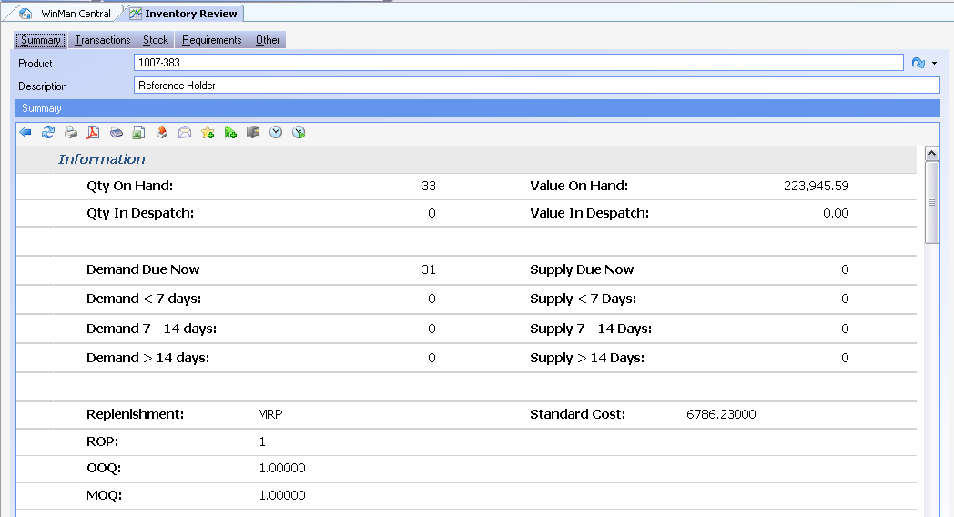
Inventory Review
Summary Tab

Slide 5
Inventory Review
Summary Tab
Qty on Hand – The quantity of the item on hand excluding items with availability of N
Value on Hand – The value of the inventory on hand
Qty in Despatch – The quantity of the item on un-finalized shipments
Value in Despatch – The value of the item on un-finalized shipments
Demand now due – Firm demand that has a due date less than or equal to the current date. Demand would be any requirements in WIP or any sales orders
Demand < 7 Days – Firm demand that is due in less than 7 days
Demand 7-14 Days – Firm demand that is due between 7 and 14 days
Demand > 14 Days – Firm demand that is due after 14 days

Slide 6
Inventory Review
Summary Tab
Supply now due – Firm supply that has a due date less than or equal to the current date. Supply would be any Purchase Order or any Manufacturing orders
Supply < 7 Days – Firm Supply that is due in less than 7 days
Supply 7-14 Days – Firm Supply that is due between 7 and 14 days
Supply > 14 Days – Firm Supply that is due after 14 days
Replenishment: The method of replenishment from the Replenishment Tab in Products
ROP: The Re-Order point from the Replenishment Tab in Products
OOQ – The optimum order quantity from the Replenishment Tab in Products
MOQ – The minimum order quantity from the Replenishment Tab in Products
Standard Cost – The total standard cost for the item from the Costs Tab in Products

Slide 7
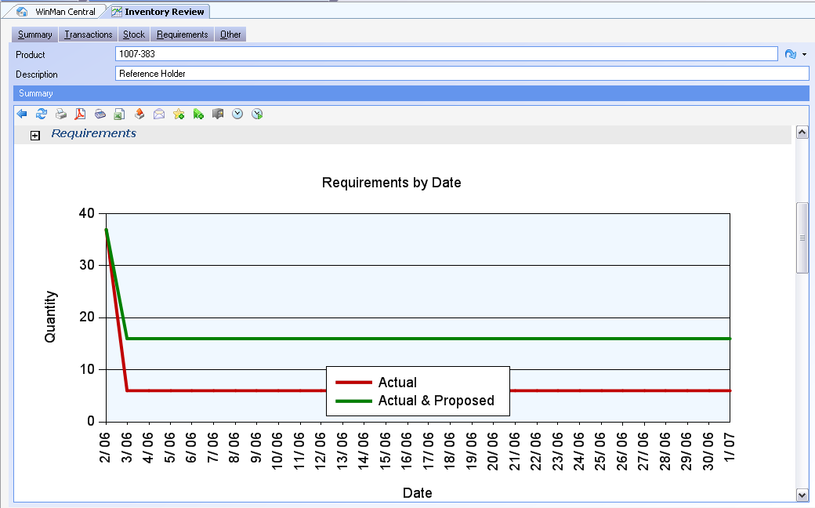
Inventory Review
Summary Tab
Requirements graph shows supply and demand as an aggregate quantity against the next 30 days.
Line graphs will show only Actual requirements as well as All requirements (including proposed and firm requirements)

Slide 8
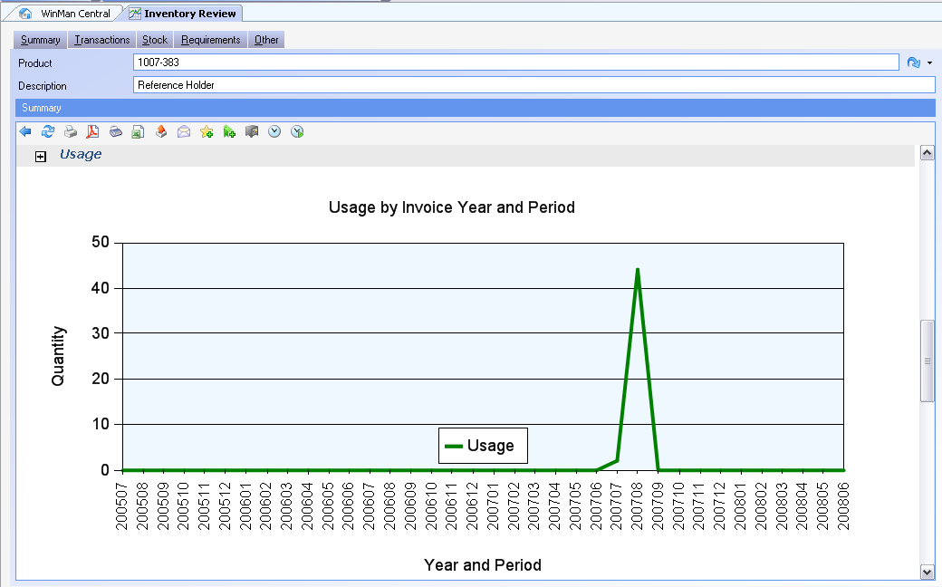
Inventory Review
Summary Tab
Usage will show all sales of the items by GL year/period

Slide 9
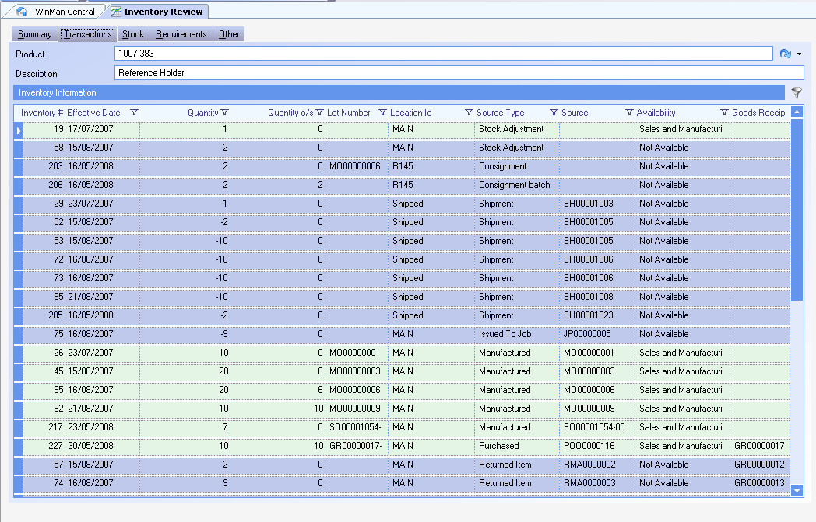
Inventory Review
Transactions Tab
The Transactions tab is a detailed listing of all the transaction for a part.

Slide 10
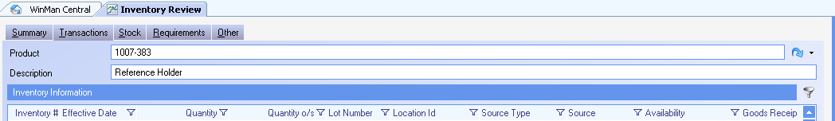
Inventory Review
Transactions Tab
An automatic filter is placed on the screen showing all transactions that have an outstanding balance, as well as all transactions that are less than 90 days old.
SYSTEM SETTING: The number of days of old transactions included on the inventory review screen is set to 90 but can be changed. Use the Inventory Review system option Days to look back to change the number of days. Enable the option and set the value to the number of days. With a high number of daily transactions, it is better to set this number lower, but if there is a low number of daily transactions it would be okay to increase the number. The more transactions that need to be returned from the server the longer it will take for the screen to populate with data.
The filter can be changed by clicking on the Funnel as indicated below.

Slide 11
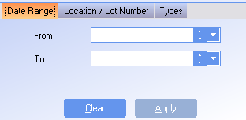
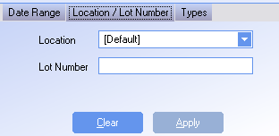

Inventory Review
Transactions Tab
Use the filter to change the default filter by;
From Date – Go back in history more than 90 days (or the number of days in the option)
To Date – Filter up to a specific date
Location – Filter a specific location
Lot Number – Filter a specific lot number or serial number
Source – Filter a specific type of transaction
Availability – Filter a specific availability
Show Detailed Shipments – Show picking records for shipments

Slide 12
Inventory Review
Right Click on a Batch Actions
View – View the transaction
Change Availability – Change the current availability of the batch. See locations and areas for a list of Availabilities and their functions. No accounting transaction takes place.
Decrease Quantity – A stock adjustment to decrease the quantity. A stock adjustment reason code must be selected to generate the accounting transaction.
Change Value – A stock adjustment to increase or decrease the value of the batch. A stock adjustment reason code must be selected to generate the accounting transactions.
Change Location – Select the location an item is to be moved to. An accounting transactions will take place as the inventory GL account used, will reflect the division of the location the item is moved to.
Change Lot Number – Change the lot number of the batch. Lot numbers are automatically generated for transactions. Goods Receipts use the Goods receipt number and the line number, and Manufacturing Orders us the Manufacturing Order number. The lot number field is also used as the serial number field if serial numbering options are being used. No accounting transaction takes place.

Slide 13
Inventory Review
Right Click on a Batch Actions
Change Expiry Date – Change the Expiration date of a batch. No accounting transaction take place
Split Batch by Serial Number – This will take a batch of inventory and split it into individual items and assign a serial number to each item. No accounting transaction takes place.
View Source – View the source of the transactions. If the item is a purchased item, purchase order and goods receipt information can be viewed. If an item is a manufactured item, the manufacturing order can be viewed.
Return Components to Stock – A manufactured item will be stock adjusted off hand and all the components will be put on hand. An option to explode transients is available if a transient item should not be put on-hand.
Create a Re-Work Order – A re-work manufacturing order will be created for the item selected, and have as the only component on the order, the item selected. Any costs associated with the work order are added and the item is put back in stock when the order is completed.
Return to supplier – A return to supplier record is created. See the guide on Supplier Returns for processing instructions.

Slide 14
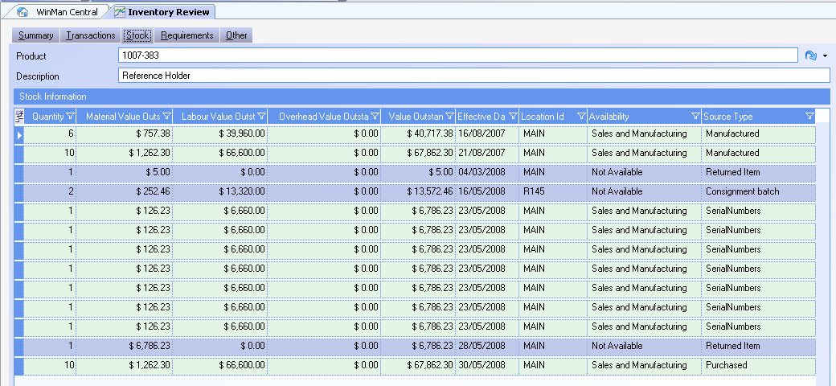
Inventory Review
Stock Tab
The stock works exactly the same as the Transaction Tab, however it has an additional filter that only shows transactions that have a quantity outstanding greater than 0.

Slide 15
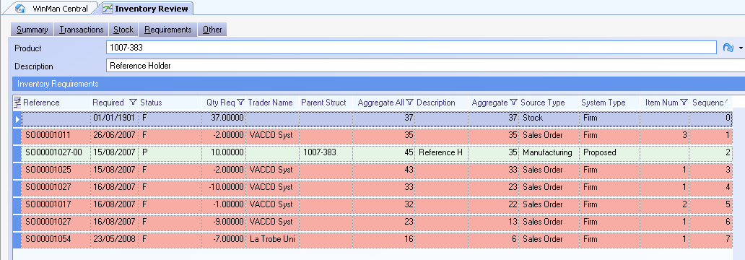
Inventory Review
Requirements Tab
The requirements tab shows all the supply and demand for the item in real time. Note that there are 2 columns that show aggregate totals. The Aggregate column shows only transactions that are firm, while the Aggregate All column shows all transactions including proposed items.
SYSTEM SETTING: By default, the stock record does not include items in locations that are set to Exclude from MRP. If items in locations that are designated Exclude from MRP should be included in the stock total, use the Inventory Review system option Include MRP excluded locations in requirements tab. Enable the option and set the value to Y to include these items.

Slide 16
Inventory Review Actions
Actions
The Search dialog allows you to search for a part. The drop down selection below it allows you to pick the version of the product.
Increase Inventory – Will allow you to create a stock adjustment to increase the quantity of the item on hand. The value of the item will default to the total standard cost. A stock adjustment reason code must be selected before the transaction can be completed.
Tools → Inventory Creation → Import– A spreadsheet can be used to import inventory as part of a large stock adjustment. This is used when another company is purchased and the inventory must be added to WinMan.
Tools → Inventory Maintenance→Bulk location Transfer – If a large quantity of items from multiple batches from a location need to be moved to another location the Bulk location transfer can be used. This will use FIFO and move items from a location to another location. If the item is in a single batch, the Right Click option to Change Location will do the same thing.
SYSTEM SETTING: By default, when stock is increased the default value is the Material cost ONLY. Use the Inventory Review system option Use total cost for default unit value when increasing inventory to have a default value of the total standard cost. Enable the option and set the value to Y

Slide 17
Inventory Trace
The inventory trace program is a way to track the history of a lot number. To use the program enter the lot number into the search dialog. The header will display the original quantity of the batch, the location as well as the quantity outstanding.

Slide 18
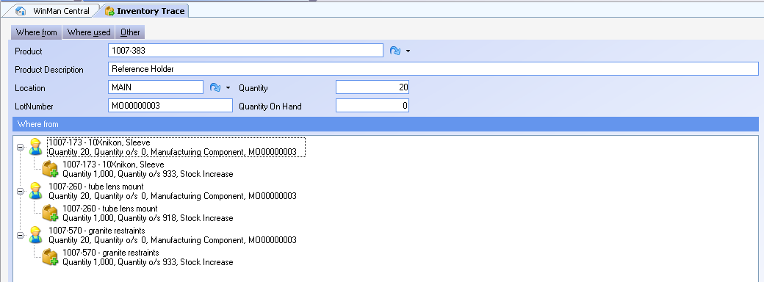
Inventory Trace
Where From Tab
The Where From dialog will show for manufactured parts, the lot numbers that went into the item. The Where From dialog will not show any data for purchased Parts.

Slide 19

Inventory Trace
Where Used Tab
The Where Used Tab will show where the item was consumed. This could be a manufacturing order, or a shipment.

Slide 20
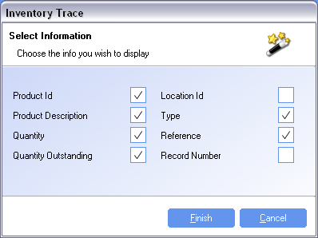
Inventory Trace
To view entire detail of a batch in the Where From or Where Used tab, right click on the line and select the option Set as Base Record. This will become the new header and all detail can be reviewed for the batch.
To view the transaction, right click on the item in the Where Used or Where From tab and select Go to… and select the program to view the transaction.
Action – Select Information
Users can select from the following fields to display for batches found in the Where Used or Where From tabs

Slide 21
Product Training Stock Counting
Where “Lean” principles are considered common sense and are implemented with a passion!

Slide 22
Inventory
The procedures and processes to ensure that perpetual inventory levels are accurate and remain accurate.

Slide 23
Inventory
ABC Classifications
Cycle Counting
Physical Inventory

Slide 24
Inventory – ABC Classifications
Based upon Pareto Principle of 80/20 (in his case he was talking about wealth distribution)
“A” parts are the most important and valuable parts, typically 70% of total value
“B” parts account for the next 20% of value
“C” parts are the remaining 10%

Slide 25
Cycle Counting
Cycle Counts are conducted regularly to validate the perpetual inventory levels. Often, a strong cycle count program will eliminate the need for an annual physical inventory.
Items are counted at regular intervals. These intervals are determined by the item classification.
Cycle Counts (and physical counts) only count inventory. This does not include items issued to Manufacturing Orders.

Slide 26
Cycle Counting & ABC Parts
The “ABC” code determines the frequency that an item is counted. Since “A” items represent the most inventory dollars or importance, we want to count them frequently. “C” items represent low value, therefore we have no need to count them often.

Slide 27
Cycle Counting & ABC Parts
An example of count intervals
“A” Items count every 30 days
“B” Items count every 90 days
“C” Items count every 365 days
Count intervals are defined by your needs. They are user definable.

Slide 28
Defining Classes
WinMan ranks all of your items according to overall value usage over time based upon actual cost. The highest value is rank #1, next #2 etc. Once this ranking has been done, you have choice of three options to classify items.

Slide 29
Inventory Class by Rank
Classifying by rank means that you want to designate the absolute ranks that make up Class “A” items and Class “B” items. The remaining items will be Class “C”.
To set the top 25 parts to be “A”, and next 50 to be “B” with the remaining “C”:
Class A – Up to rank 25
Class B – Up to rank 75
All other items will be designated as “C” parts.

Slide 30
Inventory Class by Individual Percentage
Each item has an overall usage value that can be expressed as percentage of the Total Overall Usage of all products in WinMan. An item with an overall usage of $150 where the total overall usage for all items is $1,000 has an individual usage percentage of 15%.
The criteria for determining the part classification is defined by the low threshold. That is, if we wanted to designate “A” items as those items that were at least 10% of the total overall usage, 10% would be threshold for “A” classification. Any item that was 9% of the total overall usage would fall into the next classification. The threshold for “B” items must be lower than that of the “A” items. Thresholds are only specified for “A” and “B” items. Anything not falling under either A or B will be classified as a “C” item.

Slide 31
Inventory Class by Total Usage
This is similar to rank, but in this case, WinMan considers the total overall usage percentage.

Slide 33
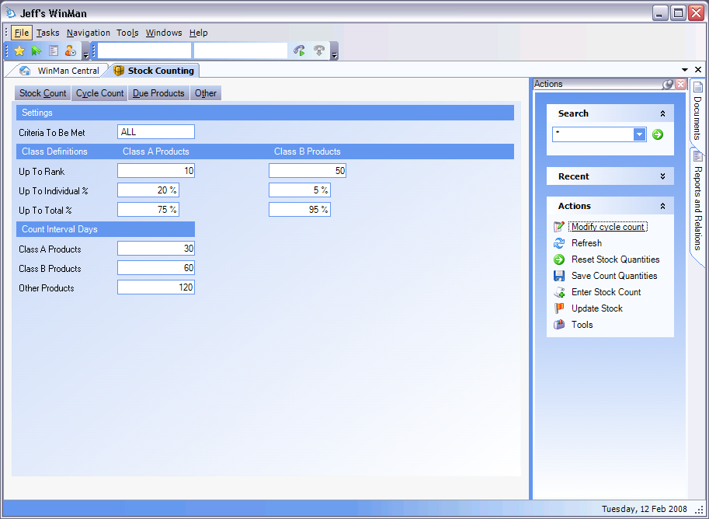
Setting Inventory Item Class Criteria
By Rank
By Individual Percentage
By Total Percentage
If “ALL”, then all of the conditions must be met, otherwise just satisfying one condition sets the class.
Cycle Count Interval

Slide 34
Modifying Item Class Criteria and Intervals
Inventory -> Stock Counting
Select an Item (any item will work)
Click on “Modify Cycle Count”
Click “OK” to save

Slide 35
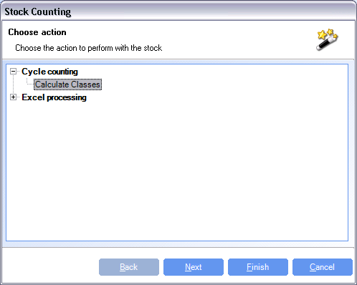
Inventory Classification - Applying
In the “Actions” area, select “Tools”

Slide 36
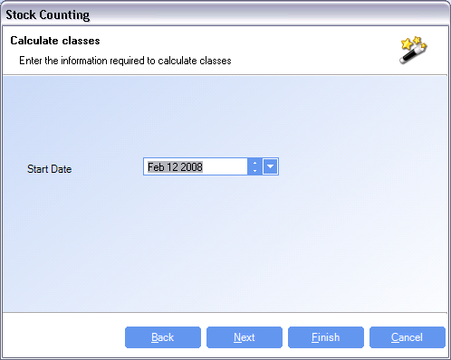
Inventory Classification - Applying
Select the start date for usage calculation:
Click “Finish” to update the ABC classifications.
Usage is defined as WIP issues and shipments.

Slide 37
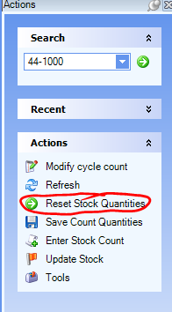
Cycle Counts – Reset Stock Quantities
Click on the Action “Reset Stock Quantities”
This creates a snap shot of your inventory levels so that when you apply the counts the system and adjust the count as it was and you can continue to do your work. For example:
106 – Item A – Perpetual
103 – Cycle Count (not applied yet)
After the cycle count was completed transactions were allowed to begin again.
71 – Issue 35 (106-35)
Now we apply the cycle count of 103.
68 – Perpetual is set at 68 (71 + (103 - 106))

Slide 38
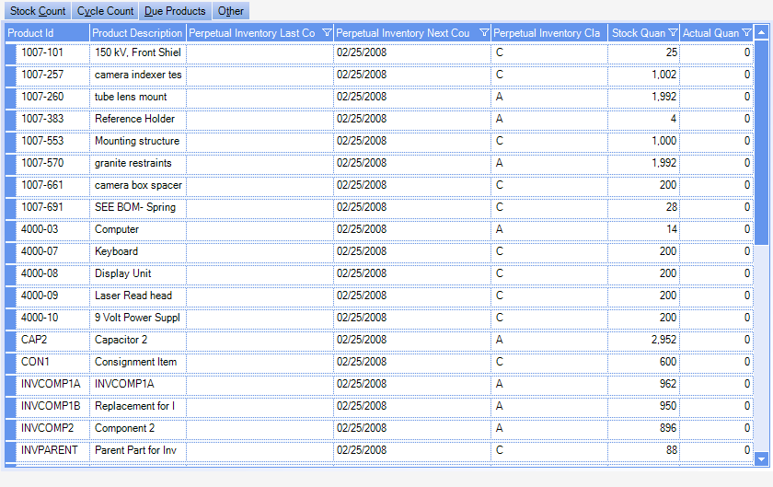
Cycle Counting – Due Products

Slide 39
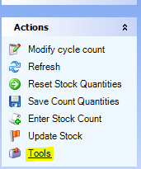
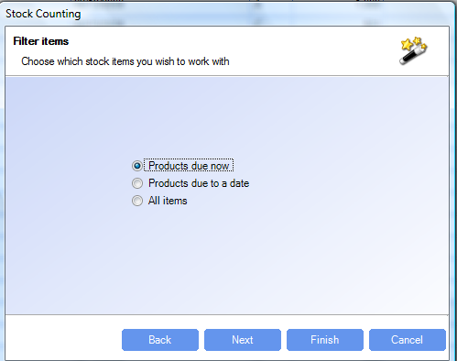
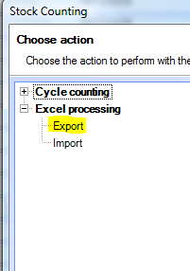
Cycle Counting – Exporting to Excel

Slide 40
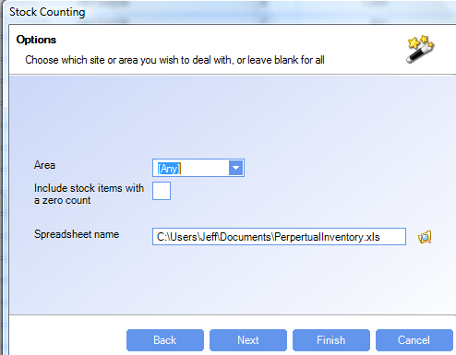
Cycle Counting – Exporting to Excel
All areas are listed in the drop down box, allowing the materials group to limit the cycle count list to a single area.
Note the check box which allows for or eliminates items with a zero count.
If you have several areas you might want to print out one sheet per area.

Slide 41
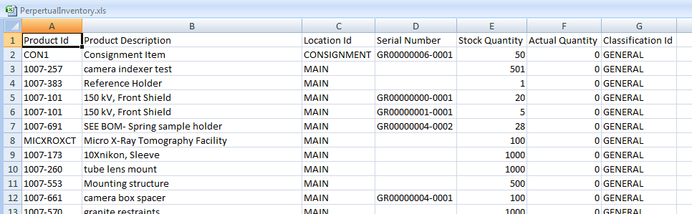
Cycle Counting – Exporting to Excel
Note that the actual quantity is 0 when you generate the spreadsheet. The person doing the cycle count will put in the actual quantities.

Slide 42
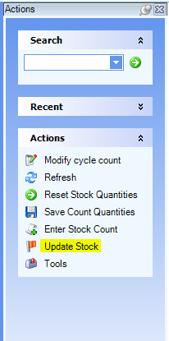
Cycle Counting – Adjusting the Inventory
Import Excel Spreadsheet Follow the wizard
Select “Save Count Quantities” once the Excel file has been imported.
In “Actions”, click on “Update Stock”

Slide 43
Cycle Counting – Adjusting the Inventory
SYSTEM SETTING: When an item has a net quantity gain due to a stock count, the value of the item added from the adjustment is the average cost as found in Products. Use the Stock Counting system option When increasing inventory, use (A)verage existing stock cost, (T)otal standard cost or (M)aterial standard cost for alternate costing. Total standard cost will use the total standard cost of the items as found in Products, and Material standard cost will use only the portion of standard cost related to material. Use A, T or M as values for the type of costing required.
SYSTEM SETTING: In cases where the average cost has no value, the system can alternatively use the total standard cost or standard material cost in place of the average. Use the Stock Counting system option When increasing inventory and no average cost is available, enable to use the total standard cost, enable the option and set the value to Y to use total standard cost. If the option is not enabled, the standard material cost will be used.

Slide 44
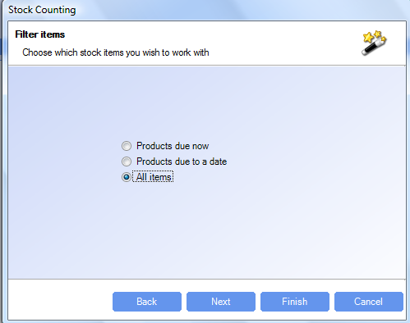
Physical Inventory
The process for taking and reporting the physical inventory is identical to cycle counting with the exception for the items to choose, “All Items”.
ABC classes also are not needed if only physical counts will be used

Slide 45
Product Training
Manufacturing Orders
Where “Lean” principles are considered common sense and are implemented with a passion!

Slide 46
Manufacturing Orders
Manufacturing Orders are used to make assemblies or finished goods. Raw materials are consumed and the parent item is produced.
Manufacturing orders have the item to be completed in the header and the components to be consumed as line items

Slide 47
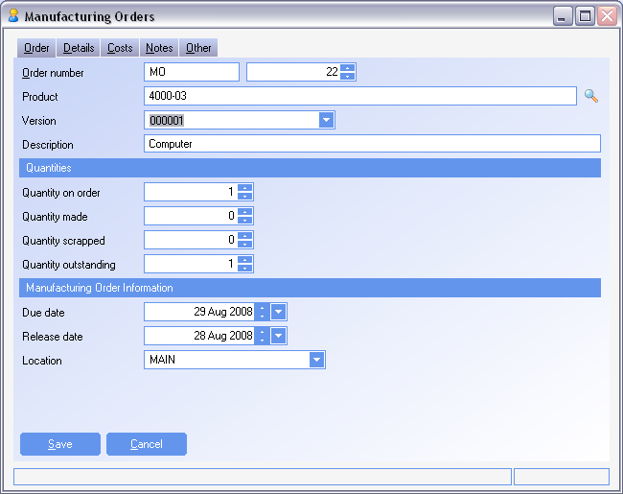
Manufacturing Orders
Order Tab
Order number - Determined by the prefix selected. Prefixes can be defined in the Manufacturing Order Prefixes module.
NOTE: A default prefix can be set up in the System Options module, on the General Tab for each site.
Product - selected items must be a manufactured item
Version - The default version from products
SYSTEM SETTING: The default length of a Manufacturing Order number is 10 characters. To change this, use the Manufacturing Orders system option Manufacturing order identifier length. Enable the option and set the value to required length. Maximum length is 20 characters

Slide 48
Manufacturing Orders
Order Tab
SYSTEM SETTING: The next number as found in the Manufacturing Order prefixes will be defaulted. To remove the ability to change the MO number, use the Manufacturing Orders system option Determines whether you can change the MO number when entering an MO. Enable the option and set the value to N to prevent number changes.
SYSTEM SETTING: A specific Prefix can be used for MO’s created from Kanbans. Use the Manufacturing Orders system option Manufacturing orders kanban prefix. Enable the option and set the value to the Prefix required. The Prefix must exist in the Manufacturing Orders Prefix module or the default prefix will be used.
SYSTEM SETTING: A specific Prefix can be used for MO’s created as re-work from the RMA. Use the Manufacturing Orders system option Manufacturing order prefix for re work orders. Enable the option and set the value to the Prefix required. The Prefix must exist in the Manufacturing Orders Prefix module or the default prefix will be used.
SYSTEM SETTING: A specific Prefix can be used for MO’s created from an import. Use the Manufacturing Orders system option Manufacturing order prefix for imports. Enable the option and set the value to the Prefix required. The Prefix must exist in the Manufacturing Orders Prefix module or the default prefix will be used.

Slide 49
Manufacturing Orders
Order Tab
Quantity on order - Must be a positive number and is the number of assemblies being made
Quantity made - The number of items already completed. Partial finishes of a Manufacturing Order are allowed.
Quantity Scrapped - The number of items scrapped when finishing items
Quantity Outstanding – Calculated as (Quantity on order – Quantity made – Quantity Scrapped)
Due Date – The date the manufacturing order is scheduled to be completed
Release Date – The date the manufacturing order is scheduled to be started. The difference between the Release Date and Due Date is the procurement lead time as found in products for the assembly.
Location – The location as it is found in Products for the assembly. This is the location that the item will be finished to.

Slide 50
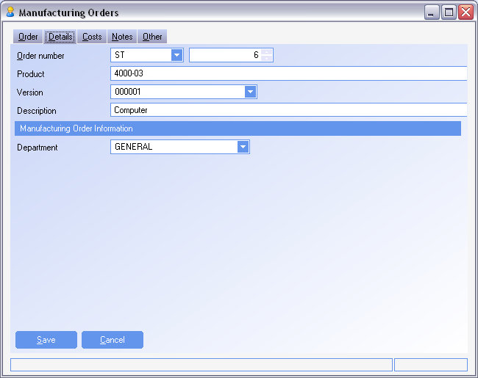
Manufacturing Orders
Details Tab
Department – The department as it is found in the products module for the assembly. This could be a planner or department responsible for the MO.

Slide 51
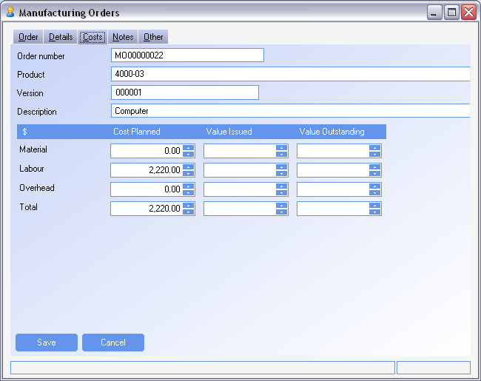
Manufacturing Orders
Costs Tab
Planned Costs – The standard costs of the assembly from Products when the MO is created
Value Issued – The value of the WIP that has already been issued to the MO.
Value Outstanding – The difference between the Planned and Issued values.

Slide 52
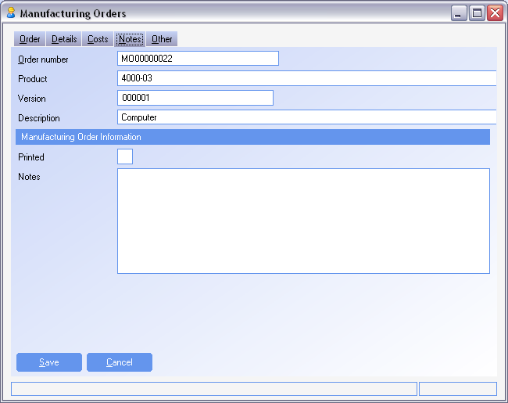
Manufacturing Orders
Notes Tab
Printed – Indicates when the Picking Note has been printed. Automatically updated, and used for reference
Notes – Any notes that relate to the Manufacturing Order

Slide 53
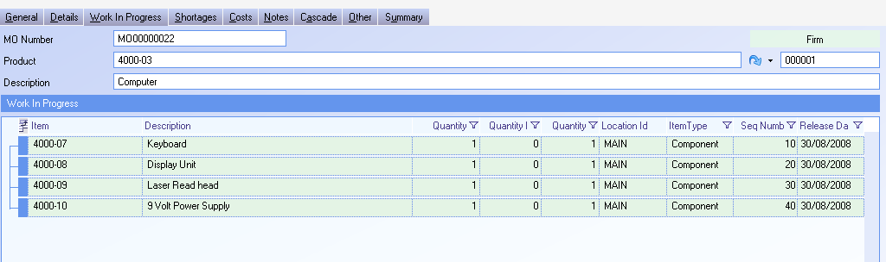
Manufacturing Orders
Work In Progress
WIP lines are created based on the Bill of material and can be viewed on the Work in Progress Tab
All components on the bill of material that have a valid effective date when compared to the release date of the Manufacturing Order will be included as a component on the MO
The bill of Material is locked in once the MO has been firmed.

Slide 54
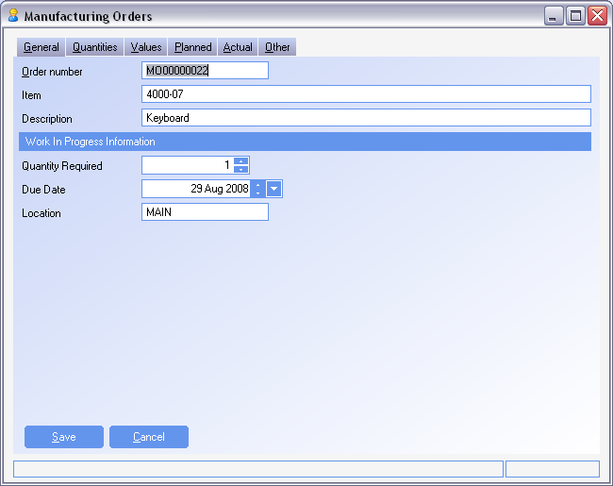
Manufacturing Orders
Work In Progress – General Tab
Quantity Required – The quantity to be issued to the work order. This is defaulted from the Bill of Material
Due Date – The Date the MO is to be completed.
Note: When using offset lead-times, the offset will be added to the release date for each line item. Release dates can be viewed on the WIP tab, in the grid.
Location – The initial location that the items will be consumed from.

Slide 55
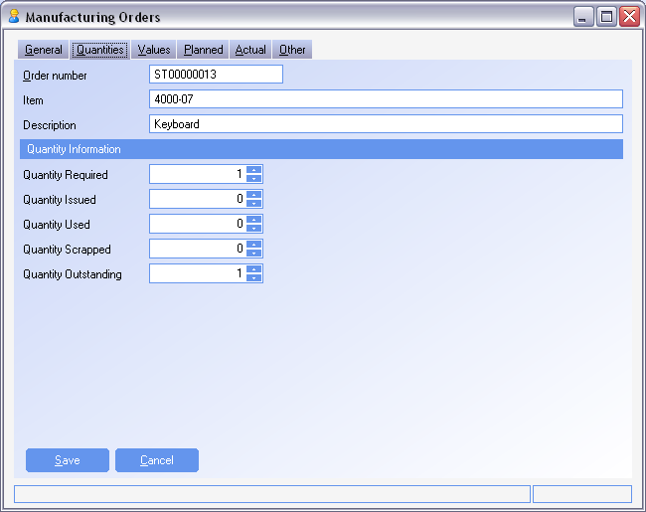
Manufacturing Orders
Work In Progress – Quantities Tab
Quantity Required – The quantity to be issued to the work order. This is defaulted from the Bill of Material
Quantity Issued – The quantity issued to the MO for that component
Quantity Used – The quantity consumed when finishing assemblies
Quantity Scrapped – The quantity scrapped for the line item
Quantity Outstanding – The net quantity still to be issued to the work order

Slide 56
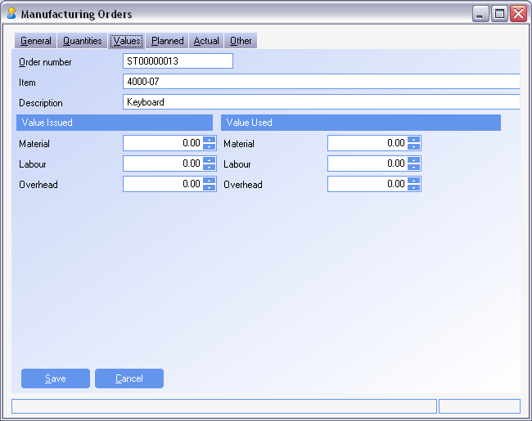
Manufacturing Orders
Work In Progress – Values Tab
Issued Values – The valued that have been issued for the specific component to the Manufacturing Order
Used Values – The values that have been consumed with any completions of the parent assembly

Slide 57
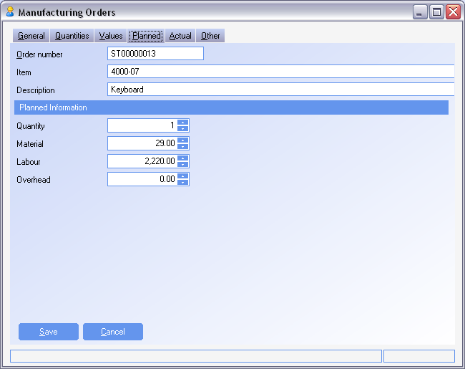
Manufacturing Orders
Work In Progress – Planned Tab
The standard quantity and values when the Manufacturing Order was firmed and the WIP was created

Slide 58
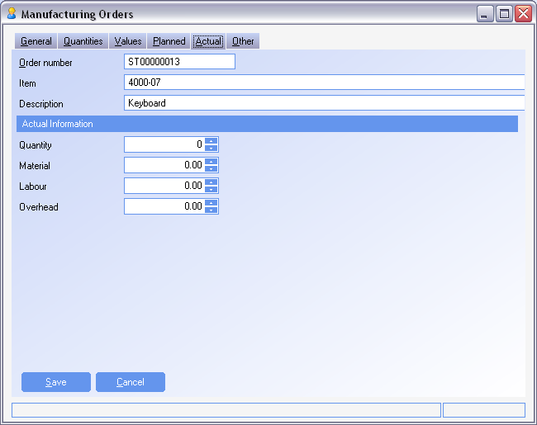
Manufacturing Orders
Work In Progress – Values Tab
The actual quantity and values that were issued to the Manufacturing Order

Slide 59
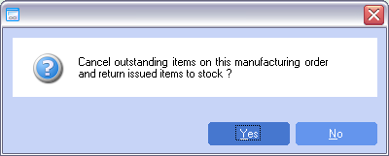
Manufacturing Orders
Actions – Cancel Remainder
Cancel Remainder will return any items that have not been consumed to inventory
Any outstanding quantity in the manufacturing order header will be cancelled and the MO will be closed

Slide 60
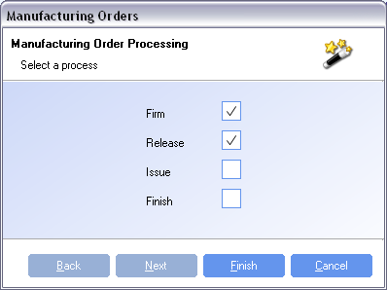
Manufacturing Orders
Actions – Process
Firm – Used to lock in the Bill of Materials
Release – Releases the order to the floor
Issue – Issues items from inventory into Work In Progress. The system by default will issue the components based on FIFO. To select a specific batch to issue, go to the Work In Progress tab and right click on the line item and select Issue.
Finish – Competes the manufacturing order and puts the assembly into stock. Using Finish via the Process Action will only complete the MO if there are no shortages and will also make all items on order.
In order to finish the manufacturing order short or to scrap any of the assemblies, use Finish via Actions as discussed later

Slide 61
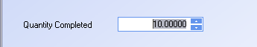
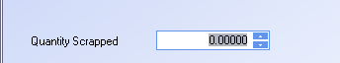
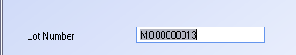
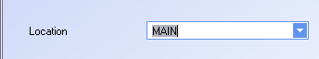
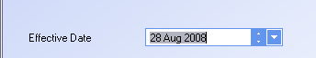
Manufacturing Orders
Actions – Finish
Finish will complete items on the Manufacturing Order. Components will be consumed and a finished assembly will be completed to inventory
Quantity Completed – The quantity that is finished. This should be less than or equal to the quantity outstanding. Excess stock can be created, but Admin security for Manufacturing Orders is required for processing
Quantity Scrapped – When using actual cost, the value of the items being scrapped will be applied to the finished items
Lot Number – The MO number is automatically assigned but can be changed.
Location – The location from the MO header for where the items are to be finished to
Effective Date – Defaults to the current date, and used for accounting purposes to determine which period the transaction will post to.

Slide 62
Manufacturing Orders
Actions – Finish
When manufacturing, if more than 1 item is to be completed from a Manufacturing Order, a negative line item can be added and placed into inventory when the MO is finished (By-Product).
The By-Product can also be added as a negative requirement to a Manufacturing Order in cases where the By-Product is not planned
SYSTEM SETTING: The ability to not allow by-products to a Manufacturing Order can be turned off by using the Manufacturing Orders system option Allow negative issues to components. Enable the option and set the value to N to prevent By-Products from being added to the Manufacturing Order
SYSTEM SETTING: When By-Products are created, they are put into stock in the location found in Products for the By-Product. The location that they are finished to can be controlled by the location found on the WIP line. Use the Manufacturing Orders system option Manufacturing Orders by products use WIP location, enable the option and set the value to Y to use the WIP location.

Slide 63
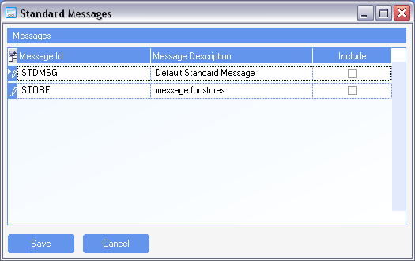
Manufacturing Orders
Actions – Add Message
Standard Messages can be added to a Manufacturing Order by selecting the Add Message action. Check the Include column to include a message and un-check to remove a message

Slide 64
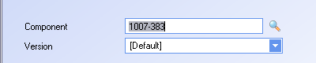
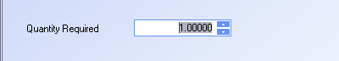
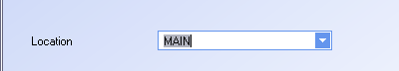
Manufacturing Orders
Actions – Add Component
Components can be added to a manufacturing order that were not on the Bill of Material by using the Add Component action
Select the component to be added
Select the quantity to be added
Select the location for the component
Add any notes that might be applicable for why the component is added.
Note: If a quantity change is required to an existing item, a new item does not need to be added
Note: If partial finishes are being used, and a component is added as a substitute, the original components should be finished, before the substitute is added to ensure proper costing

Slide 65
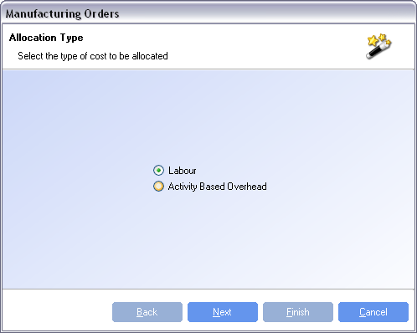
Manufacturing Orders
Actions – Add Cost
Labor and routing costs can be added to a Manufacturing Order using the Add Cost Action.
When using Standard costing for Labor or Activity Based costing, the costs will be recovered automatically and do not need to be added using this feature
If Actual Labor or Actual Activity Based costing is required, use this action to add costs to the manufacturing order before it has been finished.

Slide 66
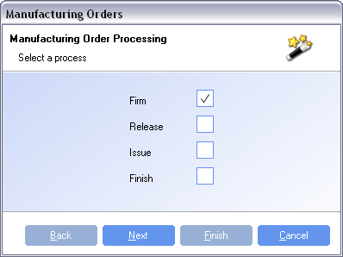
Manufacturing Orders
Actions – Mass Process
The Mass Process is only available from the Summary Tab in the Manufacturing Orders module.
Manufacturing Orders can be selected and processed as a group. The process selected will be applied to all MO’s selected for mass processing.
To select an item for mass processing, check the Include column for the required work order in the Summary Tab.

Slide 67
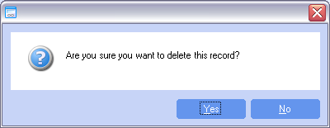
Manufacturing Orders
Actions – Delete
The Delete action will delete an order that has not had any completions.
Any items that have been issued to the Manufacturing Order will be returned to stock
When the order status is completed, it can not be deleted
When a partial completion has been done, use the action Cancel Remainder to close out the remaining items on the Manufacturing Order

Slide 68
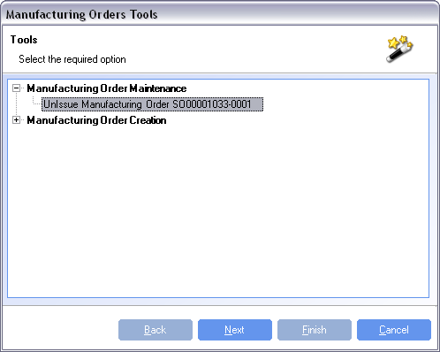
Manufacturing Orders
Actions – Tools
An entire Manufacturing Order can be returned to stock using the Tool UnIssue Manufacturing Order XXX.
To return individual items, expand the WIP line and right click on the batch. Select the action to Return to Stock.

Slide 69
Product Training
Manufacturing
Planning and Execution
Where “Lean” principles are considered common sense and are implemented with a passion!

Slide 70
Definitions
There are two major groups of activities in manufacturing. Planning and execution.
Planning Activities include:
Forecasting
Master Scheduling
MRP
Production Scheduling
Inventory Planning
Execution Activities include:
Material Issues
Material Receipts
Production Reporting
Order Launching (Purchase Orders and Manufacturing Orders)
Product Movement
Inventory Management (Replenishment and supply)

Slide 71
Manufacturing System Goals
Balance Supply and Demand
Time phase supply and demand
Alert management to problems
Shortages
Missed Dates (Production)
Missed Dates (Suppliers)
Maintain Order (formal system as opposed to informal)
All information in one place
Maintain Service Levels

Slide 72
Supply and Demand
Supply is the material/resources needed to make the product.
Demand is the amount of product required.
Independent Demand is demand generated by sales orders, master schedule, forecast, etc. For our pointer company, the only item that has only independent demand is the Laser Pointer. Generally, independent demand is determined by the market place.
Dependent demand is demand that is derived from another item. For instance, our logic boards derive their demand from the Laser Pointer. If logic boards were also sold as a repair part, then the board would have a demand component that is dependent (based upon Laser Pointer demand) and independent demand driven by the repair part sales.

Slide 73
Deriving Demand Requirements
Lean:
KanBan
Supermarkets
Traditional:
MRP
Reorder points
Companies starting on the lean journey may use all of these techniques.

Slide 74
Traditional & Lean Defined
We define “Traditional Manufacturing” as MRP driven processes using work orders and large batch quantities with the emphasis on measured efficiencies and volume produced. Product is “pushed” through the plant.
Lean is defined as a “visual” factory where demand drives production creating a “pull” system. That is only things that are required are made or purchased. Cells, kanbans, TQM and continuous improvement, identifying and eliminating waste, and visual signals are things generally associated with lean. Lean is as much a discipline as a process.

Slide 75
Kanban
A kanban is a visual signal, usually a card, that causes (indicates) movement of materials. This movement can be from a supplier, within the plant, to another plant, or to the customer.
A kanban is a pull signal to the supplier from the customer.

Slide 76
Supermarket
In lean, production is triggered by demand. Kanbans and/or customer orders is the triggering event. Lean flow can only be achieved where one piece flow (or some reasonable quantity) can happen. Value Stream mapping begins at the customer and works its way backwards. Where flow within the value stream ends a mechanism needs to be in place that can properly supply the part of the value stream that flows. The Supermarket is used for that. It gets its name from the local grocery store that stocks items for purchase and replenishes those items as rack space appears. Plant supermarkets work in precisely the same manner. The supermarket serves as in inventory buffer.

Slide 77
Reorder Points
Reorder points are set for each item. When inventory falls below the set point, the system will issue a proposed order for the item. For purchased parts it will be a proposed purchase order, for manufactured parts it will be a proposed manufacturing order.

Slide 78
MRP
MRP balances supply and demand in a time phased manner. It evaluates all of the demand and calculates the when and how much is needed to meet the demand.
MRP’s goals are:
To have the correct inventory at the correct time
Minimize inventory levels but maintain customer service levels
High levels of production efficiencies
Order consolidation
Time Phasing

Slide 79
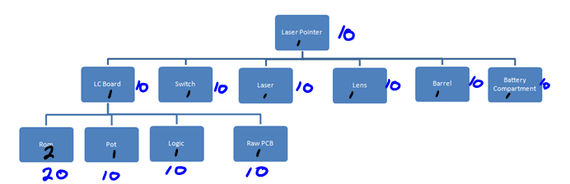
MRP
MRP calculates the requirements by time and quantity.

Slide 80
MRP Calculations
A
B
C
D
E
Parent
2nd Level
3rd Level
Assume 1 of each component to make a parent. Also assume 2 period lead time. If there is a demand for 6 A’s in period 7 then the MRP would calculate the requirements as below.
Time | 1 | 2 | 3 | 4 | 5 | 6 | 7
Required |  |  | 6C, 6D |  | 6B, 6E |  | 6 A
Start | 6C, 6D |  | 6B, 6E |  | 6A

Slide 81
MRP Calculations
In the previous example, there was no consideration to on hand inventory or other demands. For instance, if we used the same logic board for other products there would be additional demand on it. MRP calculates the demand by using simple calculations for each demand period.
Demand
Gross Requirements - On Hand Inventory - Quantity On Order

Slide 82
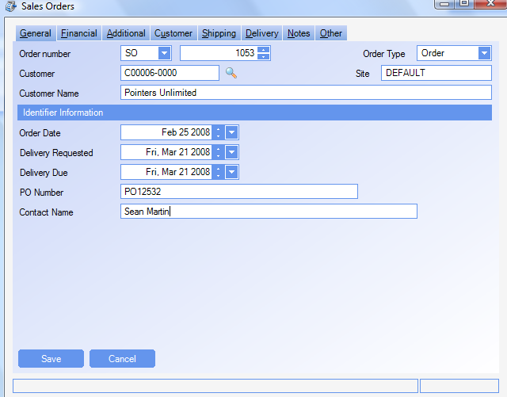

MRP Demand
MRP calculated dependent demand. Independent demand comes from orders and forecasts.
Due date March 21, 2008
Notice the available to promise.

Slide 83



MRP Demand
After running MRP we can see our demand and where it came from.

Slide 84

MRP Demand
MRP also suggests purchases based upon requirements. If some items were in stock, MRP would lower its recommendations accordingly.

Slide 85

MRP Demand
Delivery due 3/21
MRP sets Manufacturing Order due date 3/20 for Laser Pointer
release date 3/18
Subassembly Logic Board due date is 3/17 so it can be supplied on 3/18
release date 3/13 (order spans weekend)
Laser Pointer components due 3/17
Logic Board components due 3/12
SYSTEM SETTING: When calculating due dates for manufactured items, the manufacturing calendar will be used to determine the due date. By default if the lead time of the item is less than 90 days the manufacturing calendar will be used. If the lead time is greater than 90 days, WinMan will use an open calendar and simply count calendar days. Use the MRP system option Number of days leadtime after which working days will not be taken into account, to increase the number of days that the manufacturing calendar will be used. Enable the option and set the value to the number of days required, typically the longest lead time for a manufactured item.

Slide 86
Executing the MRP Plan
The process begins with the buyers who review the Orders Summary Processing screen which shows by Supplier, proposed purchase orders.
Suggested suppliers are determined by the supplier cross reference. When multiple supplier cross reference records exist, the supplier with the lowest sequence number with a lead time within the requirement will be selected
SYSTEM SETTING: To always use the supplier with the lowest lead when the due date can not be met by any supplier select the Supplier Cross Reference system option Determines whether the supplier with the lowest lead-time gets selected if no records meet the due date criteria. Enable the option and set to Y to use shortest lead time as the criteria for selecting a supplier.
SYSTEM SETTING: To always use the default supplier use the MRP system option Always use the default supplier regardless of leadtime. Enable the option and set the value to Y to always use the supplier with the lowest sequence number regardless of leadtime.
Note: This profile will override the above setting if both are used.

Slide 87

Executing the MRP Plan
All of the items for a supplier can be chosen by clicking on the “Include” checkbox for the supplier.

Slide 88

Executing the MRP Plan
All of the items for a supplier can be chosen by clicking on the “Include” checkbox for the supplier. Next we firm up the proposed orders.

Slide 89

Executing the MRP Plan
Once the proposed orders have been firmed, they can be viewed on the Generated Orders tab. Orders can be drilled down to for final review and sending of the Purchase Order to the vendor
SYSTEM SETTING: When orders are firmed, by default a Firm purchase order is created. To have New purchase orders created (and manually Firm the PO) use the Orders Summary Processing system option Create and use existing new orders instead of firm orders. Enable the option and set the value to Y for New orders to be created.

Slide 90

Executing the MRP Plan
The next step is to launch the order with the supplier, receive the parts then begin working on the subassembly, the 44-1500 (Logic Board).

Slide 91
Executing the MRP Plan
Manufacturing Orders generated by MRP are created as Proposed.
Proposed orders do not have their requirements fixed until the order has been firmed. Making changes to a Bill of Material for a proposed item will have the changes generate requirements the next time MRP is run.
SYSTEM SETTING: Proposed manufacturing orders generated in MRP will have a default prefix of MRP. To change this prefix, use the MRP system option MRP proposed manufacturing orders prefix. Enable the option and set the value to the required prefix.
SYSTEM SETTING: When the proposed manufacturing number becomes to large, the MRP manufacturing order number can be reset to 1. Use the MRP system option Resets the manufacturing orders counters to 1, enable the option and set the value to Y to reset the value.
NOTE: Once MRP has run and reset the counter, you must disable this option or each subsequent MRP run will reset the counter.

Slide 92

Executing the MRP Plan
The final step is to finish the order. This step receives the final assembly into inventory.

Slide 93
Other MRP Options
SYSTEM SETTING: MRP will generate proposed orders when the items are required. Use the MRP system option Consolidate orders within leadtime, to combine orders within the lead time of the item into 1 order. Enable the option and set to Y to use this setting. This is especially helpful for items that have long set-up times.
SYSTEM SETTING: By default, when MRP generates orders, it will suggest the date before it is required. For example, if a WIP component is required on Oct 26, the PO for the component will have a due date of Oct 25. WinMan can use “Optimistic” logic where the component will be scheduled to arrive the same day as required. In the example above, the PO would have a due date of Oct 26. To use this functionality, enable the MRP system option Use optimistic logic for supply and demand on the same day, and set the value to Y
SYSTEM SETTING: A planning buffer can be used to add additional time to the procurement lead time to add safety time. A planning buffer exists at the product level, and will be used over the global setting. To use a global setting, enable the MRP system option Planning buffer, and set the value to the number of days that should be added to the lead time
Note: Buffers allow waste to be created so caution should be used with buffers
SYSTEM SETTING: When using re-order points, a proposed order will be created regardless of demand. Use the MRP system option Re order products when there is no demand to not create proposed orders for re-order points unless there is demand for the item

Slide 94
Other MRP Options
SYSTEM SETTING: When a purchased item is required in a time shorter than the lead time, MRP will suggest an order for when it is required. Typically, the buyer will either accept the date and pay an expedite fee or move the due date of the PO. If the PO date is moved out, MRP will continue to propose a PO for the first date. These PO’s can act as signals to monitor the true PO, however, to prevent them from being created, use the MRP system option Suppress POs in Leadtime if demand to satisfy is available in leadtime. Enable the option and set the value to Y to use this option. To avoid excess PO’s from accidently being created, it is recommended to use this option.
SYSTEM SETTING: When a manufacturing item is required in a time shorter than the lead time, MRP will suggest an order for when it is required. Typically, the planner will move the due date of the MO as the lead time is not something typically changed. When the MO date is moved out, MRP will continue to propose a MO for the first date. These MO’s can act as signals to monitor the true MO, however, to prevent them from being created, use the MRP system option Suppress MOs in Leadtime if demand to satisfy is available in leadtime. Enable the option and set the value to Y to use this option. To avoid excess MO’s from accidently being created, it is recommended to use this option.

Slide 95

Production Scheduling
We can view our capacity by viewing the Production Scheduling module. We can see that the week of March 17 we have lots of capacity, but on Thursday, March 20 we have exceeded our capacity. Note the color coding.
Capacity is determined by the capacity in the activity center.
WinMan is an Infinite capacity scheduling system, which means if there isn’t enough capacity, required action must be done manually

Slide 96

Production Scheduling
We can look at that specific day and see all of the jobs scheduled, see the status of the manufacturing order, and see the resource requirements.
SYSTEM SETTING: Days can be grouped together to simplify viewing. By default WinMan will group 7 days together (1 Week). However, other logical values might be 1 day or 31 days (month view). To change the bucket size, use the Production Scheduling system option Bucket size. Enable the option and set the value to the number of days to be grouped together.

Slide 97

Production Scheduling
Looking at screen, we can see that we are over capacity on Thursday. We can drag the first operation and move it to another day. Here we moved it to Tuesday. Notice that now I have enough capacity to make the units. When re-scheduling, drag the MO line and drop on the calendar icon of the new date.
Scheduling uses the offset lead time of the process from the Bill of Material to determine when activities should be scheduled. Once the MO is Firmed, the offsets are locked in place, and changes to the schedule must be done in the Production Scheduling module.
Moving a MO will cause the remainder of the order to be rescheduled. If a work order is moved forward, the activities ahead of it will be rescheduled. If a work order is moved back, the previous activities will be rescheduled.

Slide 98

Production Scheduling
The production schedule is viewed by activity center. Select the activity center in Actions to view capacity requirements for each Activity center
Proposed orders can be viewed in the production schedule by selecting the action Show/Hide Proposed. Proposed orders can not be scheduled but used as reference to see potential scheduling conflicts
The default date range is 1 Month. To change the date range, select the action Change Date Range and select a different date range. Different date ranges can be used to see either larger or smaller schedules.

Slide 99
Labor Reporting
Labor can be recovered using a standard labor value or actual value. Standard labor is added to an item during the finish process of a manufacturing order
A direct labor value can be added to a Manufacturing Order using the Add Cost action in the Manufacturing Orders
The Time Sheets module can be used to track time against a Manufacturing Order, Job or GL account.
The Labor Recordings module can be used to track real time labor against a Job or Manufacturing Order

Slide 100

Labor Reporting
WinMan can track labor through the Labor Recordings module. The Labor Recordings module is used to track labor in real time.
Use the action Book In/Out to start or finish booking time. Time must be booked against either a Job or a Manufacturing Order. Only open Jobs or Released/Issued Manufacturing Orders can be booked against.

Slide 101
Labor Reporting
A process can be used to track what operation was completed during the labor recording.
The time in will default to the current time.
SYSTEM SETTING: By default Time in and Time out can be altered by the user to allow for any corrections. However, to prevent any changes to the times and only use the default time, the Labor Recordings system option Make the Times read only can be used. Enable the option and set the value to Y to have times read only.
SYSTEM SETTING: By Default the book in time will default to the current time. However in the case where something has already been booked off, the previous book off time can be used as the book in time regardless of the current time. Use the Labor Recordings system option Automatically suggest the book in time to be the last book out time for the current day. Enable the option and set the value to Y to use previous book out time.

Slide 102

Labor Reporting
The activity center will default to the activity center of the selected process
The labor rate will default to the labor rate assigned to the user
The department will default from the user
The GL account is the account that the labor will get expensed to. For manufacturing orders this will be the labor account for the parent item. For jobs this will be the default labor account in the system set-up.
SYSTEM SETTING: Users have the ability to change the default GL account. To prevent users from changing the GL account, use the Labor Recordings system option Make the GL Account read only. Enable the option and set the value to Y to prevent users from changing the GL account.

Slide 103
Labor Reporting
Time Sheets can be used to record labor for Jobs, Manufacturing Orders or as expenses to GL accounts.
Time Sheets are typically used when employees record time outside of WinMan and need to get a daily accounting entered.
Since Manufacturing Orders typically need to be finished in a timely manner, time cards are not recommended for MO’s.
Once a Time Sheet has been entered it must be processed before the labor values will be added to the MO/Job or posted to the GL when the item type is GL account.

Slide 104

Labor Reporting
ID – Assigned automatically when a new Time sheet is created
Effective Date – The date the transaction will post to the GL
User – The user that the time card is for
Labor Rate – The labor rate related to the selected user
Control total – The total value of labor for the entire time sheet if known. This can be used to ensure all line items are entered before processing

Slide 105


Labor Reporting
Adding Line items
Type – An MO, Job or GL account
Item – The specific item that the labor will get expensed to
Process – The process that the time relates to
Date – The date that the activity took place on
Hours and Minutes – The amount of time used
Cost – Multiplies the time by the labor rate to generate a cost
Value – The billing rate of the labor
Activity Center – The Activity center for the selected process
Labor GL account – The labor account that will be used for the transaction
Department – The department of the selected user
SYSTEM SETTING: The value and cost fields can be removed from the screen to prevent users from seeing labor values. Use the Time Sheets system option Determines whether the labor values are displayed to the user, enable the option and set the value to N to remove labor values.

Slide 106

WIP Tracking
WinMan also tracks the WIP through the operations. WIP is booked in to operations by right clicking on the operation and selecting “Book In”. Labor Recording does not check WIP into or out of an operation.

Slide 107

WIP Tracking
Once all of the stock has been booked in, the system will only allow for booking out. Below 60 have been booked out but 15 remain open in the operation.

Slide 108

WIP Tracking
The system will permit booking in of the quantity in the previous operation. Below, we can book in 75 even though only 60 have been booked out. Looking at the screen below, we know that at least 60 is in transit.

Slide 109

WIP Tracking
If 70 are booked into the LENSASSY operation, we see the entries generated for the BATBOARDASSM. Notice that another line was created for the 10 that were added to the moved 60. Next to the operation we see the amount remaining in the operation. When the full amount of WIP is received by the “Finished” operation, the Manufacturing Order is considered completed.

Slide 110

Shipping Serial Numbers
If the end item is under serial number control and you want to issue the serial numbers at shipping time, you can assign a starting serial number, give the serial numbers a prefix, enter them manually, or apply a single number to the whole batch. This permits tying the serial number (or lot) to a specific manufacturing order.

Slide 111
More on Serial Numbers
There are situations where a company needs to know what exactly what components went into an assembly, down to the serial and lot number of the components. In those cases, you need to operate in lot sizes of one since you must issue specific components (by lot or serial number) to the assembly. Many medical devices have this requirement.
Having serial controlled components and not serializing the assembly will allow you to know what lots/serial numbers went into the assembly. WinMan by default puts a lot number (the Manufacturing Order Number) on each manufactured batch.
SYSTEM SETTING: By default, duplicate serial numbers can be used in WinMan. To prevent duplicates from being used, enable the Serial Numbers system option Allow duplicate serial numbers. Set the value of the option to N to prevent duplicate serial numbers in WinMan.

Slide 112

Kanban Controlled Items
Kanban items are not planned by MRP. Children of kanban assemblies are planned by MRP. To follow the process, we start with an order of 48 Laser Pointers (44-1000)

Slide 113

Kanban Controlled Items
MRP creates a planned order for the main assembly (44-1000) and but not for the Logic Board (44-1500) that goes into it because it is a kanban controlled item.

Slide 114

Kanban Controlled Items
MRP does create requirement for the kanban assemblies. This is particularly important for companies in a mixed mode environment where some assemblies are kanban controlled and others are not but they all use common components.

Slide 115

Kanban Controlled Items
Kanban manufacturing consists of adding the item produced to the Kanban Manufacturing screen.
When an item is backflushed, a manufacturing order is created, items are issued on a FIFO basis and the MO is completed. The completed MO puts the assembly into Inventory.
If there is not enough inventory in the system to complete the backflush, a shortage will be indicated. The Manufacturing order that was created can be drilled down to by right clicking on the Kanban line. The shortage should be addressed and the MO finished manually

Slide 116


Kanban Controlled Items
SYSTEM SETTING: Additional information can be entered when creating a Kanban if the long form entry is used. Enable the Kanban Manufacturing system option Kanban Short form entry, and set the option to N to use the long form. Long form entry allows you to select either a product or existing manufacturing order to backflush. Additionally, location, date, lot number and department can be modified before the backflush is completed.

Slide 117

Kanban Controlled Items
Once a batch has been added to Kanban manufacturing “Actions” allow a new item to be added, clear the batches or process the batch.
Clearing the batch means no action has taken place. Processing the batch produces the assembly and consumes the components.
For this example, we are going to report that we made 48 and scrapped 2.
SYSTEM SETTING: Items completed from a Back-flush will be assigned a lot number starting with a “K”. To change the prefix select the Kanban Manufacturing system option Lot Number Prefix, enable the option and enter the required prefix as the value of the option.

Slide 118

Kanban Controlled Items
In the background, WinMan creates a Manufacturing Order. It does this in order to capture all of the costs.
Below is the order created by WinMan. Notice that the quantity on order is 50 and the quantity made is 48, scrapped quantity is 2. Notice that the MO is also considered completed.

Slide 119

Kanban Controlled Items
Looking at the MO we can see that 50 units of each component was consumed to make the 48 units. The material cost of the 48 units is equivalent to the sum of 50 of each component. The labor is also the value of 50 units. Since kanban manufacturing backflushes the components, it is assumed that all 50 units were made and only 48 were acceptable.

Slide 120
Backflushing Defined
Backflushing is similar to issuing inventory except it is done at the end of the process. If the product was made then these components must have been consumed.
Backflushing can be used when cycle times are relatively short. Since the components are not issued at the time the order is started, it is possible to believe that there is more available inventory than there really is. Processes that take several days or longer will usually be handled with Manufacturing Order Issues. Cycle time measured in hours are good candidates for backflushing.
The big advantage to backflushing is that it takes fewer manual transactions.

Slide 121


Backflushing Results
This view of Inventory Review shows the consumption of the ROM and the production of the Logic Board.

Slide 122

Master Scheduling
A master schedule is created simply by entering manual Manufacturing Orders. Master Scheduling is typically done when you want to drive demand through Manufacturing Orders and not outside demand. A manually created MO is always saved as a FIRM order.

Slide 123

Cascading MOs
Cascading MO’s are used to create child MO’s with the same base MO number for tracking purposes.
Cascading MO’s must be used with the Product option to Generate a MO for each sales order.

Slide 124
Cascading MOs
Use the Cascade Tab in Manufacturing Orders to view all child Jobs
Right click on a child MO and select Go to Manufacturing Orders to drill down to the child MO
The parent MO must be firmed before MRP will generate the child MOs

Slide 125
Product Training
Kanban Purchasing
Where “Lean” principles are considered common sense and are implemented with a passion!

Slide 126
Kanban Purchasing
Kanban Purchasing is a lean tool for purchasing. Kanban cards are used on the shop floor to indicate when replenishment should occur.
Kanban cards are then scanned and a purchase order is sent to the vendor.
To use Kanban successfully, a strong relationship with vendors is a must. Price, quantity are typically arranged with the vendor. High quality products are also a requirement as defects cause extra inventory
Before a Kanban can be set up in WinMan there is pre-requisite data in Products that must be set-up

Slide 127

Kanban Purchasing
Products Set-up
The product should be designated as KanBan Procured on the Replenishment tab.

Slide 128

Kanban Purchasing
Products Set-up
A supplier cross reference record must be set-up with the vendor that where the Kanban is to come from.
The normal cost in the supplier cross reference is the price for the Kanban.
On the Kanban Contract tab, the original contract quantity should be entered. The quantity outstanding will automatically be decreased with each Kanban receipt.

Slide 129

Kanban Purchasing
KanBan Set-up

Slide 130
Kanban Purchasing
KanBan Set-up
To create a new card for an item select the action Add
General Tab
Card Identifier – A WinMan generated number used to uniquely identify the Kanban
Product – The product that is to be Kanban
Supplier – The supplier that the Kanban is to be supplied from
Quantity – The quantity that each card will represent.
Location – The location that the item will be received into
Bin – A reference field for a bin if one is designated within the location
No of Cards – Number of cards that will be used for the Kanban
Weight – The weight of the product, used for reference only.

Slide 131

Kanban Purchasing
KanBan Set-up
The Contract Tab includes information from the supplier cross reference and is for reference only. If these fields need to be amended it needs to be done in the supplier cross reference

Slide 132

Kanban Purchasing
KanBan Set-up
The print Tab includes fields that will appear on the KanBan Card

Slide 133

Kanban Purchasing
Printing Cards
To print a Card select the print KanBan Card, this will generate a Card used to control replenishment on the shop floor.
A barcode can be set-up with the card so the card can be scanned.

Slide 134

Kanban Purchasing
Creating Demand
To create demand for a product based on a card, select the “Enter KanBan” action.
This will let you enter a series of cards by scanning the card number or entering it manually then selecting Add.
Select Finish to process the demand and it will tell you which cards were entered successfully.
To send the purchase order, select the Print Kanban Purchase Orders. The purchase order will have all line items for the supplier that have not yet been printed for the part.

Slide 135


Kanban Purchasing
Receiving Kanban
To receive a card select the Receive action.
Enter the card number, quantity, and delivery note number and any notes if applicable.
The Quantity Outstanding on the contract in Supplier Cross Reference will be decreased by the amount received.
Kanban quantities can be received if the contract quantity outstanding is 0, but will not decrease to a negative number

Slide 136
Kanban Purchasing
Accounting
Once the Kanban has been received it will be in inventory just as if it was a regular PO.
Kanban purchases then need to be invoiced and paid like any other Goods Receipts.
Since Kanban uses a fixed price and quantities are consistent, it is an excellent opportunity to use the Self-billing invoice option for invoice generation.

Slide 137
Product Training
Consignment Inventory
Where “Lean” principles are considered common sense and are implemented with a passion!

Slide 138
Consignment
Consignment inventory can be used for both customers and suppliers.
Consignment inventory for customers is used for inventory that is shipped to customers but is not invoiced until the items are consumed. Items remain as inventory in WinMan.
Consignment Inventory for suppliers is used for inventory held on site, but still owned by the supplier. Ownership is transferred when the item(s) are consumed.

Slide 139
Consignment
Consignment - Sales

Slide 140

Consignment - Sales
Customer Master
Customers that are to have goods sent to them must have a consignment location in their customer master (found on the Details tab).
It is recommended that each customer having consignment inventory have a location specific to the customer
Any availability can be used with the customer location. Consignment inventory will always be designated as Not Available.

Slide 141

Consignment - Sales
Sales Order Prefix
A Sales Order prefix can be set up for consignment orders
A check box for Consignment Sale can be selected and will default the Consignment sale option for the sales order

Slide 142

Consignment - Sales
Sales Order Header
The Consignment Sale check box in the sales order header is the default for the sales order lines.
This can be defaulted from a sales order prefix, or manually selected.
Consignment Sale can be found on the Additional Tab of the Sales Order header

Slide 143

Consignment - Sales
Sales Order Lines
The Consignment Sale check box will designate if the sales order line is a consignment sale. An order can have mixed items that are consignment and not consignment.
Note: For reporting, it is easiest not to mix consignment/non-consignment and have a prefix for consignment orders
This is defaulted from the sales order header, or manually selected.
Consignment Sale can be found on the Additional Tab of the Sales Order item

Slide 144

Consignment - Sales
Shipment
Consignment Sales Orders are shipped the same way as regular sales orders
Once the shipment is finalized the items are moved to the consignment location found in the customer master.
Consignment Inventory has an Availability of “N” and has a quantity outstanding of the quantity shipped.

Slide 145

Consignment - Sales
Invoicing
To manual invoice in the Sales Invoices module must be created to create the invoice for the consignment item
To add the item, select a Shipped Item. All un-invoiced items will display. Select the items to be invoiced.
Once the items has been invoiced, it will be removed from Stock.
If a partial quantity is to be invoiced, simply change the quantity in the grid for the amount to be invoices

Slide 146
Consignment
Consignment - Purchasing

Slide 147

Consignment - Purchasing
Areas and Locations

Slide 148
Consignment - Purchasing
Purchased Consignment items
Purchased items are considered consignment items if they are received into a location with an availability of Consignment.
The location an item will be received into is as follows;
Supplier Cross Reference Location
Location from Goods Receipt Header (which can be defaulted using the location in Suppliers)
Location from Product Master
Items that are received into a consignment location will show an on-hand balance. However no accounting transactions are generated
Once an item is moved from a consignment location to a non-consignment location it can be consumed and a GRNI transaction will be generated.

Slide 149
Product Training
Sales Invoices
Where “Lean” principles are considered common sense and are implemented with a passion!

Slide 150
Sales Invoices
Quote
Sales Order
Shipment
Sales Invoice

Slide 151
Sales Invoices
A sales invoice can be completed for a shipment, sales order or a manual sales invoice. A finalized sales invoice will move items from GSNI to COGS and post AR and revenue value. A finalized sales invoice will also be available to receive cash and can be seen on the customer’s account
Sales Invoices consist of one sales invoice header and at least 1 line item. The sales invoice header contains information for the entire invoice such as the customer or invoice date. The lines contain information for each item on the sales invoice such as the item and quantity.

Slide 152
Sales Invoices
Automatic Invoicing
Invoicing can be completed using the automatic invoicing functions in WinMan
The settings tab in the System Options module has the system default automatic invoicing options
Settings can be over-ridden per customer in the customer master
Options include creating an invoice for every [S]hipment, [M]onthly, [Weekly] or [N]one.
Invoices can be created as finalized or un-finalized.
Un-finalized invoices can have values modified or additional non-inventoried items added to the invoice.
Finalized invoices can not have any items or changes completed
Invoices can be created using the Generate Invoice action from within the Shipment module
Invoices can be created manually in the Sales Invoicing Module
Only 1 Invoice can be generated for a shipment, regardless of where it is created
Invoices are always created for the Billing address.

Slide 153

Sales Invoice Header
General Tab

Slide 154
Sales Invoice Header
Invoice Number – The invoice number that WinMan automatically generates
Customer – The customer for the invoice or credit. Enter either the customer name or customer number when selecting a customer
Invoice date – The date of the invoice which is from the shipment, or the day the invoice is created. This is used to calculate early pay discounts and the due date of the invoice.
Due date – When the invoice is due from the customer. This is automatically calculated using the terms of the customer
Sales Order number – The sales order number that is related to the invoice if creating the invoice by shipment. Otherwise is left blank.
Shipment – The shipment that the invoice was created for if creating the invoice by shipment. Otherwise is left blank.
Source Invoice – An internal reference field
Target Invoice – An internal reference field

Slide 155

Sales Invoice Header
Financial Tab

Slide 156
Sales Invoice Header
Settlement terms – The settlement terms for the invoice. If the invoice is created from a shipment, the settlement terms are from the sales order, otherwise it will be from the customer.
Credit Terms - The credit terms for the invoice. If the invoice is created from a shipment, the credit terms are from the sales order, otherwise it will be from the customer.
Currency – The currency of the customer
Exchange rate – The exchange rate of the invoice. This will default from the sales order if an invoice is created for a shipment, otherwise it will be the standard rate from the customer.
Printed – If the sales invoice print has been printed, marked automatically by WinMan
Tax code – The tax code for the invoice. The default tax code for sales invoice lines
Tax code secondary – The secondary tax code for the invoice. The default secondary tax code for added line items

Slide 157

Sales Invoice Header
Values Tab
The original value of the invoice and the value of the invoice still outstanding from the customer

Slide 158

Sales Invoice Header
Accounting Tab
The AR account for the transaction. This is the division and account from the customer master
The GL Year Period is the period that the invoice/credit will post to. This is determined by the effective date selected.

Slide 159

Sales Invoice Header
Notes Tab
Notes are for the invoice used for internal reference only.
Messages are used for the sales invoice print and are a communication tool to the customer

Slide 160

Sales Invoice Header
New Credit Note

Slide 161
Sales Invoice Header
Credits can be related to an invoice or have no relationship to an invoice.
Credits that are related to an invoice will automatically match to the related invoice when the credit note is finalized. Line items on a credit must be a free text item or an item from the invoice
Credit that are created with no relationship to an invoice will post to the customer’s account and can be matched to an invoice in the Customer Review module. Only free-text items can be added to credit that is not related to an invoice

Slide 162
Sales Invoice Items
Multiple sales invoice items can be added to a single sales invoice. Multiple sales orders or shipments can be selected for the same sales invoice. Sales invoice items are added to a purchase invoice by selecting the action Add Item.

Slide 163

Sales Invoice Items
Adding an item

Slide 164
Sales Invoice Items
Shipped Item – All open shipments from the customer can be selected. To include shipped items for invoicing, expand or collapse the shipment details, click on the include check box to include/exclude any shipment. This option should be selected for any products being invoiced.
Shipped items assume that the price the item was shipped at is the same as the invoice value. If a value needs to be changed, the line must be created, and then modified.
Sales Order Item – All open sales order items that are not required to be shipped into the system can be selected. All sales order items that have a quantity outstanding greater than zero can be selected. Make sure that items that are selected are not to be shipped.
NOTE: Stock items can not be used with the sales order item selection
To include sales order items for invoicing, expand or collapse the sales order details, click on the include check box to include/exclude any sales orders items. This will reduce the quantity outstanding on the sales order as if the items were shipped.

Slide 165
Sales Invoice Items
Sundry Item – A list of all sundries can be selected from.
After choosing a sundry, click Next and enter the quantity and price.
Continue to click Next until you enter a valid GL Account for the sundry revenue.
Free Text Item – A item and description must be manually entered by the user.
After entering a free text item, click Next and enter the quantity and price.
Continue to click Next until you enter a valid GL Account for the free text revenue.
Freight Item – A list of all freight items can be selected from
After choosing a freight method, click Next and enter the quantity and price.
Continue to click Next until you enter a valid GL Account for the freight revenue.
NOTE: When adding a line item for a credit, the value should be negative

Slide 166



Sales Invoice Items
Modifying a line

Slide 167
Sales Invoice Items
General Tab
Quantity Required – The quantity of the item sold.
Shipment – the shipment that the invoice line was created from
Sales order – The sales order that the invoice line was created from
For sales order items and shipped items, the quantity and value will default from the transaction. To change either quantity or value, modify the line item
If a quantity is decreased for a sales order item, the quantity not invoiced will remain outstanding.
If a quantity is decreased for a shipped item, the remaining value to be invoiced will remain outstanding on the line item of the shipment.

Slide 168
Sales Invoice Items
Values Tab
Price – The price of the item. If the item has come from a shipment it will be the value from the sales order. Manually items will be keyed in by the user
Extended Price – The price X the quantity
Discount – The discount from the sales order if a shipment item. Manual items will default to the discount from the customer
Discount – The discount value as determined by the discount selected
Value – The extended value minus the discount value
Tax code – The primary taxing authority for the line
Tax – The tax value. The value multiplied by they percent as found in the tax code. The user can not override this value.

Slide 169
Sales Invoice Items
Values Tab
Distribution Account – The account that the item is expensed to. When products are used this will be the GRNI account.
For non-inventoried items that are received or are from a purchase order the expense account will default from the purchase order line, but can be changed
It non-inventoried items are to be accrued, the NRNI account will be used
Variance Account – The variance account will be used when a difference in value exists between the value of the receipt and the value on the invoice. The variance account is from the system set-up and can not be amended by the user.
Variance Value – The difference in value from the receipt and the invoice. This can not be changed by the user and is calculated automatically from the value entered on the invoice
Description – The description for the line item. This can be amended by the user if required.

Slide 170
Sales Invoice Items
Accounting Tab
GL account – The revenue account for the item
GL year Period – The period that the accounting transaction will take place in. The effective date will determine the accounting period from the accounting calendar

Slide 171
Sales Invoice Actions
Finalize
The finalize action will set the sales invoice ready to post to the GL
No amendments can be made once the invoice has been finalized.
The action to Apply Credits will automatically come up if selected on the finalize dialog

Slide 172
Sales Invoice Actions
Add Message
Standard messages can be added to the sales invoice. These will print on the sales invoice print for the customer

Slide 173

Sales Invoice Actions
Apply Credits

Slide 174
Sales Invoice Actions
Unapplied cash or applied credits can be applied to an invoice using Apply Credits.
All open cash and credits will display and can be selected for matching to the selected invoice
Specify the value to be matched in the CurInvoiceValueAllocated column. Values cannot exceed the value outstanding for the credit or cash receipt
Apply credits can also be done using the Customer Review module.

Slide 175

Sales Invoice Header
Relations Tab

Slide 176
Sales Invoice Header
The relations tab displays sales orders and shipments that have been created for the sales invoice
The relations tab also shows cash allocations for the sales invoice. This includes any receipts for the invoice or credits that were matched to the invoice
Right click on line item to drill down to related transaction

Slide 177

Progress Payments

Slide 178
Progress Payments
Progress Payments are used as a way to set up a billing cycle for items that have long lead times or that have large prices.
Progress Payments are generated in the sales order module. They can be viewed on the Commissions Tab.
The progress payment invoices that are generated are then viewed in the sales invoice module.

Slide 179

Progress Payments
Adding a Progress Payment

Slide 180
Progress Payments
Adding a progress payment can be completed by using the Add Progress Payment action in the Sales Order Module
A progress payment can be set up to be a percentage of the order or a fixed value. The value used for the percentage calculation is the value of the sales order when the progress payments are processed.
The date of the invoice can be a fixed date or when the order is firmed. Fixed dates can be used when an agreed payment plan has been set-up before items are shipped.
Multiple progress payments can be set up for the same order
To modify existing progress payment invoices right click and select modify on the progress payment found on the commissions tab of the sales order module.
Select the action Process Progress Payments when invoice are to be generated. Automatic invoicing will generate invoices required on future dates.
Once progress payments have been processed, right click on the line in sales orders to drill down to the invoice.

Slide 181
Progress Payments
Invoices will be created with free text items called Progress Payment with the sales order specified in the description.
A default revenue account should be set-up in the system set-up for the revenue account used in progress payment line items. This may or may not be treated as deferred revenue
When the sales order has shipped, it will determine the outstanding value by subtracting any progress payment invoices to determine the value outstanding.

Slide 182
Product Training
Customer Review
Where “Lean” principles are considered common sense and are implemented with a passion!

Slide 183
Customer Review
Customer Review is used to see an overview of a customer account. AR transactions as well as sales orders can be viewed from Customer Review

Slide 184

Customer Review
Summary Tab
The Summary tab will display an overview of the account.
Current Balance – The outstanding balance on the customer account minus any unallocated funds.
Total Outstanding – Total of all outstanding AR transactions
Credit Limit – The credit limit of the customer as found in the customer master
Unallocated Funds – Any unapplied cash transactions
Aged Analysis – A graph showing the outstanding invoice transactions and their aging buckets

Slide 185

Customer Review
Summary Tab
Payment History can be viewed below the Aged Analysis
Payment history shows payments for the last year

Slide 186

Customer Review
Summary Tab
The Turnover graph can be found below the payment history graph
Graph displays invoice values for the last 3 years by GL periods

Slide 187

Customer Review
Summary Tab
Customer transactions can be found below the Turnover graph
Last Movements, Order history, Shipment History and Invoice history can all be viewed
Click on a transaction to drill down for more detail.

Slide 188

Customer Review
Debtors Tab

Slide 189
Customer Review
Debtors Tab
Customer AR transactions including Sales Invoices, Credits, Cash Receipts, and Payments to Customers can be viewed.
All open AR transactions will be displayed as well as closed transactions that are less than 20 days old.
Right click on transaction to move the transaction to another customer
SYSTEM SETTING: By default, closed transactions older than 20 days will not be displayed on the debtors tab. To increase the number of days of closed transactions use the Customer Review system option Days to look back for sales invoices and receipts. Enable the option and set the value to the number of days to look back for closed transactions. The higher the number the longer it may take for the screen to retrieve data from the server.
SYSTEM SETTING: Invoices with a value outstanding can be written off by right clicking on the invoice and selecting the menu item Write this item off. A maximum write off value can be set so that transactions exceeding the value may not be written off. Use the Customer Review system option Sales invoice write off threshold. Enable the option and set the value to the maximum write off value.

Slide 190

Customer Review
Orders Tab
Orders for the customer can be viewed.
Select or click on an order to view shipments and shipment line items for the selected order

Slide 191

Customer Review
Credit Cards Tab
Credit Cards on file and all credit card receipts can be viewed
Credit Cards will display only the last 4 digits of the card number for security purposes.

Slide 192

Customer Review
Details Tab
Customer information on the details tab and notes on the notes tab can be viewed ONLY on the details tab. Modifications must be made from the Customer module

Slide 193

Customer Review
Actions – Change Trading Status
A customers trading status can be changed using the Change Trading Status action
Trading status can be;
Trading
Held
Stop

Slide 194




Customer Review
Actions – Pay Customer
A customer can be paid in cases where a credit is not suitable.
Select the amount to pay
Enter a cash description
Select the bank that the payment will come from. The check number will default to the next check number
Enter the date of the transaction
To print a check, use the report Remittance Advice – Customers found in the Cash reports folder

Slide 195

Customer Review
Actions – View Credit Status
The credit status of the customer can be viewed.
To view detail information about the credit status dialog, please see the Credit Checks document.

Slide 196
Product Training
Purchase Invoices
Where “Lean” principles are considered common sense and are implemented with a passion!

Slide 197
Purchase Invoices
Quote
Purchase Order
Requisition
Receipt
Purchase Invoice

Slide 198
Purchase Invoices
A purchase invoice can be completed for a goods receipt, purchase order or a manual purchase. A finalized purchase invoice will remove items from GRNI or expense items. A finalized purchase invoice will also be available for payment and can be seen on the supplier’s account
Purchase Invoices consist of one purchase invoice header and at least 1 line item. The purchase invoice header contains information for the entire invoice such as the supplier or invoice date. The lines contain information for each item on the purchase invoice such as the item and quantity.

Slide 199

Purchase Invoice Header
General Tab

Slide 200
Purchase Invoice Header
Invoice Type – Can be an invoice or credit
Supplier – The supplier for the invoice or credit. Enter either the supplier name or supplier number when selecting a supplier
Invoice – The invoice number from the supplier’s invoice
Invoice date – The date on the invoice from the supplier. This is used to calculate early pay discounts and the due date of the invoice.
Accounting date – The date used to determine the posting period of the invoice or credit
Due date – When the invoice is due for payment. This is automatically calculated using the terms of the supplier
File Reference – A field for an internal filing reference
GL account – The AP account that the transaction will post to. This is creating using the supplier control account, and supplier division.
Stop Payment – If stop payment is selected, the invoice is not available for payment in cash transactions

Slide 201

Purchase Invoice Header
Values Tab

Slide 202
Purchase Invoice Header
Gross Value – The total value of the invoice including any tax value. If a value is entered, it will be used as a control total. When an invoice is finalized, the control total will be checked against the value of all lines entered on the invoice.
Tax Value – The tax value of the primary tax code.
Tax value secondary – The tax value of the secondary tax code
Net value – The value of the invoice MINUS any tax calculated
Exchange rate – The exchange rate for the invoice transaction. This is defaulted from the standard rate in the currency table
Tax code – The primary tax code used for the invoice. This is defaulted from the supplier master
Tax code secondary – The secondary tax code for the invoice. This is defaulted from the supplier master.

Slide 203

Purchase Invoice Header
Supplier Tab
Supplier information for the selected supplier. This is used for reference only.
If supplier information needs to be changed, it must be done in the supplier master.

Slide 204

Purchase Invoice Header
Notes Tab
Notes for the invoice used for internal reference only.

Slide 205
Purchase Invoice Header
Notes Tab
Notes for the invoice used for internal reference only.

Slide 206


Purchase Invoice Header
New Credit Note

Slide 207
Purchase Invoice Header
A new credit note can either be created manually or converted from a debit note created in the supplier returns module.
Credits created manually can be related to an invoice or have no relationship to an invoice.
Credits that are related to an invoice will automatically match to the related invoice when the credit note is finalized. Line items on a credit must be a free text item or an item from the invoice
Credit that are created with no relationship to an invoice will post to the supplier’s account and can be matched to an invoice in the Supplier Review module. Only free-text items can be added to credit that is not related to an invoice

Slide 208
Purchase Invoice Items
Multiple purchase invoice items can be added to a single purchase invoice. Multiple purchase orders or goods receipts can be selected for the same purchase invoice. Purchase invoice items are added to a purchase invoice by selecting the action Add Item.

Slide 209

Purchase Invoice Items
Adding an item

Slide 210
Purchase Invoice Items
Received Item – All open receipts from the supplier can be selected. To include received items for invoicing, expand or collapse the goods receipts details, click on the include check box to include/exclude any receipts. This option should be selected for any products being invoiced.
Received items assume that the price the item was received at is the same as the invoice value. If a value needs to be changed, the line must be created, and then modified.
Purchase Order Item – All open purchase order items that are not required to be received into the system can be selected. All purchase order items that have a quantity outstanding greater than zero can be selected. Make sure that items that are selected are not to be received in.
NOTE: Stock items can not be used with the purchase order item selection
To include purchase order items for invoicing, expand or collapse the purchase order details, click on the include check box to include/exclude any purchase orders items. This will reduce the quantity outstanding on the purchase order as if the items were received.

Slide 211
Purchase Invoice Items
Sundry Item – A list of all sundries can be selected from.
After choosing a sundry, click Next and enter the quantity and price.
Continue to click Next until you enter a valid GL Account that the sundry will be expensed to.
Free Text Item – A item and description must be manually entered by the user.
After entering a free text item, click Next and enter the quantity and price.
Continue to click Next until you enter a valid GL Account that the line will be expensed to.
Freight Item – A list of all freight items can be selected from
After choosing a sundry, click Next and enter the quantity and price.
Continue to click Next until you enter a valid GL Account.
NOTE: When adding a line item for a credit, the value should be negative

Slide 212


Purchase Invoice Items
Modifying a line

Slide 213
Purchase Invoice Items
General Tab
Quantity Required – The quantity of the item that is to be expensed.
Value – The value of the item being expensed
For purchase order items and received items, the quantity and value will default from the transaction. To change either quantity or value, modify the line item
If a quantity is decreased for a purchase order item, the quantity not invoiced will remain outstanding.
If a quantity is decreased for a received item, the remaining value to be invoiced will remain outstanding on the line item of the receipt.

Slide 214
Purchase Invoice Items
Additional Tab
Distribution Account – The account that the item is expensed to. When products are used this will be the GRNI account.
For non-inventoried items that are received or are from a purchase order the expense account will default from the purchase order line, but can be changed
It non-inventoried items are to be accrued, the NRNI account will be used
Variance Account – The variance account will be used when a difference in value exists between the value of the receipt and the value on the invoice. The variance account is from the system set-up and can not be amended by the user.
Variance Value – The difference in value from the receipt and the invoice. This can not be changed by the user and is calculated automatically from the value entered on the invoice
Description – The description for the line item. This can be amended by the user if required.

Slide 215
Purchase Invoice Actions
Finalize
The finalize action will set the purchase invoice ready to post to the GL
No amendments can be made once the invoice has been finalized.
If a control total was entered into the header, and the line items have a different total, the user is prompted. The user can go back and modify the line items so that the totals will match, or proceed and have WinMan automatically update the header values

Slide 216

Purchase Invoice Header
Relations Tab

Slide 217
Purchase Invoice Header
The relations tab displays purchase orders and goods receipts that have been created for the purchase invoice
The relations tab also shows cash allocations for the purchase invoice. This includes any payments for the invoice or credits that were matched to the invoice
Right click on line item to drill down to related transaction

Slide 218

Purchase Invoice Header
Self Billing Tab

Slide 219
Purchase Invoice Header
Self Billing invoice is a lean tool used to automate the invoice matching process
A lean tool that can have big savings in time from time saved doing invoice matching. With time saved in invoice matching process it is much more feasible to take advantage of early pay discounts
Self-Billing Invoice is used best with suppliers that can provide cost certainty and a receiving department that is accurate.
Self Billing Invoice is determined by supplier. A supplier is designated as self billing if the field Include in SBI on the Details Tab is selected
Suppliers that are set to be Included in SBI can still have items invoice matched. However, it a supplier is not Included in SBI, an invoice can be created using Self Billing.
All suppliers that are set up for SBI can be viewed on the self billing tab.
Expand each supplier to view and select open items that an invoice can be created for.

Slide 220
Purchase Invoice Header
Once items are selected for creation right click on the supplier and select Process
A default Invoice number starting with SBI will be generated
The dates for the invoice will default to the day it is created and the due date is calculated using the terms
Use the search feature Last 10 System records to find the SBI invoice and finalize the invoice.
NOTE 1: If accurate pricing is not established either with the supplier or through accurate prices on purchase orders, many credits will need to be created and productivity gains will be lost.
NOTE 2: Self billing can be used to transition suppliers on a per part basis. Select parts can be selected for SBI while other parts are invoice matched.
NOTE 3: Kanban parts work extremely well with Self Billing as prices and quantities are fixed

Slide 221
Product Training
Supplier Review
Where “Lean” principles are considered common sense and are implemented with a passion!

Slide 222
Supplier Review
Supplier Review is used to see an overview of a supplier account. AP transactions as well as purchase orders can be viewed from Supplier Review

Slide 223

Supplier Review
Summary Tab
The Summary tab will display an overview of the account.
Current Balance – The outstanding balance on the supplier account minus any unallocated funds.
Total Outstanding – Total of all outstanding AP transactions
Credit Limit – The credit limit of the supplier as found in the supplier master
Unallocated Funds – Any unapplied cash transactions
Aged Analysis – A graph showing the outstanding invoice transactions and their aging buckets

Slide 224

Supplier Review
Summary Tab
Payment History can be viewed below the Aged Analysis
Payment history shows payments for the last year

Slide 225

Supplier Review
Summary Tab
The Spend Analysis graph can be found below the payment history graph
Graph displays invoice values for the last 3 years by GL periods

Slide 226

Supplier Review
Summary Tab
Supplier transactions can be found below the Spend Analysis graph
Last Movements, Order history, Goods Receipts History, Invoice history and Payment history can all be viewed
Click on a transaction to drill down for more detail.

Slide 227

Supplier Review
Invoices Tab

Slide 228
Supplier Review
Invoices Tab
Supplier AP transactions including Purchase Invoices, Credits, Cash Payments, and Cash Receipts from Suppliers can be viewed.
All open AP transactions will be displayed as well as closed transactions that are less than 20 days old.
Right click on a transaction to move the transaction to another customer
SYSTEM SETTING: By default, closed transactions older than 20 days will not be displayed on the Invoices tab. To increase the number of days of closed transactions use the Supplier Review system option Days to look back for supplier review. Enable the option and set the value to the number of days to look back for closed transactions. The higher the number the longer it may take for the screen to retrieve data from the server.
SYSTEM SETTING: Invoices with a value outstanding can be written off by right clicking on the invoice and selecting the menu item Write this item off. A maximum write off value can be set so that transactions exceeding the value may not be written off. Use the Supplier Review system option Purchase invoice write off threshold. Enable the option and set the value to the maximum write off value.

Slide 229

Supplier Review
Orders Tab
Orders for the supplier can be viewed.
Select or click on an order to view goods receipts and goods reciepts line items for the selected order

Slide 230

Supplier Review
Details Tab
Supplier information on the details tab and notes on the notes tab can be viewed ONLY on the details tab. Modifications must be made from the Supplier module

Slide 231


Supplier Review
Actions – Receive from Supplier
Cash can be received from suppliers where a credit will not work
Select the amount to receive
Enter a cash description
Select the bank that the cash will be received to.
Enter the date of the transaction

Slide 232
Product Training
Cash and Cash Management
Where “Lean” principles are considered common sense and are implemented with a passion!

Slide 233
Cash
Cash Received
Cash
Cash Paid

Slide 234
Cash
There are three types of cash transactions that can take place in Winman
Cash Receipts from Customers
GL payment/GL receipt
Payment to a Supplier
Cash transactions are recorded against a Bank which can be found in the header of the transaction. Cash transactions can have multiple line items.

Slide 235
Cash
Cash Receipts
The only place in the system where cash receipts can be completed is the cash program.
Cash be received against an invoice, or when no invoice exists, an unallocated cash receipt can be completed.
A single cash receipt transaction in WinMan can have receipts from multiple customers and can combine receipts against invoices and unallocated receipts.
To enter a cash receipt select the action New Transaction.
SYSTEM SETTING: Cash Receipt transactions will have a transaction number that by default has a prefix of “R”. This prefix can be changed using the Cash option Receipt Prefix. Enable this option and set the value as the required prefix.
SYSTEM SETTING: Cash Receipt transactions will have a description that by default is Receipt – {Date} where {Date} represents the date of the transaction. The default description can be changed using the Cash option Default Receipt Description. Enable the option and set the value to the required default description. Use {0} for the current date with time or use {1} for the current date with no time if having the current date in the description is desired.

Slide 236

Cash Receipts Header
General Tab

Slide 237
Cash Receipts Header
Transaction Type – Select Receipt
Description – The description will default to the transaction type and the date. This can be amended by the user if desired.
Value – The value of the transaction in the system default currency. This is a calculated field that can not be amended by the user. If is calculated by taking the bank value / standard rate of the currency for the selected bank.
Note – If only 1 currency is used, or the currency of the bank is the same as the system default currency, these values will be equal.
Bank Value – The value of the transaction in the currency of the selected bank.
Bank – The bank that this cash is to be received to
Effective Date – The date that the transaction will post to the GL.

Slide 238
Cash Receipts Header
Check Number – Not used with Cash receipts.
Pay By Bacs – Not used with Cash Receipts
Reconciled – Not used when entering cash receipts
Exchange Rate – The exchange rate can be used with Banks that are set up with a currency that is different that the system default. The exchange rate will default to the Standard Rate of the currency but can be changed. The exchange rate entered, will be applied to all line items added to the Cash Receipt transaction.
The exchange rate will be set to 1 and is read only for banks with the same currency as the system default.
Bank Currency – The currency of the bank selected. This can not be changed by the user.
Payment Run – Not used with Cash Receipts

Slide 239

Cash Receipts Header
Accounts Tab
GL account – The cash account used for the transaction. This is the account for the bank selected for the transaction
GL Year Period – The posting period for the transaction based on the selected effective date

Slide 240
Cash Receipts Items
Multiple cash receipt items can be added to a single cash receipt. Cash receipt items are added to a cash receipt by selecting the action Add Item. The same receipt can have line items from multiple customers.

Slide 241

Cash Receipts Items
Adding an item
Adding an item is used when the cash receipt relates to an existing invoice
Select the customer that cash is to be received from
If a check was sent, the check number can also be recorded for reference

Slide 242

Cash Receipts Items
All open invoices for the customer will be displayed.
Invoices are selected by checking the Include column for the invoice that cash is to be received
Note: If there is a difference in the value of the check and the invoice, finish with the wizard, making sure to include the invoice with the different value. Right click on the line item and select Modify. Change either the Account value or the Bank value to reflect the value of cash that is actually being received, and then save the changes.

Slide 243

Cash Receipts Items
Adding Unallocated Item
Adding unallocated cash is used when the cash receipt has no related invoice.
Select the customer that cash is to be received from
Enter the value of the cash receipt
If a check was sent, the check number can also be recorded for reference

Slide 244

Cash Receipts Items
Modifying a line

Slide 245
Cash Receipts Items
General Tab
Customer Reference – The customer that the cash is being received from
Account Value – The value of the receipt in the default system currency. If entered by the user, the Bank value will automatically be calculated by multiplying the Account value by they exchange rate in the Receipt header. The Account value is the value that will be applied to the customer account.
Bank Value – The value of the receipt in the bank currency. If entered by the user, the Account value will automatically be calculated by dividing the Bank value by the exchange rate in the Receipt header.
Value – The cash value of the line. This is read-only and cannot be amended by the user. The value is the value that will be posting to the GL.
Settlement Discount – Not used with Unallocated cash receipts. When receiving cash against an invoice, if the effective date for the cash transaction minus the number of days for settlement for the settlement term of the invoice is less than the invoice date the settlement discount will be taken.

Slide 246
Cash Receipts Items
General Tab
Account Currency – The currency of the customer
GL Account – The AR account for the cash receipt. This is the AR account from the customer master and cannot be amended.
Exchange Difference – Not used with Unallocated cash receipts. The exchange difference is the value, in the system currency, of the transaction using the cash receipt exchange rate being received vs the value of the transaction at the rate it was invoiced at.
Exchange Code – Not used with Unallocated cash receipts. When an exchange difference value does exist, the Exchange difference code will determine what account the difference will post to.
Check Number – The customer’s check number for the cash receipt.

Slide 247

Cash Receipts Items
Modifying a line
Source Invoice – The invoice that the cash is received against. Not used with Unallocated cash receipts.
Target Invoice – Read only field. Populated with the receipt number-customer number to identify the receipt in customer review

Slide 248

Cash Receipts Items
Modifying a line
Write offs are used to remove values from invoices that will not be collected
Write Off value – The value of the write off in the currency of the bank. If a write off value is to be applied to an invoice, the write off value should be added to the cash receipt line for the desired invoice.
Note: Using the Action Add Write Off will not affect invoice values.
Write off Code – The write off code used to determine the GL account for the write off.
Write Off account – The GL account for the write off. User can select the division and department for the account from the write off code.

Slide 249
Cash Receipts Actions
Finalize
The finalize action will set the cash receipt ready to post to the GL
No amendments can be made once the cash receipt has been finalized.
If the value specified in the header is greater than zero and does not match the total of the line items, the user will be alerted to the difference. Line items can then be amended to match the header, or the header can be updated automatically to match the lines if Continue is selected

Slide 250

Cash Receipts Actions
Add Write Off
Using the Action add write off will decrease the bank balance and offset to the write off account.
Adding a write-off will not affect invoice values or customer balances. If a write off is desired for an uncollectible amount, right click on the invoice line, select Modify, and adjust the write off for the invoice using the Write Off tab.
The action to Add Write off is the equivalent of using a GL transaction from within a receipt and not having to complete a second transaction.

Slide 251
Cash
Cash General Ledger
GL payments and GL receipts are used to receive or pay cash from a bank where no supplier or customer exists. This could be a employee re-payment, bank charge or any other event that would affect the balance of a bank account.
NOTE: When the balance of a bank is affected, a journal entry should never be used. A journal entry will affect the balances of the cash account and the other distribution account. However, it will NOT affect the balance of the bank. The bank should match the GL, and to maintain this, a GL payment or GL receipt should be completed to affect GL accounts and the bank balance.
To enter a GL transaction select the action New Transaction
SYSTEM SETTING: Cash General Ledger transactions will have a transaction number that by default has a prefix of “G”. This prefix can be changed using the Cash option GL Prefix. Enable this option and set the value as the required prefix.
SYSTEM SETTING: Cash GL transactions will have a description that by default is GL Transaction – {Date} where {Date} represents the date of the transaction. The default description can be changed using the Cash option Default GL Transaction Description. Enable the option and set the value to the required default description. Use {0} for the current date with time or use {1} for the current date with no time if having the current date in the description is desired.

Slide 252

Cash GL Header
General Tab

Slide 253
Cash GL Header
Transaction Type – Select GL Transaction
Description – The description will default to the transaction type and the date. This can be amended by the user if desired.
Value – The cash value of the transaction. This is a read only field that is calculated based on the exchange rate of the transaction divided by the value entered in bank value.
Note – If only 1 currency is used, or the currency of the bank is the same as the system default currency, these values will be equal.
Bank Value – The value of the transaction in the currency of the selected bank. Negative value reflect GL payments and positive values reflect GL receipts.
Bank – The bank that the transaction will affect
Effective Date – The date that the transaction will post to the GL.

Slide 254
Cash GL Header
Check Number – This field defaults to blank and will not use the next check number. If a check number is required (manual check is being used), uncheck the Pay by BACS field and the next check number will be consumed.
Pay By Bacs – This option is automatically selected when creating GL transactions. This indicates to WinMan that no check number is to be used in the transaction. If a check number is required, (using the next check in the series used for payments to Vendors) uncheck this field and the check number will be used.
Reconciled – Not used when entering cash receipts
Exchange Rate – The exchange rate can be used with Banks that are set up with a currency that is different that the system default. The exchange rate will default to the Standard Rate of the currency but can be changed. The exchange rate entered, will be applied to all line items added to the Cash Receipt transaction.
The exchange rate will be set to 1 and is read only for banks with the same currency as the system default.
Bank Currency – The currency of the bank selected. This can not be changed by the user.
Payment Run – Not used with Cash GL

Slide 255

Cash GL Header
Process Schedule Tab
The process schedule Tab is used to set up recurring GL transaction. The value of the transactions will remain the same for all transactions. The Fields on the Process schedule will set up the recurring transaction.

Slide 256
Cash GL Header
Enable – Check this box if the process schedule is to be set up
Description – A description for the schedule. Can include why it is a recurring entry
Active – If the Process schedule will be processed. A process schedule can be enabled, but if it is not active, no posting will occur.
Period – These 2 fields determine the frequency of the posting. The first field increments the process schedule while they second field determines the length of time, which can be days, months or years.
If a cash GL is to post every 10 days, the first field will be 10 and the second would be Days.
Last Processed Date – The last date that the process schedule was completed. The next posting is determined by adding the period to the last processed date.
Process Day – Used with time frames of Months and Years. This is the day of the month that the process schedule will post at.
Note: If you enter a process day of 31, in months where there are less than 31 days, the last day of the month will be used for processing

Slide 257
Cash GL Header
Accounts Tab
GL account – The cash account used for the transaction. This is the account for the bank selected for the transaction
GL Year Period – The posting period for the transaction based on the selected effective date

Slide 258
Cash GL Items
Multiple Cash GL items can be added to a single Cash GL transaction. Cash GL items are added to a Cash GL Header by selecting the action Add Item. Cash GL items can not be added using the Add Write Off action or Add Unallocated item action

Slide 259

Cash GL Items
Adding an item
Add a description for the Line item being added
Enter the value of the line in the bank currency or local currency. Make sure to put payments as negative and receipts as positive values
Select the GL account that the transaction affects.
Note: The account selected for cash GL lines should not be the cash account as this is already specified in the header
SYSTEM SETTING: The description for a Cash GL line item will default to the description of the GL account selected. A system option exists to use description last used for a cash GL line item during the current session of WinMan instead of the GL account description. Use the system setting Default Cash Description to use to activate this setting. Enable the profile and select the value “L” for last description. The value “G” will be the same as the system default.

Slide 260
Cash GL Actions
Finalize
The finalize action will set the Cash GL ready to post to the GL
No amendments can be made once the cash transaction has been finalized.
If the value specified in the header is greater than zero and does not match the total of the line items, the user will be alerted to the difference. Line items can then be amended to match the header, or the header can be updated automatically to match the lines if Continue is selected

Slide 261
Cash
Cash Payments
Payments to suppliers can be completed in the Cash program or the Payment Runs program.
The Cash program should be used for payments to a supplier when a partial amount is to be paid or any amendments need to be made.
The Payment Runs program is used to mass process payments for suppliers. The Payment runs program is designed to pay multiple suppliers at one time. The program uses defaults where necessary but does not allow for exceptions.
Eg No partial payments are allowed, and calculated settelement discounts may not be amended. If exceptions do exist, the Cash program should be used to generate the payment.
SYSTEM SETTING: Cash Payment transactions will have a transaction number that by default has a prefix of “P”. This prefix can be changed using the Cash option Payment Prefix. Enable this option and set the value as the required prefix.
SYSTEM SETTING: Cash Payment transactions will have a description that by default is Payment – {Date} where {Date} represents the date of the transaction. The default description can be changed using the Cash option Default Payment Description. Enable the option and set the value to the required default description. Use {0} for the current date with time or use {1} for the current date with no time if having the current date in the description is desired.

Slide 262

Cash Payments Header
General Tab

Slide 263
Cash Payments Header
Transaction Type – Select Payment
Description – The description will default to Payment and have the date of the transaction appended. This can be amended by the user if desired.
Value/Bank Value – Are read only and will automatically calculate based on the line items added to the payment
Bank Account – The bank that the payment will be made from.
Effective date – The date the transaction will post to the GL.
Check Number – The next sequential check number for the bank selected will default in.
Pay By BACS – If the payment is to be electronic and no check is required, the Pay by BACS should be checked. This will disable the check number field above and not use a check number.
Exchange Rate – If the bank selected for the payment is a foreign currency bank, the standard exchange rate will be used. Users can amend this exchange rate for an individual payment.
SYSTEM SETTING: Cash Payment transactions will have the Pay By BACS field automatically checked for electronic payment. If checks are used more frequently, the Pay By BACS field can automatically not be checked. Use the Cash setting Pay by cheque as default setting, enable the setting and set the value to Y to pay by check by default.

Slide 264
Cash Payments Header
Accounts Tab
GL account – The cash account used for the transaction. This is the account for the bank selected for the transaction
GL Year Period – The posting period for the transaction based on the selected effective date

Slide 265
Cash Payments Items
Multiple cash payment items can be added to a single cash payment. Cash payment items are added to a cash payment by selecting the action Add Item. Only items from the specified supplier can be added to the cash payment.

Slide 266

Cash Payments Items
Adding an item
Adding an item is used when the cash payment relates to an existing invoice
Select the supplier that cash is to be paid to

Slide 267

Cash Payments Items
All open invoices for the supplier will be displayed.
Invoices are selected by checking the Include column for the invoice that is to be paid
Note: If there is a difference in the value of the check and the invoice, finish with the wizard, making sure to include the invoice with the different value. Right click on the line item and select Modify. Change either the Account value or the Bank value to reflect the value of cash that is actually being received, and then save the changes.

Slide 268

Cash Payments Items
Adding Unallocated Item
Adding unallocated cash is used when the cash to be paid has no related invoice.
Select the supplier that cash is to be paid to
Enter the value of the cash receipt

Slide 269

Cash Payments Items
Modifying a line

Slide 270
Cash Payments Items
General Tab
Account Value – The value in the supplier currency that will be applied to the invoice. If the account value is amended, the difference between the full invoice amount, and the new value, will be the value outstanding on the invoice.
Bank Value – The total value of the transaction including settlement terms and exchange gain/loss.
Value – The calculated total value of the transaction. This is a calculated value based on the exchange rate of the Payment. The value is calculated by taking the bank value and dividing by the exchange rate.
Settlement Discount – The discount value in the currency of the supplier.

Slide 271
Cash Payments Actions
Finalize
The finalize action will set the cash receipt ready to post to the GL
No amendments can be made once the cash receipt has been finalized.
If the value specified in the header is greater than zero and does not match the total of the line items, the user will be alerted to the difference. Line items can then be amended to match the header, or the header can be updated automatically to match the lines if Continue is selected

Slide 272
Cash Payments Actions
Add Write Off
Using the Action add write off will decrease the bank balance and offset to the write off account.
Adding a write-off will not affect invoice values or supplier balances.
The action to Add Write off is the equivalent of using a GL transaction from within a payment and not having to complete a second transaction. It can be used for bank charges or fees

Slide 273

Payment Runs Header
Run Type

Slide 274
Payment Runs Header
To start a Payment run select the Action → New Run
Payment Method
Check – A check number will be assigned for each supplier payment
BACS – Used with electronic payments, no check numbers are assigned
Item Selection
Select All items for Payment – Will default all invoices to be paid
Select No items for Payment – Will default no invoices to be paid
Select items by Due Date – All invoices up to a specified date will be selected
NOTE: Item selection will set the default value for the invoice to be paid. These settings can be overridden and invoices can be either added or removed for payment.

Slide 275

Payment Runs Header
Bank
Bank – The bank that the payment is to come from. Only invoices from suppliers that have the selected bank set the supplier bank can be selected.
Due Date – When using the item selection to select items by due date, all invoices with a due date less than the specified due date will be defaulted to be selected for payment

Slide 276

Payment Runs Header
Description
Identifier – The identifier of the payment run. The default is the date that the run is created on. This can be amended by the user.
Description – A description for the payment run. The default is the bank name, but can be amended by the user.

Slide 277
Payment Runs Items
Multiple Supplier Invoices can be added to a Payment run. All invoices for a supplier will be included on a single payment for the supplier

Slide 278

Payment Runs Items
Adding an item
A listing of all invoices for suppliers that have the selected bank set-up as the supplier bank will be displayed. Use the include column to amend the default setting if an invoice should be included in the payment run.
Once invoices have been selected, use the action Process Payments to create payments.

Slide 279


Payment Runs Actions
Process Payments

Slide 280
Payment Runs Actions
Process Payments
Effective Date – The date of the transaction and the date that is used to determine what accounting period the transaction will post to.
Check number – The starting check number for the run. WinMan will determine the last check number used for the bank and suggest the next number.
The process payments action will set the payment run ready to post to the GL
No amendments can be made once the payment run has been finalized.

Slide 281

Payment Runs Actions
Remittances

Slide 282
Payment Runs Actions
Remittances
Checks can be printed by selecting a range, using the All unprinted option or selecting the Payment run most recently completed. Using the All Unprinted option assumes that all checks have been printed from WinMan and that the only checks to be printed are the ones from the most recent payment run.
Note: When using the cash program to create a payment or a GL payment, and consuming a check number, make sure to print the check from WinMan. This will ensure that the check numbers from WinMan will match the check stock being printed. If a manual check is created, print the check to a blank piece of paper to ensure future correct check printing.
Note 2: Use the “Checks only” check box to ensure only checks are printed. In runs that use electronic payment, and paperwork is required, ensure the “Checks only” check box is not selected and a non-numbered check will print.

Slide 283
Cash Management
Bank Review
The bank review program may be used to review all transactions for a bank. It is also used to reconcile the bank, complete transfers of funds between banks, and complete bank contras.

Slide 284

Bank Review Header
Summary Tab
Statement Balance – The bank balance as it appears in the bank table. This will be the total of all reconciled transactions. As transactions are reconciled, the value of the transactions will be added to the statement balance
Actual Balance – The value of all transaction for the bank.

Slide 285

Bank Review Header
Cash Tab
SYSTEM SETTING: The cash tab will display all transactions that have not been reconciled or are less than 60 days old. 60 Days is a WinMan default and can be amended using the Bank Review setting Days to look back for Bank Review. Enable this option and set the value to the number of days to be included.
TIP: Use the Funnel icon just above the grid and on the far right of the page to manually override the 60 days a single instance. If the funnel is used repeatedly, use the system setting.

Slide 286
Bank Review Actions
Reconcile
Use the cash view to view all transactions and make sure the Reconciled column is visible. Check the items that are to be reconciled. Once complete use the action → Reconcile to complete the reconciliation. This will indicate the date of the reconciliation as well as update the statement balance of the bank
Note: All reconciled transactions that are older than 60 days will automatically be filtered from the screen. This setting can be altered by;
Administration→ System Option→ Options → Bank Review → Days to look back for Bank Review
A manual override can also be done by selecting the Filter icon beside the grid label “Cash Information” and entering a new date range.

Slide 287


Bank Review Actions
Transfers
Transfers are used to transfer funds between banks. Use the action→ Transfer and select the bank where the funds are being transferred to as well as the bank where the funds are to be transferred from.
Select the value of the transfer. In cases where the 2 banks have different currencies, the value to be transferred will have to be entered as well as the value to be received. Select a description for the transfer and the date that the transaction will use for posting.

Slide 288

Bank Review Actions
Bank Contras
Bank contras are used to pay customers and receive cash from suppliers. Theses types of transactions are opposite of the typical transactions. Cash is typically received from customers and paid to suppliers.

Slide 289
Bank Review Actions
Make Payment to Customer
When paying a customer;
Select the customer
Enter the value of the payment
Enter a description for the payment
Enter the bank that the cash is to be paid from
Enter the check number
Enter the date of the transaction for posting
Print the check using the report “Remittance Advice – Customers”

Slide 290
Bank Review Actions
Receive Cash from Supplier
When receiving cash from a supplier;
Enter the supplier
Enter the value of the receipt
Enter the description for the receipt
Enter the bank that the cash is to be received to
Enter the date of the transaction for posting

Slide 291

Bank Review Actions
Tools – Renumber checks
Select the bank for the checks that need to be re-numbered
Select the starting check number
Select the ending check number
Select the starting check number used for re-numbering

Slide 292

Bank Review Actions
Reversing Transactions
To reverse a payment or a receipt right click on the transaction to be reversed.
For receipts select the option to Reverse Receipt and for payments select the option to Reverse Receipt.

Slide 293
Product Training
RMA
Where “Lean” principles are considered common sense and are implemented with a passion!

Slide 294
RMA
RMAs are used for customer returns. A RMA consists of a header and multiple line items. The header consists of the customer. It also provides an RMA number that can be issued to a customer for multiple items being returned.
Processing of RMA’s is managed at the line item level.
RMA’s can generate credits, re-work Manufacturing Orders, and replacement orders for line items.
RMA’s can be assigned to a user and given due dates.

Slide 295

RMA Header
Delivery Address Tab
The delivery address used will be the default delivery address for the customer selected.
Details of the delivery address can be changed if the address requires modification
The delivery address will be used for a replacement sales order if generated

Slide 296

RMA Header
General Tab
User – Someone that the RMA can be assigned to. This will default to the line item
Due Date – A due date for the RMA for when it is to be completed. This will default to the line item and can be changed.
Note: User and Due date may be used in reporting, however, no system action will be taken

Slide 297

RMA Header
Notes Tab
Internal notes can be taken for the entire RMA and used for reference.
Notes are also available for line items. Notes in the header are for the entire RMA

Slide 298
RMA Items
Multiple RMA items can be added to a single RMA. RMA items are added to a RMA by selecting the action Add Item. The same RMA can have line items with different processing actions.

Slide 299

RMA Items
Adding an item
When returning the items by any of the first four methods the system is selecting a lot to return that has been shipped in WinMan.
The different methods of return are used to identify the required lot.
Identifying the RMA by Product is used when it is not possible to identify the item.

Slide 300

RMA Items
When using a search method (not including by Product) a listing of items that have shipped that meet the search criteria will be displayed. A search can be limited by entering a specific sales order, shipment or invoice
Double click the item that is to be returned

Slide 301

RMA Items
Adding an Item
Each of the selection methods allow the user to select a location to receive the goods to, the fault code (can be used for later analysis) and any notes required.
If an item is to be inspected once it is received, it is a good idea to create a location with no availability (naming it Quarantine, RMA or Inspection if a similar location has not yet been created), and receive items to that location.

Slide 302

RMA Items
Modifying a line

Slide 303
RMA Items
Returned Items Tab
Quantity Returned – The quantity of the RMA. Can be amended if original quantity is not accurate.
Quantity Received – The quantity received; a read only field that is populated based on receipts in WinMan.
Location – The location that the item is to be received to.
Repair Job – The repair job if the Jobs Module is being used for Repairs.
User – The user assigned to the RMA line item.
Due Date – The due date for completion of the RMA line item. Has no impact on the due dates used in sales orders of manufacturing orders.

Slide 304

RMA Items
Modifying a line
The warranty tab will determine if an item is still under warranty.
If the RMA line item was not added by Product, WinMan will determine what warranty was sold with the item as well as when that warranty expires.

Slide 305


RMA Items
Modifying a line
Any notes that relate to the fault. This can be any notes from the customer that relate to the return
Any notes that relate to the action taken against the RMA line item. This can be any notes about what was done to the item once it was received.

Slide 306

RMA Actions
Receive Goods

Slide 307
RMA Actions
Receive Goods
Receiving an RMA can be done either in the Goods Receipts program or in the RMA program using the Receive Goods action.
Select the RMA that is to be received using the search function in the RMA program. Select the action Receive Goods. A Goods Receipt header dialog will come up with the following information;
Return Note – The return note ID which is defaulted to the RMA number
Effective Date – The effective date of the stock transaction
Location – A location that the entire receipt will be received to, overriding the location of the RMA line item. If left as default, the item will be received into the location of the RMA item

Slide 308

RMA Actions
Receive Goods
A listing of items on the RMA that are to be received will display
Select the items that are to be received by selecting the check box in the Include column. If quantities are different, amend the quantity in the QuantityToBeReceived column.
Goods that are received at cost (see System setting to the right) require an inventory reason code
The stock is booked into the location selected on the RMA once the receipt is finalized.
SYSTEM SETTING: By default, items that are received from an RMA are received at standard cost. The RMA system setting Book in items at zero cost can be used to book items in at $0. Enable the option and set the option value to Y to receive goods at $0. When using this option, a value adjustment is typically manually done before the item is processed.

Slide 309

RMA Processing
Processing
All RMA items can be processed as a collection, or individually, to process all items select the required option from the actions on the right of the screen.
Items can be process individually by ‘right clicking’ on the required line and selecting Process><option>.
SYSTEM SETTING: By default, when processing occurs on an RMA line item, a dashboard listing all the processes completed will display. This dashboard can be turned off using the RMA system option Hide process dashboard. Enable the option and set the value to N to turn the dashboard off.

Slide 310

RMA Processing
Replace Item

Slide 311
RMA Processing
Replace Item
Replace item will create a sales order for the item, that will facilitate an item being shipped back to the customer.
Quantity – This is the quantity of the item that will be on the replacement sales order. It will default to the RMA quantity of the line, but can be amended.
Price – By default the price will be $0 as it is assumed that the customer has already paid for the item. If the customer is to receive a charge for the RMA, a price can entered for the part, or a sundry can be manually added to the sales order for Repair Charge.
Replacement Product – The replacement product will be the product on the sales order. This will default to the item on the RMA but can be amended. Typically, the only time the product is changed is if the wrong product was sent originally, or if an alternate part can be used in place of the original.
Sales Order Prefix – The sales order prefix for the replacement sales order. While it is not required, it is recommended that a sales order prefix be set up for RMA replacement sales orders. This will give clear visibility that the sales order is a replacement order and not a standard order.
Note: Once a sales order is created for an RMA, all additional line items will be added to the original replacement order.

Slide 312
RMA Processing
Replace Item
The replacement sales order can be viewed either by right clicking on a line item and selecting Go-To Sales orders or by using the drill down in the RMA header for the Replacement Order.
SYSTEM SETTING: By default, when a sales order is created from the RMA module, the order is created as firm. If the order needs review before being able to be shipped, the order can also be created as New. Use the RMA system option Sales order system type for returns & replacements. N = New, F= Firm (Default). Set the value to N for New order and enable the profile.

Slide 313

RMA Processing
Repair Item

Slide 314
RMA Processing
Repair Item
SYSTEM SETTING: When repairing items, either a job or a re-work manufacturing order can be used to track costs. Use the RMA system option Use Rework orders instead of Jobs in RMA to set the required method. Set the value to Y to use Rework orders and N for Jobs. The default value is to use Jobs, however the system will come loaded with this profile set to use Rework orders.
Repair item will create either a Job or a manufacturing order to carry out the repair work, this is set in the system profile Navigation/Administration/System Options.
Manufacturing Orders are advantageous over Jobs for the simple reason that most people are already using Manufacturing Orders, know how to use the module and it comes with the standard WinMan licence.
The Jobs module is an additional module that comes with additional cost, additional training and additional functionality. If additional parts and/or labor are being added for repair and the costs need to be tracked, Manufacturing Orders will be able to provide all the functionality required.

Slide 315

RMA Processing
Repair Item
After completing the wizard a manufacturing order is created at issued status, the user can link to the RMA by ‘right clicking’ on the required line and selecting Go to…>/Go to Manufacturing order.
The repair item has automatically being issued to manufacturing order.
Additional components and costs can be added to the manufacturing order, as they are required. Any additional components must then be issued to the MO before it is completed.

Slide 316

RMA Processing
Restock Item
The restock will simply move the item to another location.
The stock must be restocked before it can be sent back to a supplier to populate the ‘Quantity Processed’.
The wizard will ask the user to enter a new location and confirm the value.
If the value remains the same as it was received at, no inventory reason code will be prompted for.
If the value is adjusted, an inventory reason code will need to be entered.

Slide 317

RMA Processing
Scrap Item
The item can be scrapped directly from the RMA line after it has been received. After selecting the option follow the wizard.
The wizard requires a reason code. If the goods were returned with a value the reason code will be used to link to the relevant GL code, if there is no value against the line the reason code is still required for analysis.

Slide 318

RMA Processing
Credit Item

Slide 319
RMA Processing
Credit Item
The item can be credited at any time, even before it has been returned, this is used if the item is very low value and the customer scraps the item (see close note). The wizard has the following fields;
Reason Code – The credit reason code for the credit. This is for each line item. A general code for all RMA’s can be created or more specific ones can be created. This is used for reporting only.
Credit Value – It the item was added to the RMA by any way other than by product, the system will determine the invoice value and default the credit value to the invoice value. For items added by product, the credit value will be $0 and a value will need to be entered.
Quantity – The quantity of the items that will be credited. This will default to the quantity of the RMA but can be amended.
The credit will be created as an unfinalized transaction. A work-flow should be developed for the process of finalizing the credit note.
Note: The credit can be viewed by clicking on the drill down for the Credit Note field found in the RMA header. Right clicking on a line and using the Go-To Sales Invoices is used to drill down to the sales invoice generated by the replacement sales order and will not work for the Credit created

Slide 320

RMA Processing
Close Note
This option will cancel an unprocessed quantity on the RMA. Select the action to Close Note.
Before the RMA can be closed, all items that have been received must be processed and once the RMA has been closed, no further processing can happen.
Closing the RMA will cancel any quantity outstanding on the RMA to be received. The RMA will also track who and when closed the RMA.

Slide 321
Product Training
Lean Manufacturing
Where “Lean” principles are considered common sense and are implemented with a passion!

Slide 322
Lean Defined
Earlier we defined lean as:
A “visual” factory where demand drives production creating a “pull” system. That is only things that are required are made or purchased. Cells, kanbans, TQM and continuous improvement, identifying and eliminating waste, and visual signals are things generally associated with lean. Lean is as much a discipline as a process.
At WinMan, we believe that “lean thinking” goes beyond the plant floor. It should extend through the entire supply chain and encompass all of your internal functions, including sales, marketing, accounting, etc. Functions such as automatically generating vouchers upon receipt of materials is an example of a lean process as opposed to doing the traditional three way match (voucher, purchase order, receiver). Of course to get there you need to have a trusting partnership with your supplier.

Slide 323
Lean Partnerships
Partnerships with suppliers is key to leaning out inventories, cutting engineering costs, and decreasing costs. This runs counter to having many suppliers for each item as is the general rule in some industries. The US Auto Industry for instance, demanded price reductions from their suppliers without regard to their suppliers cost or efficiency. A good supplier may have already cut their costs through good management, but they were still required to cut more, often sacrificing quality. Bottom line, good suppliers were punished and bad suppliers rewarded because they had room to but.
In today’s environment, many suppliers have more knowledge about the items they sell to us than we do. Using their R&D to better your parts and reduce their costs (and yours) can save both sides cost. Companies that partner with suppliers this way will often find they have over engineered the part or are creating a part that with a few simple changes could be made at less cost. It is in both parties interest to have both entities being profitable and thriving.
Adversarial relationships do not lead to mutual success.

Slide 324
Starting the Lean Journey
The main tenant of lean is to drive out waste. Adopting lean techniques helps to identify the waste where as traditional manufacturing will often hide waste.
For companies starting out on lean for the first time, the beginning step is “Value Stream Mapping”. The value stream map starts at the end with the customer and we work our way towards receiving. There are many books and seminars given on Value Stream Mapping.
The value stream map reveals the following:
Product Flow
Where one piece flow ends
Cycle Time
Actual value add time
Waste
Poor information flow
The typical result is the realization that little time is spent on value added activities when compared to the entire cycle time.

Slide 325
Value Added
Value Added activities are those activities for which a customer will pay.
Take an everyday example of an oil change at an auto shop.
Here is a quick rundown of the activities.
Go get car
Search for the keys
Drive car to work center
Go to tool bin to get wrench that fits oil pan drain plug
Remove drain plug
Let oil drain into used oil receptacle
Go to tool bin to get filter wrench
Remove filter
Dispose of filter
Replace drain plug
Go to parts department to get new filter
Talk to pretty girl at the counter
Replace Filter
Replace Oil
Record work
Drive car to completed work area
Deliver paperwork to cashier

Slide 326
Value Added
Go get car
Search for the keys
Drive car to work center
Go to tool bin to get wrench that fits oil pan drain plug
Remove drain plug
Let oil drain into used oil receptacle
Go to tool bin to get filter wrench
Remove filter
Dispose of filter
Replace drain plug
Go to parts department to get new filter
Talk to pretty girl at the counter
Replace Filter
Replace Oil
Record work
Drive car to completed work area
Deliver paperwork to cashier

Slide 327
Non Value Added but Necessary
Some work is non value added but necessary. Inspection falls under that category. In most cases, quality should be built in, thus requiring no or little inspection. However, we would like to make sure that the oil pan drain plug was put in properly. We certainly are happy airplanes are inspected.

Slide 328
Dealing with Non Value Add
In our auto example, what can be done to eliminate the waste?

Slide 329
Dealing with Non Value Add
In our auto example, what can be done to eliminate the waste?
The mechanic should not be getting the car, the car should come to the mechanic
The mechanic should have a full set of tools at arms length.
The car or work order should come with the parts (it could also come with the appropriate tools if special tools are required or the mechanic doesn’t have a full set)
Another worker should make the rounds disposing of used items
Once the mechanic signals that the work is done, the car should be removed from the work station and another brought in. During the idle time tools can be put away. Special tools should be picked up at the same time the car is moved out.
What about the time spent while the oil drains. This is not value added time but perhaps might be necessary, though while under the car the mechanic could do an inspection of the car.

Slide 330
Learning To Identify Waste
The Lean Education Institute calls this “Learning to See”. Once you understand what waste is you can attack it. On the value stream map these areas are marked for a kaizan event.

Slide 331
Setting Kanban Sizes
As we discussed earlier, a kanban is nothing more than a visual pull signal for something to be made. It is not totally unlike a reorder point in some cases, but it is certainly more visible.
There are various thoughts and kinds of kanbans. The simplest is a place on the floor, bin, or work surface that when empty needs to be filled. For instance, when our mechanic has an auto in his work area, it is pointless to put another one there since he cannot work on two at once. When the car leaves, the space is empty which should be a pull signal for another car to be placed in the work center. If you apply this to the factory, do not keep providing the next center material if they cannot process it. This may cause the previous center to stop work, but it certainly leaves a cleaner, more orderly plant and requires far less space.
Sometimes a two bin system is used, when one bin is empty it is sent back to the supplier while the other bin supplies material. The two bin system is easy, but not readily adjustable. It also has the danger of allowing too much inventory. If our bin sizes are large, we may get back a filled bin from the supplier before we have made a dent in the other bin.

Slide 332
Setting Kanban Sizes
If we are not sure how big to make it (and we seldom are) we estimate the size and start there. We put the kanban card on the item that signals it is time to reorder, so when we get to that part, we send the card to the supplier. At that point there is a supply of the part left that should carry us until the stock is replenished. If there is too much left when the stock arrives we are carrying excess inventory. We can put another card in the supply to see if we ever reach it (in a rack it is typically a mark to see if inventory falls below that mark). If we do not, we can make the kanban smaller. We keep doing this until we are comfortable that our kanban size is correct.
This technique can also be used in the supermarket area.

Slide 333
Mythical One Piece Flow
One piece flow is the ultimate goal in any company trying to get lean. One piece flow ensures quality, because each step in the process validates the previous one.
Large batches can contain flaws that are not recognized until they are used at which time large quantities may have to be reworked, or worse scrapped. Large batches also increase the total product cycle time.
Let us assume we have 5 steps each 10 minutes in length. We also are going to build 6 units.

Slide 334
Mythical One Piece Flow
When batches move through the system, it takes 60 minutes to go through each operation. If there is no move time, it takes 60 minutes before the second operation begins work. After 5 hours we can finally deliver parts.
60 min
60 min
60 min
60 min
Op 1
Op 2
Op 3
Op 4
Op 5
300 min
60 min

Slide 335
Mythical One Piece Flow
With one piece flow the first unit comes out after 50 minutes and every 10 minutes thereafter we get another part. It takes 100 minutes to receive the last item.
10 min
10 min
10 min
10 min
Op 1
Op 2
Op 3
Op 4
Op 5
50 min
10 min

Slide 336
What Prevents One Piece Flow
While it is clear that one piece flow can yield great benefits, it is not always possible. Furnace operations, injection molding, deburring, etc. are cases where one piece flow does not make sense. Where goods cannot flow, kanbans and supermarket concepts should be used.

Slide 337
Every Part Every Interval
Takt time is the rate at which the company receives orders. Producing at a higher rate than demand is wasteful. The goal is not only to match the rate of demand, but also match the mix.
If demand runs at the ratio 100 part A, 100 part B, 75 part C and 50 part D we need to produce at the rate of 4 As and Bs, 3 Cs and 2 Ds. In a truly flexible line, we might run production in this sequence
ABCABCDABDABC
The length of time to produce this set of parts in called an interval. We expect every part to be made in every interval at the rate of demand. We can monitor the progress of the plant by making sure that we do produce what is expected at the end of each interval.

Slide 338
Quality
Lean companies are more likely to produce quality items. As already mentioned, flowing production ensures quality is checked at each step of the way. Engineering is also tasked to design to build. That is design the product so that it is easy to build (and thus to maintain) and that it is fool proof (poka yoke). Poka yoke ensures parts are put together properly by having them fit together only when properly oriented. A USB plug is an example. When we switched to from leaded to unleaded gasoline, cars requiring unleaded fuel had smaller openings so that leaded fuel hoses would not fit in them.

Slide 339
Obsolescence
Change is a fact of life. To minimize the effect of change, keeping inventories lean lets a lean company to react faster to change with less inventory at risk.

Slide 340
Other Tidbits
Machines wait for people, people don’t wait for machines. Waiting is wasteful.
Do not hide waste, identify it and try to eliminate it. Hidden waste will not be eliminated.
Simple is better than complicated. Single use machines require less set up, are less expensive and can react faster to changes in mix or volume.

Slide 341
Product Training Configurator
Where “Lean” principles are considered common sense and are implemented with a passion!

Slide 342
Overview
The Configurator module is used to define products which have features and options which can be selected in a variety of combinations resulting in a potentially huge number of unique bills of material. It would be impractical if not impossible to create every one of these so one can be selected when a customer places an order. Many possible combinations would never be required and would therefore have consumed a lot of valuable time and resources in their creation; they would also clutter the database and obscure the useful data.
The configurator enables a relatively small number of products or models to be defined with all their available options including rules for determining which can be selected with another, e.g. on a car a sun-roof can be selected on a saloon body style but not on a roadster.
When a user is entering a sales order and selects a product which is defined as ‘Configured’ that user will be presented with a list of available options and can select whatever is required.
Each time a product is configured in this way it creates a new product and a unique BOM.

Slide 343
A Configured Product
We are going to configure a WinMan Automobile that has the following rules.
Option Group | Option | Electric (33-050) | Combustion (33-060)
Transmission | CVT (33-100) | Y | Y
 | 6 Speed (33-110) | N | Y
Color | Green (33-201) | Y | Y
 | Blue (33-202) | Y | Y
 | White (33-203) | N | Y
Towing | Light Towing (33-301) | Y | Y
 | Heavy Duty (33-302) | N | Y

Slide 344

A Configured Product
On Options tab, you click to select the “Use Configurator” box.

Slide 345

A Configured Product
The Configurator module (by default found under Manufacturing) allows us to add an item to be configured.

Slide 346

A Configured Product
We begin by adding the options we have to offer. In our example, that would be:
Engine
Transmission
Color
Towing Package
Options are added at the top level by right clicking on the product (33-000). To add options within options, simply right click on the option to be the parent of additional options. For instance, in our example, if we wanted different kinds of internal combustions engines, we would add an engine type and perhaps diesel or gasoline option items.

Slide 347

Option Item
Here we have added the combustion engine as an “Option Item” to the Engine option. In this case we want this engine to be the default, so we put “True” into the default field. The “default” field is set when the configuration is loaded. If you want an option to be the default when a specific action is chosen, use the “Calculation” field. The prefix field helps build the configuration part number depending upon the system options.

Slide 348

Option Item
Our six speed transmission is only available with the internal combustion engine and cannot be bought with the electric motor. We build the proper expressions using the Expression Builder (we get to it by clicking on the Wizard symbol next to the expression for which we want to build the expression).

Slide 349

Option Item
This option is only enabled if the ICE (combustion engine) is chosen because we put that as a condition. It is also the default for the ICE, made so by placing the same condition in the Calculation field. We don’t want the option to show up for any other choice, so we put a visible condition (same expression). If left empty, the option would have been visible but not selectable.

Slide 350

Option Item
For our color, we wanted to do a special double coat of green for the “Green” electric version. Any other green auto gets the regular coat. We also are charging more for the electric version of the green. Notice the price line.

Slide 351

Components
Adding a component is similar to adding an option item. We fill in the Add to BOM field the same way we added to the option item expression field. Here we put in all of the conditions that would cause an item to be put into the structure. For the Electric Motor Package, we want it if the electric option is selected.

Slide 352

Components
Since the electric option gets 2 units of Green Paint we can put an expression in the quantity field that will cause 2 units to be used for only the electric option.

Slide 353

Sales Order
When the WinMan Automobile is selected as an item in a sales order, the configuration window pops up.

Slide 354

Sales Order
Notice that the Towing Package does not have an asterisk (*) next to it. That is because we put “True” in the Allow No Selection field of the option.

Slide 355

Sales Order
Here is the summary of our selections.

Slide 356

Sales Order
The sales order line that is generated has a the generated item number based upon the selected options. The price is a sum of the options.

Slide 357

Option Settings
The option settings affect the way the configurator works.
We can set the separator that makes up the configured item number, determine how the number is built (from Prefix or generated), and if the options contain the pricing.

Slide 358
Product Training
Jobs
Where “Lean” principles are considered common sense and are implemented with a passion!

Slide 359
Jobs
A Job can be used to track costs for projects. Projects could be internal, such as R&D, or external, such as the sale of a custom or capital item.
Jobs consist of one job header and at least 1 line item. The job header contains information for the entire job such as the customer or job date. The lines contain information for each item on the job such as the item and quantity.

Slide 360

Job Header
General Tab

Slide 361
Job Header
Job Number – Select the job prefix and the next number for the prefix will automatically be used
Status – The status of the job. Statuses are created against the Job prefix and used for reporting.
Customer – The customer for the job. Enter either the customer name or customer number when selecting a customer. A specific customer should be created/designated for use with internal jobs.
Description – A description of what the job is
Date – The date of the job.
Due date – When the job is due for completion.
Contact – The contact from the customer master, but can be changed for the job
Currency – The currency of the customer
Exchange Rate – When using foreign currency, the exchange rate at which items will be billed at
Cost Recovery – Defaulted to the default Cost of Sale account

Slide 362

Job Header
Delivery Tab
The delivery address of the selected customer is automatically defaulted. Delivery information can be changed for the job by clicking in the field to be changed and updating to the correct address

Slide 363
Job Items
Multiple job items can be added to a single job. Estimated and Confirmed items can be added to a job. Job items are added to a job by selecting the action Add Item.

Slide 364

Job Items
General Tab

Slide 365
Job Items
Status – The item can be either estimated or confirmed. Estimated items are used to generate a quote and to compare to the actual value. Confirmed items are the actual costs that are incurred for the job
Item Type
Both Estimated items and Confirmed Items
Product – An item from the Product module
Sundry – An item from the Sundry module
Freight – A freight method from the Carriers module
Labor – A labor rate from the Labor Rates module
Process – A process/routing step from the Processes module
Other – A free text item
Estimated Items only
Milestone – A milestone is a free text item to which other estimate items can be related. When a milestone item is added the user is prompted to select the estimate items to relate to it. When an item is related to a milestone it’s value is added to the milestone. Estimate items can also be added to a milestone by right clicking on the item in the grid.
Related Job – An existing job for the customer.
Confirmed Items only
Received Item – A batch of stock identified by its Goods Receipt note
Purchase Invoice Item – An item from a purchase invoice
Sales Invoice Item – An item from a sales invoice

Slide 366
Job Items
Quantity – The quantity of the line item
Cost – The standard cost of the item if one is available. Used as reference.
Price – The price that the item is being sold to the customer
Sequence Number – The sequence number for ordering any Jobs prints created
Date – The date the line item is entered. For Confirmed items, this is the date used to calculate what period the item will post to in the GL
Due Date – When the item is due
Completed – The percentage of the item that is completed. This is manually updated and used to track how far along the line is. It is also used on the Jobs dashboard.

Slide 367

Job Items
Values Tab

Slide 368
Job Items
Price List – The default price list from the customer master. Used to create default prices for any product that has a price list.
Discount – The discount for the selected item.
Discount Value – The Discount value calculated
Total Value – The total extended price – the total discount
Tax code – The applicable tax code used to calculate taxes
Tax value – The value of tax for the line item

Slide 369

Job Items
Related Items Tab
Sales Invoice – The invoice created from the Jobs module for the line item
Sales Order – The sales order created from the Jobs Module
Note: It the sales orders is shipped and invoiced outside the Jobs module the Sales Invoice field will not populate

Slide 370

Job Items
Accounts Tab
GL Account – The default Jobs account as found in the system set-up. This can be amended by the user
GL Year Period – The period that the transaction will post to the GL. This is calculated based on the date selected for the line. To change the posting period, the user must change the date, and the period will automatically update. The period itself is for reference and not be changed by the user.

Slide 371

Estimated Items

Slide 372
Estimated Items
Estimated items are found on the Estimated Items Tab
Estimated items can be created into Quoted items. A specific line item can be right clicked on and selected for quote, or the action Create a Quote can be used to select any unquoted, estimated line items.
A single quote can be created for the entire job or separate quotes can be created.
Quotes can be viewed in the Sales Order module. They can be converted to a sales order, shipped and invoiced in the manner as if the quote was created manually.
A bill of Material can be added to the Estimated items using the action Import a BOM. This action will add the top level BOM as Estimated items. The Import a BOM action only works for estimated items and not with Confirmed items
Once a Job is firmed, the estimate items that are products, will become requirements to MRP and have proposed orders generated. To firm a job use the action Firm Job

Slide 373
Confirmed Items
Confirmed Items can be viewed on the Confirmed Items Tab
Only Jobs that have been firmed can have Confirmed items added

Slide 374


Confirmed Items
Confirmed items can be added using Add item action, or using the action Confirm Estimate Items.
Confirm Estimate Items can confirm any amount of estimate line items from the job
Items selected to be confirmed are then issued to the Job.

Slide 375
Confirmed Items
The user can select to firm up either the whole or a part of an estimate item.
When an estimate item is firmed up it’s completed value is updated automatically (i.e. if 5 products are firmed up from an estimate item for 10 products then the estimate item will be set as 50% completed)
If the estimate item is related to a milestone then the milestone’s completed value will be updated automatically.
The estimate item’s cost outstanding and value outstanding will be reduced by the cost and value of the quantity of the estimate items being firmed up.
If a milestone item is firmed up then all of it’s related estimate items are firmed up automatically and set to 100% completed.

Slide 376


Jobs Actions
Purchase Item

Slide 377
Jobs Actions
Products can be purchased specifically for a job by clicking on the ‘Purchase Item’ action on the right hand menu. These items are added as estimate items
An option is available to create a new purchase order or to add an item to an existing purchase order that is related to the job.
The value of the purchased product is taken from the products material cost.
Purchased estimate items can be received by right clicking on the purchased estimate item and selecting ‘receive item’. Purchased estimate items can only be received on a firm job. If items are selected to be received on an estimate job then the user is prompted to firm up the job.
A new goods receipt will be created and related to the job. The received item is automatically issued to the job.

Slide 378

Jobs Actions
Make an Item

Slide 379
Jobs Actions
Items can be made by the job by selecting the Make an item action. The product and quantity to be made is selected. The confirmed items that were used to make the item are then selected from a grid of the confirmed items with a quantity outstanding.
The made item is added to inventory with a material cost calculated from the sum of the confirmed items used to make it. The confirmed item’s outstanding costs are reduced according to the quantity of the item that was selected to be included in the made item.
A cost recovery item is added to the confirmed items to reflect costs recovered by the made product. The cost recovery item is created with a value outstanding equal to the sum of the value outstanding of the confirmed items used to make it. The selected confirmed item’s value outstanding is reduced according to the quantity of the item that was selected to be included in the made item.

Slide 380

Jobs Actions
Create a Sales Invoice

Slide 381
Jobs Actions
Items can be added to sales invoices either by selecting the Create Sales Invoice action or by right clicking on a confirmed item in the grid.
The user can select the items to be invoiced from a grid of the confirmed items with a value outstanding.
An unfinalized sales invoice is created and related to the job.
A cost recovery record is added to the confirmed items to indicate the cost and value recovered by the sales invoice.

Slide 382

Jobs Actions
Relieve Costs

Slide 383
Jobs Actions
Costs can be relieved from a job by clicking on the Relieve Costs action.
Select the items to have their costs relieved from a grid of confirmed items with outstanding costs.
Select the account to relieve the costs to.
A cost recovery item is added to the confirmed items to reflect the costs that have been relieved.

Slide 384
Jobs Actions
Completing a Job
Jobs can be completed by selecting the Complete Job action.
If there are any confirmed items with outstanding costs then the user will be prompted to relieve those costs before the job can be completed.
Version Control
All jobs are created as version 1. To record a version of a job select the Version Control action.
The Version Control action will produce a report containing the jobs details and the items on the job at that point.
The report is saved as a document against the job and the version number will be increased by 1.

Slide 385
Product Training
Commissions
Where “Lean” principles are considered common sense and are implemented with a passion!

Slide 386
Commissions
The WinMan commissions module is used to track commissions paid to agents. Commissions are paid to agents and can be paid on products or sundries.
WinMan Commissions handle split commissions and can have as many reps splitting a commission as required.
WinMan Commissions also handle payments to Agents, which are set up as suppliers and paid like most vendors. The WinMan commissions module generates the necessary purchase invoices for payment.

Slide 387

Commissions

Slide 388

Commissions
Commission Product Groups
Commission Product groups are used to group parts and/or sundries that will receive the same commission.
The Product Group is cross references with the customer class to determine the commission percent.
Product groups provide advanced functionality where not all items will receive the same commission, and each product and customer relationship doesn’t have to be defined.

Slide 389


Commissions
Commission Product Groups
Product Groups are related to a product on the Detailed Tab of the Product module using the Commission Group field
Product Groups are related to a sundry on the Details Tab in the Sundry module using the Commission Group field

Slide 390

Commissions
Commission Customer Classes
Commission Customer classes are used to group customers that will receive the same commission.
The Customer Class is cross references with the product group to determine the commission percent.
Customer Classes provide advanced functionality where not all customers will receive the same commission, and each product and customer relationship doesn’t have to be defined.

Slide 391

Commissions
Commission Customer Classes
Customer Classes are related to a customer on the Details Tab of the Customer module using the Commission Class field

Slide 392

Commissions
Commission Setup
Commission Setup is where the Customer Classes and Product Groups are related to each other
The commission rate is the percentage of the sale value that the commission will generate.

Slide 393

Commissions
Commission Agents
Commission Agents (sometimes called Reps) are used to report commissions to.
When creating an agent, fill out all fields as necessary.
Commission At will determine at what event the agent will be paid. An agent can be paid at;
Order (When the order is taken)
Invoice (When the invoice is generated)
Receipt (When the cash receipt has been received)
Once an agent has been created, a Supplier will automatically be created using the Agent information and supplier defaults. A drill down is provided to get to the supplier next to the Commission Agent field
SYSTEM SETTING: Use the Commission Agents option Default Commission at to (I)nvoiced, (R)eceived or (O)rdered when adding an agent to set default Commission At.

Slide 394

Commissions
Agents and Customers

Slide 395
Commissions
Agents and Customers
Agents that are to receive commission for a sale to a customer, should be added to the customer record
Commissions relate to specific branch. If multiple branches exist for a customer, all branches that are to receive commissions need to have agents added.
Agents are related to customers in the Customer module using the Add Agent action. Multiple agents may be added to the same customer in cases where a split commission is to take place. Agents can also be related to customer in the Commission Agents module using the Add Customer action.
The Default Percentage for each agent added refers to the percentage of the calculated commission that the agent is to receive.
eg If 2 reps are used and they are to split the commission 60/40, 1 rep would have a default Percentage of 60% and the other would be 40%.
SYSTEM SETTING: When multiple agents are added to a customer the system default is to set the default percentage to 100%. Use the Commission Setup option The first agent will receive 100% and then all subsequent agents for a customer will receive 0% by default with this profile enabled to have only the first agent default to 100% and have all others have a default percentage of 0%.

Slide 396


Commissions
Sales Order Commission

Slide 397
Commissions
Sales Order Commission
SYSTEM SETTING: To use commissions, the Sales Orders system option for Use Commissions on Sales Orders must be set to Y and activated
Sales Order line items are added using the Add item action in the Sales Order module
If the product/sundry commission group for the item added to the sales order and the customer commission class for the customer exist in the commission set-up then a commission line item will be added on the commission tab
When multiple agents exist for the same sales order, commissions will be grouped by agent. When each agent is expanded, all commission lines can be viewed
To change commission details, modify the commission line item. The agent, or rate may be changed. The commission value will be updated based on the rate change.
To add a commission line to an item that is not found in the set-up module right click on the sales order line and select the action Add Commission for line.

Slide 398
Commissions
Sales Order Commission
SYSTEM SETTING: Free Text items by default will not have commission line items generated. Use the Commission Setup option Set a commission rate to use for free text sales order items to specify the commission percentage that all free text items will receive when created.
SYSTEM SETTING: Freight items by default will not have commission line items generated. Use the Commission Setup option Set a commission rate to use for freight sales order items to specify the commission percentage that all freight items will receive when created.

Slide 399

Commissions
Sales Invoice Commission

Slide 400
Commissions
Sales Invoice Commission
Commissions that have been created in Sales Orders will automatically populate the Commission Tab in Sales Invoices. Once the sales order has been invoiced, any modifications needed for the commission must be done to the invoice. The sales order commission line items can no longer be modified
To change commission details, modify the commission line item. The agent, or rate may be changed. The commission value will be updated based on the rate change.
To add a commission line to an item that requires commission right click on the sales invoice line and select the action Add Commission for line.
Manual invoices created in the Sales Invoice module will automatically add commissions for any sundries set-up in the commission set-up.
Credits that are created and related to an invoice item where a commission was generated, will generate a negative commission line item.

Slide 401
Commissions
Sales Invoice Commission
SYSTEM SETTING: Free Text items for manual invoices, by default, will not have commission line items generated. Use the Commission Setup option Set a commission rate to use for free text sales invoice items to specify the commission percentage that all free text items will receive when created. When credits are created, negative commissions will also be generated for all free text items on the invoice, regardless of if they are related to an invoice where commission is generated.
SYSTEM SETTING: Freight items for manual invoices, by default, will not have commission line items generated. Use the Commission Setup option Set a commission rate to use for freight sales invoice items to specify the commission percentage that all freight items will receive when created.

Slide 402

Commissions
Commission Payment

Slide 403
Commissions
Commission Payments
The Unpaid Invoices Tab of the Commission Payments module will display any open commissions that are at the invoice status. This will only have data if you are using the option to pay Agents when cash is received
The Unpaid Orders Tab will display any open commissions that are at the Sales Order status and have not been invoiced.
The Pending Payments Tab will display the commission line items that are ready to be paid.
The Invoices Created Tab will display the purchase invoices created to the Agent for payment. Right clicking on the invoice provides a drill down to the purchase invoice.
The Commission Payments module will automatically select items for payment based on the Commission At field for each agent. Additional items can be selected for payment and items already selected can be selected by checking/unchecking the Include column in the Unpaid Invoices. Selected items can be viewed on the Pending Payments Tab.
SYSTEM SETTING: By Default, Unpaid Order items can not be selected for payment. To be able to select order items for payment, select the Commission Payment setting Pay Commissions from Sales Order. Enable this option and set the value to “Y” to be able to select order items for payment

Slide 404
Commissions
Commission Payments
When first entering the Commission Payments module, all commission reps will be displayed together. To view an individual Agent, use the Search feature to find a specific Agent.
SYSTEM SETTING: By default, all Agents can be viewed with the initial opening of the commission payments module. If there are many reps, or many sales lines receiving commissions, this initial start-up can become slow. To remove the option of seeing all reps at the same time when first opening the Commission Payments module select the commission payments option Allow viewing of commissions by agent. Enable this option and set the value to N to view each agent individually.

Slide 405
Commissions
Commission Payments - Action
Use the action Pay Commissions to pay an agent the selected items for payment. If a specific agent is selected, only that agent will be paid.
SYSTEM SETTING: By default, the purchase invoice that is created will be created as New and need to be manually finalized. Use the Commission Payments setting Finalize invoices automatically to create purchase invoices automatically finalized and ready for payment
SYSTEM SETTING: By default, line items created on the purchase order will show each sales order line. When many lines are being paid this can create a large invoice. Use the Commission Payments setting Create invoice lines grouped on lines, order or agent to group commission lines on the purchase invoice. Selecting the Order option will create one line on the purchase invoice for all items on a sales order. Selecting the Agent option will create one line on the purchase invoice for all items being selected.

Slide 406
Product Training
Customer Relationship Management (CRM)
Where “Lean” principles are considered common sense and are implemented with a passion!

Slide 407
CRM
CRM is an advanced module in WinMan that can be used in many ways. At the very basic level CRM tracks Potential customers and contacts which can later be converted to Customers. Layers such as sources, projects, campaigns and events can be added as required.
The CRM module is designed to be flexible and allow the multiple tool sets to be configured for a site. Modules can be used in multiple ways depending on the requirements of the site.

Slide 408

CRM Flowchart

Slide 409

CRM Standing Data
CRM Groups
CRM Groups are used to group CRM contacts.
CRM Groups are used for reporting.

Slide 410

CRM Standing Data
CRM Regions
CRM Regions are used to group CRM contacts.
CRM Regions are used for reporting.
CRM Regions can represent geographical areas where contacts can be found

Slide 411

CRM Standing Data
CRM Sources
CRM Sources are used to identify where a project or a contact come from
CRM Sources are typically things like Web Site, fax, or Referral. They can also be more detailed such as Mailing 07, or NY Trade show 06.
CRM Sources are similar to CRM campaign but lack functionality such as entering a budget, assigning an owner or viewing all projects related to the CRM Source (which CRM Campaigns have)
Sources are simple and have no task, calendar or note capability

Slide 412

CRM Standing Data
CRM Task Classifications
CRM Task Classifications are used to identify the type of task.
CRM Tasks Classifications are related to CRM Tasks as well as CRM notes
CRM classifications could be;
Phone Call
Email
Fax
Note
Send Document
The Icon feature will allow you to select an icon that relates to the task. This will display on the Today tab in CRM Summary

Slide 413

CRM Standing Data
CRM Task Statuses
CRM Task Statuses are milestones for a task.
A percentage complete is used to designate the completion percentage once a status has been completed.
CRM Task Statuses are used for CRM Tasks, as well as CRM calendar events

Slide 414

CRM Standing Data
Email Messages
Email messages are standard emails that are sent out multiple times.
When sending an Email, an Email message can be selected which will populate the subject and body of the email. Changes can be made to the email before it is sent to customize for the instance
Attachments can be added to the standard message using the Add Attachment action

Slide 415

CRM Standing Data
Letters
Letters are used to store mail merge letters that can be sent to a contact.
The letter ID, descripiton and Category are used to classify the different types of letters
The Procedure to Use is a WinMan stored procedure that is used to pull data from the contact and company records for the purpose of automatically inserting data into the mail merge letter.
An Alternate procedure can be written if different fields are required for mail merge letters

Slide 416

CRM Standing Data
Letters

Slide 417
CRM Standing Data
Letters
Fields that can be automatically used with the default stored procedure include;
CompanyName Your company name (from Sites)
CompanyAddress Your company address (from Sites)
CompanyPhoneNumber Your company phone number (from Sites)
CompanyFaxNumber Your company fax number (from Sites)
CompanyEmailAddress Your company email address (from Sites)
CompanyWebsite Your company web-site (from Sites)
UserName Your user name (from Users)
Emailaddress Your email address (from Users)
RecipientName The company or contact’s name the letter is being sent to
Address The company or contact’s address the letter is being sent to
City The company or contact’s city the letter is being sent to
Region The company or contact’s state the letter is being sent to
PostalCode The company or contact’s zip code the letter is being sent to
CountryID The company or contact’s country the letter is being sent to
Balance The value of outstanding sales invoices. Used when sending a letter to a CRMCompany or Customer

Slide 418
CRM Standing Data
Letters
To add a form letter, select the action Add Attachment
Sample letters can be found on the WinMan documentation portal found at;
http:\training.winman.com
ERM → CRM

Slide 419


CRM Events
CRM Events

Slide 420
CRM Events
CRM Events
CRM Events can be used for processes that will occur multiple times. A CRM event can be added to a Contact or all contacts for a company
CRM Events are like a work flow where multiple defined events are established. When defining an event, the event should be given an ID that represents the work flow. Ie New System Sale.
INFORMATION TAB
Activities can be added to the Event and can be 1 of the following;
Task
Appointment (Calendar item)
Note
Email
Fax
Letter
Sequence the activity in order that they should be completed. Generally, increase your sequence by 10 so that future items can be inserted without having to re-sequence all activities

Slide 421
CRM Events
CRM Events
DETAILS TAB
Task Classification is what type of activity is this.
Offset – The number of days that the task will take. The next sequenced activity will start on the end date of the previous activity
Priority – The priority of the item which can be Low, Normal, or High
CRM Campaign – Attached to generated Notes and Tasks when the event is added. Can be used for reporting.
CRM Contact – The contact that the activity is related to. If an activity has a contact selected, all other activities should also have a contact. If the activity is an email fax or letter the activity must have a contact. If a contact is used, the event can not be applied against other contacts.
CRM Project – Attached to generated Notes and Tasks when the event is added. These are visible in CRM Projects when reviewing a project.
NOTE: When adding a CRM Event a project can be linked to the entire Event when it is added.
Owner – The owner of the activity.

Slide 422

CRM Conversation Templates

Slide 423

CRM Conversation Templates
CRM Conversation Templates

Slide 424
CRM Conversation Templates
CRM Conversation Templates
CRM Conversation templates are used to create a script when logging phone calls
Conversation templates are used when a defined set of questions or points are required during a conversation.
Templates can be used for a variety of situations including(but not limited to);
Initial sales Call
Follow up after quote is sent
Pre-defined questions for an item being returned
A conversation Template consists of a header, what the template is used for, and line items, the items to review during the call
Items can be sequenced in any order and automatically increment by 10 so that any steps in between can be added at a later date.

Slide 425

CRM Actions

Slide 426
CRM Actions
CRM Actions
There are a number of common CRM Actions that can be found in multiple CRM modules.
The common CRM actions will be examined in this section and noted in which CRM modules they can be found
Actions that are unique to an individual CRM module will be examined with the module
CRM Actions can be found in CRM Companies, CRM Contacts, CRM Projects, CRM Campaigns and CRM Summary.

Slide 427


CRM Actions
Add Calendar

Slide 428
CRM Actions
A Calendar item can be added and related to a project, contact, both or neither
If the Calendar relates to a contact, enter the contact name. Only projects that relate to the contact may be selected.
If the Calendar relates to a project, enter the project. Only contacts that relate to the project can be selected
If the Calendar does not relate to a project or a contact, select the check box for Personal task and no contact or project is required to be selected.
Details Tab
Select the classification. This is from CRM Task Classifications and will indicate what is to be done for the Calendar item
Select the priority. Available options include High, Normal and Low.
Select the owner of the Calendar item, the default is the user entering the Calendar. This is who will see the Calendar item in the CRM summary module.
Select the Calendar Status. This is from CRM Task Statuses and indicates the percentage complete. A percentage can be manually entered if applicable

Slide 429

CRM Actions
Phone Call

Slide 430
CRM Actions
A phone call can be added and related to a contact. It can also be related to a project or a task if applicable
If the phone call relates to a project, enter the project. Only projects that relate to the contact can be selected
Select the phone conversation that is to be used
Enter the notes about the conversation point in the second text box. Select Enter and the notes will go to the main text box and the next conversation point will display.
At any point, the primary note being created by using the conversation template can be amended
Once a phone call has been completed select Save. The notes made from the conversation can be viewed in the Notes tab of the contact/company/project that it was related to.

Slide 431

CRM Actions
Send Email
An email message can be sent to a contact. When using the action from CRM Companies, email addresses from all contacts for the company can be selected in the drop down.
Predefined email addresses can be selected and used to automatically populate the email. The user can make any required changes before sending
Additional email addresses can be selected from the address book using the icon next to the email address
Sent emails will be displayed as notes against the contact and company

Slide 432

CRM Actions
Import Email
Importing an email will work with Outlook Clients.
Selecting the action will display all Outlook folders
Select the email to import. The email will automatically be attached to the active record in the active module
Ie When in CRM projects, the import email will attach to the selected CRM project
To view imported emails, use the Documents tab (beside the Actions Panel)

Slide 433

CRM Actions
Send Fax
A Fax can be sent to a contact
The fax number will default from the contact or the company fax number depending on where the Send Fax action is initiated from
A Fax plug-in is required and needs to be set-up for this action to work.
Multiple fax numbers may be used, depending on how the fax plug-in is set-up
Sent emails will be displayed as notes against the contact and company

Slide 434


CRM Actions
Send Letter
A mail merge letter can be sent to a contact, customer, supplier or company
Select the letter to be sent and WinMan can automatically send the letter or it can be opened for editing

Slide 435


CRM Actions
Add Notes

Slide 436
CRM Actions
Notes can be added and related to a project, contact, both or neither
If the note relates to a contact, enter the contact name. Only projects that relate to the contact may be selected.
If the note relates to a project, enter the project. Only contacts that relate to the project can be selected
If the note does not relate to a project or a contact, select the check box for Personal task and no contact or project is required to be selected.
Details Tab
Select the CRM Task Classification
Select the priority. Available options include High, Normal and Low.
Select the owner of the note, the default is the user entering the note. This is who will see the note in the CRM summary module.

Slide 437


CRM Actions
Add Task

Slide 438
CRM Actions
A CRM Task can be added and related to a project, contact, both or neither
If the Task relates to a contact, enter the contact name. Only projects that relate to the contact may be selected.
If the Task relates to a project, enter the project. Only contacts that relate to the project can be selected
If the Task does not relate to a project or a contact, select the check box for Personal task and no contact or project is required to be selected.
Details Tab
Select the classification. This is from CRM Task Classifications and will indicate what is to be done for the Task
Select the priority. Available options include High, Normal and Low.
Select the owner of the Task, the default is the user entering the Task. This is who will see the Task in the CRM summary module.
Select the Task Status. This is from CRM Task Statuses and indicates the percentage complete. A percentage can be manually entered if applicable

Slide 439


CRM Actions
Add Event

Slide 440

CRM Actions
Select the CRM Event that is to be used
The CRM Event must be related to a contact. A project can also be selected to relate the event to, but is not required.
All of the tasks that have been created against the CRM Event will be displayed. Double click the task to change any details before it has been created
Selecting Finish will create the tasks and appointments against the contact and project.

Slide 441

CRM Overview

Slide 442
CRM Campaigns
CRM Campaigns
CRM Campaigns are used as a high level activity that groups Projects.
CRM Campaigns are a TOOL, and can be used in many different ways depending on the desired end result.
Typically they would be used to identify a marketing activity that is to be tracked. This could be general such as Trade Show or specific like New York Trade show. How a campaign is set up is dependant on the level of detail required
CRM Projects and CRM Contacts can be created from the CRM Campaign module using the New Project and New Contact actions

Slide 443

CRM Campaigns
CRM Campaign Statuses
CRM Statuses provide a status of the campaign.
This can be as simple as Open and Completed. It could also include other statuses such as Stage 1 – Pre-Launch.
Statuses are information and can be as detailed as required
A sequence number is provided to sequence the order the status will appear in when selection is taking place in the Campaign

Slide 444

CRM Campaigns
CRM Campaigns
A CRM campaign is used to group CRM projects
A CRM campaign has a CRM campaign status for information
The owner of the campaign will see the campaign in CRM Summary on the My Campaigns tab.

Slide 445

CRM Campaigns
CRM Campaigns
Projects related to the Campaign can be viewed on the Projects tab. Right clicking on the project offers a Drill down to the project
The forecast for the campaign can be entered using the Add Forecast action and viewed on the forecast tab. A dashboard can be created to compare the forecast to the actual results.

Slide 446
CRM Projects
CRM Projects
CRM Projects are a collection of tasks, appointments and notes or a CRM Project can also be a collection of contacts.
CRM Projects are used for events that typically extend over at least a couple of days and have multiple steps that need to be tracked.
CRM Projects can be used for Customers, Suppliers, Leads and Opportunities.
New Contacts can be added from the CRM Projects module using the New Contact Action

Slide 447

CRM Projects
CRM Project Statuses
CRM Project Statuses provide a status of the project.
This can be as simple as Open and Completed. It could also include other statuses such as Stage 1 – Initial.
Statuses are information and can be as detailed as required
A sequence number is provided to sequence the order the status will appear in when selection is taking place in the Project

Slide 448


CRM Projects
CRM Projects

Slide 449
CRM Projects
CRM Projects
Project ID – The project ID can be a number or code of any kind. Like part numbers, they can be a sequential number, semi-intelligent or intelligent.
Project Description – The description of the project
Project Type
Lead – Used for potential customers/contacts. Typically used to group multiple contacts together. A Lead type project could be used to include all contacts gathered from a marketing campaign.
Opportunities – Used to manage a sale that takes an extended period of time. Typically used for potential customers but also used with existing customers
Customer – Used for current customers/contacts. Customer projects could be anything from a price renegotiation to a credit review
Supplier – Used for current suppliers/contacts. Supplier projects could be anything from re-quoting a series of products to establishing a Kanban relationship

Slide 450
CRM Projects
CRM Projects
Project Value – The potential value of the project. This is typically used with opportunities only to measure potential sales
Campaign – The campaign that the project relates to. Mostly used with opportunity type projects but could also include Lead type projects.
Project Status – The status of the project. Project statuses are defined in the Project Statuses module
Probability – The probability that the project will be completed. This is typically used with opportunities to measure potential sales.
Owner – The WinMan user responsible for the project. The owner will view the project in their CRM Summary module
CRM Source – The CRM Source that relates to the CRM Project.
Primary Contact – The primary contact for the project.

Slide 451
CRM Projects
CRM Projects
Forecast Tab
Contract Funding – Used typically with Opportunities as a measure to determine how close the opportunity is to converting to a sales order
Timing – Used typically with Opportunities as a measure to determine how close the opportunity is to converting to a sales order
Success – Used typically with Opportunities as a measure to determine how close the opportunity is to converting to a sales order
Note: The labels of the three fields can be changed to more accurately represent items that are measured when converting an opportunity to a sales order

Slide 452

CRM Projects
CRM Projects
Project Contacts Tab
Multiple contacts can be added to a project and viewed on the Project Contacts tab.
Multiple contacts can be added if a project is used to gather all contacts gained from a marketing event or if a mass mailing is to be done.
Individual contacts can be added to the project using the Add Project Contact Action
Multiple CRM contacts can also be added to a project using the Import Contacts action. A predined-query or spreadsheet can be used to select a group of contacts for a project.
Note: When using the import contacts action, the contact must exist in CRM contacts first

Slide 453

CRM Projects
Review Calendar
Use the Calendar Tab to view all calendar events for the project.
Calendar can be viewed by selecting the option on the left side of the tab;
Today
5 Days
Month
Advance the Calendar to view future Calendar items

Slide 454

CRM Projects
Review Tasks
Use the Tasks Tab to view all tasks for the project.

Slide 455

CRM Projects
Review Actions
The actions tab will show all actions that have been completed against the project.
This will include any phone call, emails, or faxes.

Slide 456

CRM Projects
Review Notes
The notes that have been made against a project can be reviewed using the Notes Tab.
Right click on the line item to view or modify the entire note

Slide 457

CRM Projects
Forecast
A forecast can be made for a project and viewed on the Forecast tab.
Measuring the forecast against actual values would have to be done by a dashboard or report.

Slide 458


CRM Projects
Add Forecast Action
A forecast is entered for a year.
The forecast value can be entered 1 of 3 ways;
One amount spread evenly over the year – Enter a quantity and a price and the value will be spread over 12 periods
Enter by period – Enter the quantity and price for each period
Relative – Enter a project, the budget year you are comparing to and percent of that budget to create the new budget values

Slide 459



CRM Projects
Add Sales Order Action
Add Sales Order action is available from;
CRM Projects
CRM Companies
CRM Contacts

Slide 460
CRM Projects
Sales Orders and Quotes can be added to a CRM company using the Add Sales Order action
Companies that have been promoted to Customers can add firm sales orders or quotes
Companies that have not been promoted to Customers can only add quotes
The default project contact will be the default contact for the sales order, and the selected project will act as a default project. Only contacts related to the project can be selected.
Select an Order prefix and for firm sales orders, specify the customer PO
The currency will default from the CRM company and price lists can only be selected from price lists related to the customer record
The date information will be applied to the header of the quote or sales order
Due Date – The date the order is to ship
Requested Date – The date the customer has requested the item
Effective Date – The order date

Slide 461
CRM Contacts
CRM Contacts
CRM Contacts are used to store all contacts. A contact must relate to a company, which can be a customer, supplier or lead. Many contacts can be related to the same company.
Notes, actions, tasks and appointments can be stored against a contact for a complete contact history.
New CRM Companies can be created in CRM Contacts when a contact is added and new CRM Projects can be created using the New Project action

Slide 462


CRM Contacts
New Contact

Slide 463
CRM Contacts
New Contacts can be added to a company in the following modules;
CRM Companies
CRM Contacts
Customers
Suppliers
Details Tab of adding a contact allows you to track;
Work Phone
Mobile Phone
Home Phone
Fax Number
Work Email
Home Email
Additionally on the General Tab the following fields are provided;
Job Title – The contact’s job title
Owner – The WinMan user who is responsible for the contact
Lead type – The type of contact
Active – If the contact is active
CRM Source – The CRM source of the contact
CRM Group – The CRM group of the contact
CRM Region – The CRM region of the contact

Slide 464
CRM Contacts
SYSTEM SETTING: By default the contact title field has choices of MR, MRS, MISS, MS and DR. This list can be altered using the Addressing system setting Default salutations for use with the title field. Enable the option, and in the value field enter the choices using a ; to separate the choices
Ie MR;DR,MRS.
SYSTEM SETTING: By default the contact ID length is set to 15 characters. The Contact ID length is adjustable using the CRM system setting CRM Contact identifier length. Enable the system setting to reduce the number of characters found in the contact ID by entering the required number of characters in the value field. 15 characters is the maximum number of characters allowed.
SYSTEM SETTING: By default the prefix for the contact ID is CT. The prefix can be amended using the CRM system setting CRM Contact identifier prefix. Enable the system setting and enter the required prefix in the value field.
SYSTEM SETTING: CRM Projects, CRM Campaigns, CRM Contacts, and CRM Companies all have dashboards as a Tab. The dashboards can be removed using the CRM system setting Show dashboards in CRM programs. Enabling this setting and setting the value to N will turn off all dashboards in the aforementioned CRM modules.

Slide 465
CRM Contacts
Review Tabs
Calendar – The Calendar tab will display all appointments that have been related to the contact
Tasks – The Tasks tab will display all the tasks that have been related to the contact
Actions – The Actions tab will display all the actions that have been completed for the contact
Notes – The Notes tab will display all the notes that have been made against the contact
Project – All the projects that the contact is related to will be displayed. This includes all projects regardless of if the contact is the default contact.
Other Contacts – All the contacts that have been added to the contact’s company can be found on the Other Contacts tab.
Cases – All the open CRM support cases for the contact can be viewed.

Slide 466

CRM Contacts Actions
Import Contacts
Contacts can be imported to WinMan using a predefined query or a spreadsheet.
Contacts that are being imported can be added to existing companies or new Companies can be created during the import process

Slide 467

CRM Contacts Actions
Tools
A contact can be moved from their current company to any other company found in the CRM Company database

Slide 468




CRM Contacts Actions
Add Purchase Order
Add Purchase Order actions can be found in;
CRM Contacts
CRM Companies

Slide 469
CRM Contacts Actions
Purchase Orders and Quotes can be added to CRM company using the Add Purchase Order action
Companies that have been promoted to Suppliers can add firm purchase orders or quotes
Companies that have not been promoted to Suppliers can only add quotes
The supplier/company that is selected will be the company/supplier used to add the sales order
A single quote or purchase order can be selected or an ITT (Information To Tender)/Mass Quote can be sent to multiple companies
Select an Order prefix for the order
A supplier order can be entered if applicable and the contact name can be selected from the CRM contacts or typed manually
The date information will be applied to the header of the quote or purchase order
Due Date – The date the order is to be received
Effective Date – The order date

Slide 470
CRM Companies
CRM Companies
CRM Companies are used to hold suppliers, customers and leads. CRM companies that are customers also exist in the Customer table and a change made in either CRM Companies or Customers will update the related record. Supplier work in the same manner.
CRM Companies can have multiple contacts related to the company. Every CRM Contact record must be related to a CRM Company record

Slide 471

CRM Companies
General Tab
A company that is added to the CRM module is classified as potential customer or potential supplier.
A company must be promoted to a customer or supplier before a firm order can be placed
Quotes can be entered for non-customers and non-suppliers. The company must be promoted to a customer or supplier before the quote can be converted.
Companies are added by using the action New Company

Slide 472
CRM Companies
Company Name – The name of the Company
Address, City, Region, Postal Code and Country – The address information for the company
Phone Number – The general phone number for the company
Fax number – The general fax number for the company
Email Address – The general email address for the company
Note: Phone, fax and email information is also stored for each contact. Phone, fax and email for the company are not contact specific.
Website – The website of the company
Owner – The WinMan user responsible for the company. This is used to identify companies for the CRM summary module.

Slide 473
CRM Contacts
SYSTEM SETTING: By default the company ID length is set to 8 characters. The Company ID length is adjustable using the CRM system setting CRM Company identifier length. Enable the system setting to reduce the number of characters found in the contact ID by entering the required number of characters in the value field. 15 characters is the maximum number of characters allowed.
SYSTEM SETTING: By default the prefix for the company ID is CP. The prefix can be amended using the CRM system setting CRM Company identifier prefix. Enable the system setting and enter the required prefix in the value field.

Slide 474

CRM Companies
Details Tab
While a company can be a customer and a supplier it is not recommended.
Credit terms, Settlement terms, and GL account types are typically different in customers and suppliers even though they are the same company.
Customers added from the Customers Module and Suppliers added from the Suppliers Module are automatically added to CRM
Changes made in Suppliers, Customers or CRM companies will sync records for consistency

Slide 475
CRM Companies
Currency – The currency of the company. Once the company is promoted this can no longer be modified
Industry – The industry of the company.
Department – The buyer or sales rep for the company.
Tax code – The tax code used for the company.
Credit terms – The credit terms for the company.
Settlement terms – The settlement terms for the company.
GL account division – The AR or AP division for the company when promoted.
GL account type – The AR or AP account for the company when promoted.
Note: The above fields will update the customer or supplier record if modified (with the exception of currency which can not be modified.

Slide 476

CRM Companies
Branch Options Tab
A new company can be added as a branch to an existing customer or supplier
Once an option has been selected select the customer that the branch should be added to and specify the branch
Note: The next sequential branch number will default as the branch
Each Company in CRM will have a unique Company ID. Branches only relate to Customers and Suppliers

Slide 477

CRM Companies
Contacts and Branches
Contacts related to the company will display.
Note: For customers and suppliers contacts are specific to a branch. Branch 0001 contacts are separate from Branch 0000 contacts
All branches for the customer or supplier can also be viewed.
Tip: If a branch exists, right click on the line for drill down options.

Slide 478

CRM Companies
Review Calendar
Use the Calendar Tab to view all calendar events for the company. This will include all Calendar items for all the company’s contacts
Calendar can be viewed by selecting the option on the left side of the tab;
Today
5 Days
Month
Advance the Calendar to view future Calendar items

Slide 479

CRM Companies
View Sales Orders
Sales orders and quotes can be viewed from the Sales Orders Tab
The sales orders tab can only be viewed if an open quote or sales order exists for the company
Quotes can be converted from the Sales Orders Tab by right clicking on the quote and selecting Convert Quote
Quotes can only be converted for companies that have been promoted to a customer

Slide 480

CRM Companies
View Purchase Orders
Purchase orders and quotes can be viewed from the Purchase Orders Tab
The purchase orders tab can only be viewed if an open quote or purchase order exists for the company
Quotes can be converted from the Purchase Orders module by firming the quote
Quotes can only be converted for companies that have been promoted to a supplier

Slide 481

CRM Companies
Review Tasks
Use the Tasks Tab to view all tasks for the company. This will include all tasks for all the company’s contacts

Slide 482

CRM Companies
Tracking

Slide 483
CRM Companies
Tracking
Serialized items can be tracked by serial number using the Tracking tab
Product tracking is turned on in Administration→ Standing Data →System Options → Settings →Track Product. Functionality can also be managed on a per product basis using the products module →Settings → Track product
Items to be tracked must have the serial number option “Serial Number When Shipped” selected in products.
Once an item is sold to a customer, it can also be moved to another customer by right clicking on the item and selecting “Move to CRM Company”
An item can also be removed from the field by right clicking on the item and selecting “Remove from CRM Company”

Slide 484

CRM Companies Actions
Tools - Promote Company
Use Action Tools to promote a company to a customer or supplier. Promoting to a customer or supplier will create a customer or supplier record.

Slide 485
CRM Support Cases
CRM Support Cases
CRM Support Cases are used to manage after sale support of items. A support case can often be completed before a RMA is issued. Support cases can offer possible solutions and allow assignment to WinMan users for resolution
CRM Support cases can be added and viewed in the CRM Support Cases, CRM Companies, CRM Contacts and CRM Summary modules.

Slide 486

CRM Support Cases
General Tab

Slide 487
CRM Support Cases
General Tab
Outline – Specify a description of what the case is for
Case Closed/Date Closed – Designates if the case has been closed and when
CRM Contact – The contact for the support case. A contact is not required for each case
CRM Company – The company for the case. This is automatically populated if a contact is specified. A CRM Company is required for each case.
Case Status – The status of the case used for information and reporting.
Case Category – The category of the case used for information and reporting
Case Reason – The reason for the case used for information and reporting
Priority – Used to prioritize the case, and indicate importance to the person resolving the case
Assigned to – Who the case is assigned to for resolution

Slide 488

CRM Support Cases
Adding Comments
Comments can be added to a case using the action Add comment.
Comments can be marked as private. When a service rep is active with the customer private comments can be excluded from conversation
All comments can be viewed on the Case Comments tab in the CRM Support case module and viewed by double clicking.

Slide 489

CRM Support Cases
Adding Documents
Documents can be added to a case using the action Add documents.
Documents could be any internal documents that could assist with the case or any documents that the customer may have sent in pertaining to the case.
All documents can be viewed on the Documents tab in the CRM Support case module and viewed by double clicking.

Slide 490

CRM Support Cases
Adding Solutions
Case solutions can be added using the Add solution action.
Previously added solutions can be looked up using the Find Solution action.
Multiple solutions can be attached to a case. Only solutions that actually provide a resolution should be marked as Approved.
All solutions can be viewed on the General Tab of the Support Cases module

Slide 491

CRM Support Cases
Send Email
The Email action will send a summary email to the customer with a status of the case.
The email will include company, and contact information. It will also include non-private comments, the status of the case, a description of the case and any approved solutions.
The email is created as a template and can be edited before it is actually sent to the customer

Slide 492
CRM Summary
CRM Summary
CRM Summary brings all the CRM modules together. A user can review all the items that they have ownership of. This includes;
CRM Calendar items
CRM Projects
CRM Contacts
CRM Tasks
CRM Companies
CRM Campaigns
CRM Actions
CRM Notes
CRM Cases

Slide 493
CRM Summary
SYSTEM SETTING: By default the number of CRM calendar events that will display in the CRM Summary screen is 50. This number can be altered to any number using the CRM Summary system setting Number of CRMCalendar entries to show on opening page in CRMSummary. To increase this number from 50 enable the option and enter the required number in the value field.
SYSTEM SETTING: By default the number of CRM contacts that will display in the CRM Summary screen is 20. This number can be altered to any number using the CRM Summary system setting Number of CRMContacts entries to show on opening page in CRMSummary. To increase this number from 20 enable the option and enter the required number in the value field.
SYSTEM SETTING: By default the number of CRM companies that will display in the CRM Summary screen is 20. This number can be altered to any number using the CRM Summary system setting Number of CRMCompanies entries to show on opening page in CRMSummary. To increase this number from 20 enable the option and enter the required number in the value field.
SYSTEM SETTING: By default the number of CRM campaigns that will display in the CRM Summary screen is 20. This number can be altered to any number using the CRM Summary system setting Number of CRMCamapigns entries to show on opening page in CRMSummary. To increase this number from 20 enable the option and enter the required number in the value field.

Slide 494
CRM Summary
SYSTEM SETTING: By default the number of CRM projects that will display in the CRM Summary screen is 20. This number can be altered to any number using the CRM Summary system setting Number of CRMProjects entries to show on opening page in CRMSummary. To increase this number from 20 enable the option and enter the required number in the value field.
SYSTEM SETTING: By default the number of CRM Actions that will display in the CRM Summary screen is 20. This number can be altered to any number using the CRM Summary system setting Number of CRMActions entries to show on opening page in CRMSummary. To increase this number from 20 enable the option and enter the required number in the value field.
SYSTEM SETTING: By default the number of CRM tasks that will display in the CRM Summary screen is 20. This number can be altered to any number using the CRM Summary system setting Number of CRMTasks entries to show on opening page in CRMSummary. To increase this number from 20 enable the option and enter the required number in the value field.
SYSTEM SETTING: By default the number of CRM notes that will display in the CRM Summary screen is 20. This number can be altered to any number using the CRM Summary system setting Number of CRMNotes entries to show on opening page in CRMSummary. To increase this number from 20 enable the option and enter the required number in the value field.

Slide 495

CRM Summary
Today Tab
The Today Tab will display all the Calendar items, overdue tasks and Today’s tasks

Slide 496

CRM Summary
Viewing others tasks
In CRM Summary, all the WinMan users and departments are listed in the select area of the Actions panel
Click on a user to view their CRM items.
To view all CRM items for a department, select the department.
Note: In the Users module each winman user can be linked to a department. By selecting a department, all of the department’s users’ CRM items can be viewed.
Ie If I click on SALES, I will see all the CRM items for all the users that have SALES as their department

